Slide 1

Online training course on Nutrition Sensitive Agriculture
MODULE 1
Food and nutrition security policy issues
(Global and national relevant policies, plans)
Sayvisene Boulom, Department Head of Agricultural Economics and Food Technology, Faculty of Agriculture, National University of Laos
sayvisene.b@nuol.edu.la, Tel: +856 202220118

Slide 2
Pre-learning activities

Slide 3
Lesson learning outcomes
After completing this lesson, the students will be able to:
- Understand nutrition challenges, Why is it important for development? Common nutritional statues and deficiencies (stunting, wasting, underweight, vitamin/mineral deficiencies) and their impact on health, education, and the economy.
- Understand Nutrition Sensitive Agriculture. How is it different from conventional agriculture and What is the main goal of NSA (improving nutrition through the food system).

Slide 4
Lesson overviews (this is the outline of this lesson)
In this lesson, learners will learn about:
Importance of nutrition and malnutrition in Lao PDR
2. introduction of Nutrition Sensitive Agriculture

Slide 5
Keywords
Keywords | Definition
Nutrition ໂພຊະນາການ | the study of nutrients in food, how the body uses them, and the relationship between diet, health, and disease ການສຶກສາຂອງສານອາຫານໃນອາຫານ, ວິທີທີ່ຮ່າງກາຍໃຊ້ພວກມັນ, ແລະຄວາມສໍາພັນລະຫວ່າງອາຫານ, ສຸຂະພາບ, ແລະພະຍາດ
Malnutrition ການຂາດໂພຊະນາການ | Malnutrition refers to a state of nutritional imbalance, which can occur when the body doesn't get enough or gets too much of essential nutrients. It's a significant global health issue, particularly affecting children and vulnerable populations
Care practices | An individual caretaker’s typical practices for feeding and caring for infants, young children, mothers/selves and others in the family (FAO, 2016).
Food and Nutrition Security (FNS) | Food and nutrition security is achieved, if adequate food (quantity, quality, safety, socio-cultural acceptability) is available and accessible for and satisfactorily used and utilized by all individuals at all times to live a healthy and active life (Weingärtner, 2004)

Slide 6
Pre-quiz
This quiz is used to review previous lesson or ask students some questions related to the introduction of this lesson. You can add 3-5 questions. Types of questions could be: MCQ, True or False, Matching, Fill in short words.
Questions | Possible answer | Correct Answer | Feedback
Q1: What is the primary objective of nutrition-sensitive agriculture? | To increase food production to eliminate hunger. To integrate nutrition goals into the design and implementation of agricultural policies and programs. To promote the use of chemical fertilizers for higher yields. To encourage export-oriented cash crop production. | B | To integrate nutrition goals into the design and implementation of agricultural policies and programs
Q2: What is the malnutrition of children under five and younger children? | Wasting Underweight Stunting Overweight All above | E | Malnutrition was classified in three categories such as wasting, underweight and stunting which children had not enough foods to eat while overweight or fat was new trend in the city
Q3: A key pathway through which nutrition-sensitive agriculture improves health is by | Encouraging the exclusive production of staple grains. Promoting the consumption of processed and packaged foods. Improving the dietary diversity and nutrient quality of household diets. Decreasing the number of smallholder farms. | C | Improving the dietary diversity and nutrient quality of household diets

Slide 7
Lesson body

Slide 8

1. What is malnutrition
World hunger is still increasing
Up by 10 million people in one year and nearly 60 million in five years
Looking beyond hunger
Over 2 billion people do not have regular access to safe, nutritious and sufficient food
The world is not on track to eradicate hunger
If recent trends continue, the number of hungry people would surpass 840 million by 2030
Covid-19 has posed a serious threat to food security
The pandemic has added as many as 132 million people to the total number of hungry in 2020
The world is not on track to defeat malnutrition
While there is some progress in child stunting and breastfeeding, child overweight is not improving and adult obesity is rising
Notes:
SOFI is the leading global report on information and analysis of food security and all forms of malnutrition.
- Info for Maximo’s reference:
One of the routine revisions involves the series of population data used for all countries. Figures were obtained from the World Population Prospects released by the Population Division of the UN in June 2019
Another major revision that FAO regularly implements is the update of the Food Balance Sheet series used to estimate the average DES for all countries of the world.
Finally, the new estimates consider new food consumption data from household surveys that have been made available. Since the last edition of this report, 25 new surveys from the following 13 countries have been processed to update the CV: Bangladesh, China, Colombia, Ecuador, Ethiopia, Mexico, Mongolia, Mozambique, Nigeria, Pakistan, Peru, Sudan and Thailand.
In particular, newly accessible data enabled the revision of the entire series of annual undernourishment estimates for China resulting in a downward shift of the series of undernourished people in the world

Slide 9
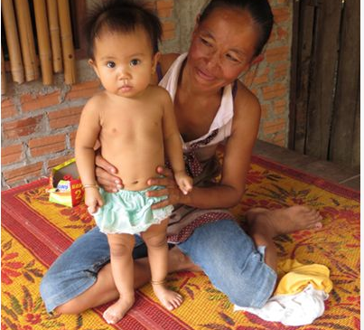
1.1. Malnutrition: A global phenomen
Under-nutritrion contributes to more that one-third of child death globally
Leading cause pf arrested develovement in children 6-24 months of age
Direct impact on GDP- loss up to 2% in highly affected countries

Slide 10


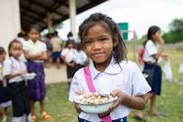
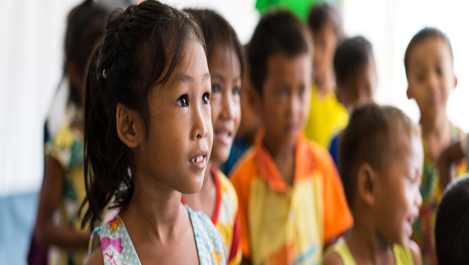
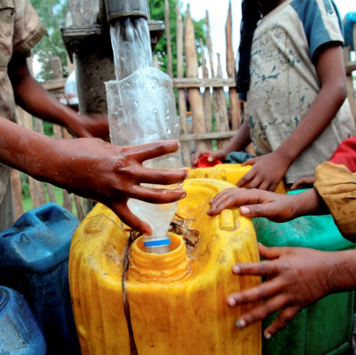
1.2. The causes of malnutrition are complex and interconnected
requires people to work together for
Sufficient availability of, or access to, affordable, safe and nutritious
FOOD
throughout the year
Adequate
CARE for mothers and children, and support for mothers on appropriate child feeding practices
Easy and sustained access to HEALTH sanitation and clean water services
All these are influenced by social, cultural and political determinants, including the level of women’s empowerment
Notes:
The causes of under nutrition are many and interconnected.
Globally, nutrition is now viewed in terms of three main themes, food, health and care practices and behaviours.
As shown in this slide
All are rooted in contextual determinants poverty, position of women , the socio political environment and culture.
In order to address problems in nutrition, all these factors have to be addressed

Slide 11
1.3. Lao PDR addressing malnutrition (2021-2025)
The high burden of malnutrition in Lao PDR is a clear threat to achieving the Sustainable Development Goals (SDGs) and the country’s 9th National Socio-Economic Development Plan (NSEDP)
To reduce malnutrition and to enable access for all to diversified nutritious food sources, it urges all public and private sectors at central as well as local level pay more attention and involve in implementation of nutrition interventions.
The NPAN focuses on maternal, infant, and young child nutrition. It also lays out the links between malnutrition, food security and food systems, agriculture, education, access to health services, PHC, adolescent health, responses to disasters and emergencies, including climate change-related events and epidemics such as COVID-19.
Social and behavior change communication (SBCC), gender equality and the need to address nutrition from birth up to 8000 days (up to 21 years of age) and throughout the life cycle are some of the central strategies. The NPAN, emphasizes the importance of a multisectoral approach to nutrition.
The NPAN features an updated and clarified conceptual framework and an updated and shortened strategic framework. There are 8 Indicators for the overall goal, 13 strategic objectives, 22 interventions and 36 indicators at outcome or output level.

Slide 12
1.4. Challenges of malnutrition
Around 45% of the deaths among children under five globally are linked to undernutrition.
Stunted growth causes underdeveloped brains and bodies if children do not get the right type or amount of nutrients from food within the crucial first 1,000 days.
Childhood malnutrition is preventable or treatable with high-impact, low-cost interventions, such as immunization, nutrition and child health services and nutrition sensitive interventions
The impact of these interventions on child nutrition varies greatly depending on socio-economic group, ethnicity, geographical location and the educational level of the parents
Because malnutrition leads to An overall lower intelligence quotient (IQ) and reduced school performance, malnutrition can have significant economic ramifications in the form of reduced work productivity and earning

Slide 13

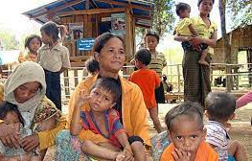
NUTRITION SITUATION IN LAO PDR
Stunting is the silent scourge of many children throughout Lao PDR, affecting around a third of children under five years of age, as per LSIS II data.
Chronic undernutrition (stunting) levels remain high, with 33% of children under five years stunted, 21% percent underweight, and 9% wasted
The Lao Nutrition programme works at national and local levels to ensure effective, high-impact policies exist to improve maternal and child nutrition, help make children and their families healthier, particularly the most vulnerable and disadvantaged
In 2015, the Ministry of Health launched the revised National Nutrition Strategy and Plan of Action in order to deliver an integrated package of maternal, newborn and child health interventions that includes internationally recommended actions to reduce all forms of malnutrition
Also, the overarching aim of the National Information Platforms for Nutrition in Lao PDR, launched in 2018, is to build the country’s capacity to manage and analyse nutrition data from multiple sectors to track progress and nutrition investments in the country.

Slide 14
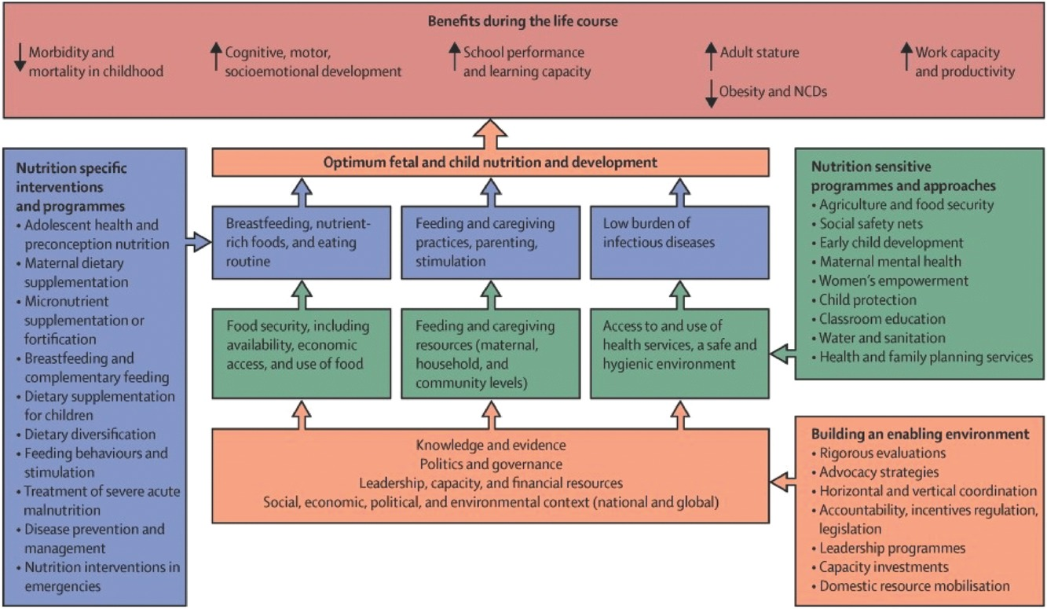
Agriculture, Food Systems, Nutrition and Health Context
To enhance the consumption and utilization of healthy and diversified diets for achieving nutrition improvements
Global Challenges, Volume: 1, Issue: 3, First published: 03 March 2017, DOI: (10.1002/gch2.201600002)
Notes:
Framework for actions to achieve optimum fetal and child nutrition and development :Nutrition-sensitive interventions and programmes address the underlying determinants of foetal and child nutrition and development – food security; adequate caregiving resources at the maternal, household and community levels; and access to health services and a safe and hygienic environment – and incorporate specific nutrition goals and actions. Nutrition-sensitive programmes can serve as delivery platforms for nutrition-specific interventions, potentially increasing their scale, coverage, and effectiveness. Nutrition-specific interventions and programmes address the immediate determinants of foetal and child nutrition and development – adequate food and nutrient intake, feeding, caregiving and parenting practices, and low burden of infectious diseases. Ten high-impact nutrition-specific interventions are identified in the framework.
I

Slide 15
What Works to Reduce Undernutrition? Nutrition-Sensitive Interventions
Nutrition-sensitive interventions, which address the deeper causes of malnutrition, are important for addressing the remaining 80 percent of chronic malnutrition (Black et al. 2013; Lim et al. 2012; Steckel 2013; IFPRI 2016).
Nutrition-sensitive interventions address the underlying causes of undernutrition—food, care, and health.
We are talking about interventions that increase household access to diverse, nutritious foods, year-round. o Interventions that enable access to health services and ensure a healthy environment through appropriate water, sanitation and hygiene (WASH) strategies and activities.
Interventions that enable caregivers, primarily women, to provide proper care to their families, including ensuring age-appropriate feeding practices

Slide 16
How does Agriculture Affect Nutrition
There are three essential linkages between agriculture and nutrition—food production, income, and gender (how women’s time and energy are spent).
The most obvious linkage between agriculture and nutrition is the production of nutritious foods. This is one way agriculture can contribute positively to nutrition—by making more diverse, nutritious foods available in local markets and in farmer households.
Households also depend on income, which they use to purchase food, health services and hygiene-related goods that are necessary to maintain good health and nutrition.
Not all household income derives from agriculture related-activities. One way to promote resiliency is to assist households with both on-farm and off-farm income-earning opportunities
Women are highly engaged in agricultural activities. How women use their time and energy can have significant implications for their health and nutrition as well as the health and nutrition of their children.
Women who have some control over how household income is spent tend to ensure that household income is spent on things that improve the health of the family (USAID 2017).

Slide 17

Narrowing the “nutrition gap”- the gap between what food are available and what foods are needed for a healthy diet
Poor diets low in quantity, quality and variety lead to hunger and malnutrition
Increased production of staple foods is not sufficient
Ensure local availability and access of the right mix of foods (dietary diversity) in all seasons
Consumers must be informed
Collaboration must be established with social protection programmes to reach the poorest

Slide 18
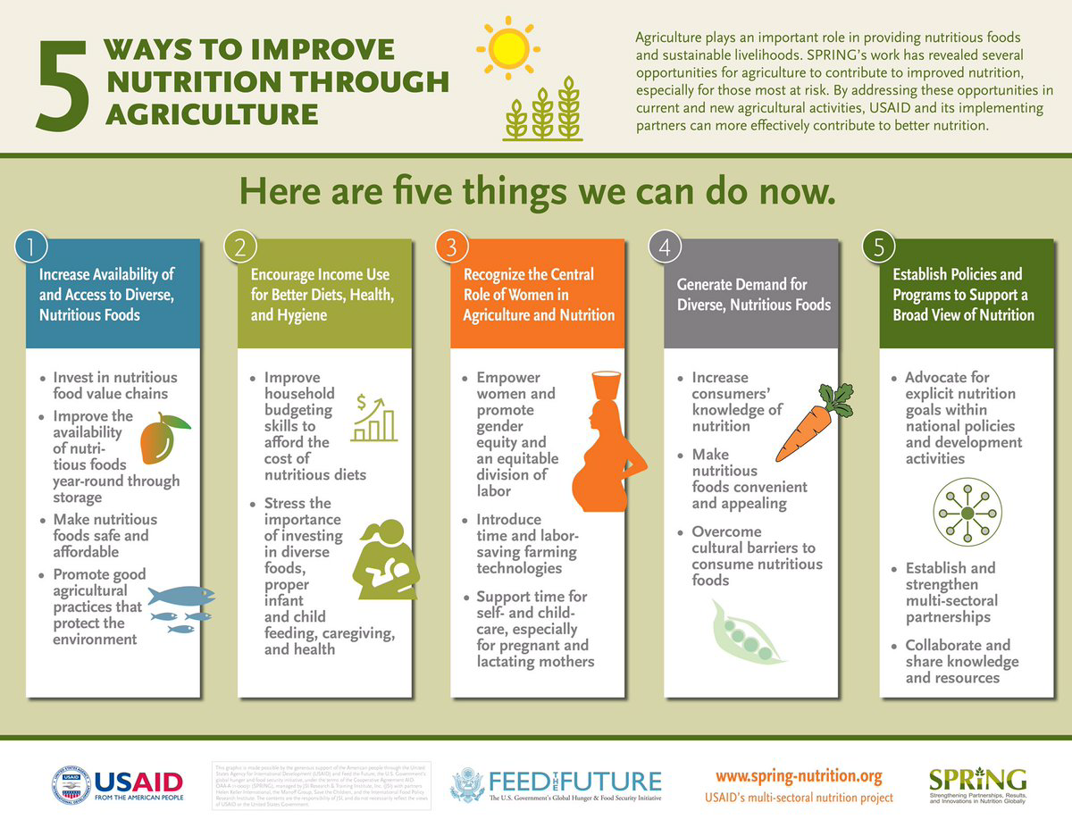

Slide 19
Making agriculture work for nutrition
Planning programmes with explicit nutrition goals/objectives
Food composition and food based dietary guidelines to inform policies ( supply push –demand pull)
Monitoring and evaluation mechanisms
Capacities for nutrition in agriculture (cross sectoral expertise)
Notes:
It is well recognized that food and agriculture systems have a primary role in feeding people well by increasing the availability, affordability and consumption of diverse, safe nutritious foods and diets throughout the year
FCT and FBDGs to orient and inform policy and planing
There is need for stronger evidence of impact, and a need for more and better designed research, policies and programmes and monitoring mechanims to make agriculture work towards enhancing diets and improving nutrition .”
In terms of capacities for nutrition in agriculture – nutrition professionals with cross sectoral expertise are few and awareness among stakeholders of the importance of agriculture and food systems to nutrition and possibilities for action is low.
There is also need for common and consistent nutrition messaging across agriculture extension services and programmes. Improvements in production practices and diversification of crops can lead to better nutrition when coupled with appropriate nutrition messaging.

Slide 20
Entry points for nutrition-sensitive agriculture and food systems
Assets and inputs | Seed supply Micronutrient fertilisers Irrigation Compost Greenhouses
Food production | Agriculture intensification Agricultural diversification (nutritious grains; pulses; fruit & veg; medicinal plants) Animal source foods (fish, poultry, meat, dairy…)
Post-harvest management | Off-season supply Storage & transport Women’s income and time allocation Processing (germination, roasting, dehydration, preservation)
Trade and marketing | Trade: linking small producers to markets; prices Marketing: commodity groups, agri-business knowledge centres, labelling, nutrition education
Preparation and consumption | Preparation: cooking demonstrations Consumption: consumption surveys; school meals; adapt to individuals
FOOD SAFETY
GENDER
Notes:
Seed and input supplies can enable farmers to directly bridge the practical concerns of production (how to plant, how to save seeds, how to fertilize) with the behavioral and knowledge components of consumption (what nutritious foods to grow, who should eat it, how to prepare it).
Balanced use of pesticides, nutrient fertilizers, irrigation and natural composting and green houses can support a nutrient rich food supply while safeguarding the ecology and food environment.
Need to meet diversity in production and consumption
Utilization of appropriate technologies can provide food for off season supply with storage and transport can be linked to markets for enhancing income and nutrition ; need to value women’s time and enhance income
Preserving and improving use of natural resources are essential to ensure positive and sustainable impacts on FS and N.

Slide 21
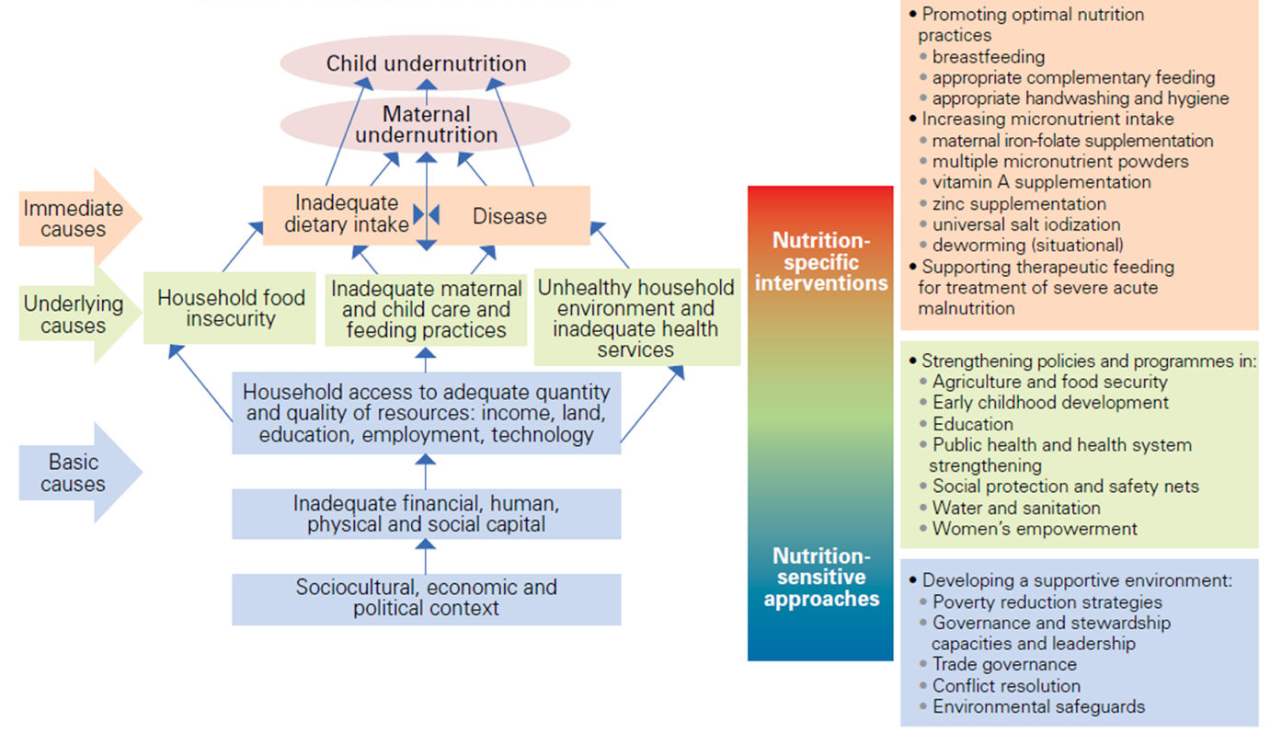
Nutrition Sensitive and Specific interventions
UNICEF conceptual framework and nutrition-specific and nutrition-sensitive interventions (Source: Levinson et al., 2013)

Slide 22
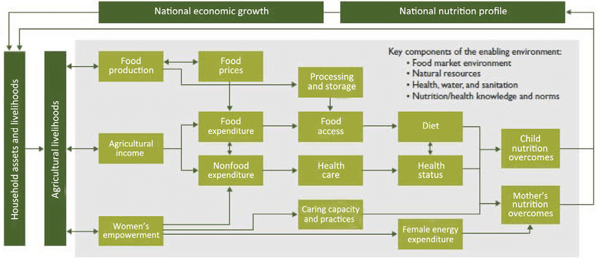
Nutrition Sensitive Agriculture Pathway
Figure 2: The conceptual pathways between agriculture and nutrition (Herforth and Harris 2014b)

Slide 23
Updated Vision, Mission, and overall goal of the National Nutrition Strategy and Plan of Action : 2021-2025
VISION : A prosperous country, with a healthy, food-secure population, with reduced malnutrition and poverty.
MISSION : Create an enabling environment to reduce all forms of malnutrition in Lao PDR, focus on nutrition priorities, and ensure effective multisectoral coordination, implementation, and monitoring and evaluation at all levels.
OVERALL GOAL
To reduce malnutrition among women and children and improve the nutritional status of all Lao people so that they are healthy and have a high quality of life, and thus contribute to the achievement of national socio-economic development targets by 2025.
INDICATORS for the overall goal are targeted towards: (1) stunting in children under 5 years of age, (2) wasting in children under 5 years of age, (3) underweight in children under 5 years of age, (4) anemia in children aged 6-59 months, (5) anemia in women of reproductive age (15-49 years), (6) infants born with low birth weight, (7) overweight in children under 5 years of age; (8) infants under 6 months of age who are exclusively breastfed.
NUTRITION contributes to broader national health indicators.

Slide 24
NPAN : STRATEGIC FRAMEWORK
Strategic Framework : The Strategic Framework comprises 3 Components, 13 Strategic Objectives, 22 Interventions, and 36 Indicators at outcome- and output-level.
The Components are to (1) address direct (immediate) causes of malnutrition, (2) address indirect (underlying) causes of malnutrition, and (3) address basic causes of malnutrition, create an enabling environment, and promote multisectoral action.
The Strategic Objectives are: (1) improve nutrient intake, (2) improve water and sanitation, promote hygiene, prevent and control diseases, (3) increase availability of and access to nutritious food, (4) improve child and adolescent knowledge and behavior about nutritious diets, (5) improve mother and child health and care, (6) strengthen institutional capacity, governance, management, and coordination,(7) strengthen human resources, (8) improve health service delivery system for communities, (9) improve information management and use of evidence for decision-making, (10) improve financial management and increase investment, (11) ensure effective preparedness and response to disasters and emergencies, and social protection, (12) scale up social and behavior change communication (SBCC) for nutrition, and (13) promote gender equity.

Slide 25
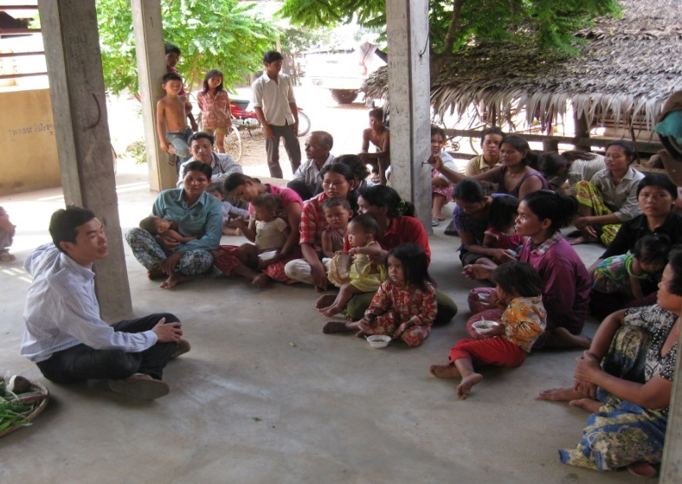
Identification of What Could be Feasible -
Seasonal Food Availability Calendars
Dialogue with community:
Types of foods produced or collected from nature
Seasons when the foods are available
Implication of the food availability-access - ability to prepare balanced CF and family meals
Notes:
To date the TIPs work that FAO has been involved in has generated sets of messages and recipes using locally available, culturally appropriate foods. Observational evidence suggests that families are interested in learning more about improving complementary feeding practices using locally available foods. Similarly available evidence has suggested that a major constraint facing families is seasonal food availability and affordable sources of micronutrient-rich foods. It is therefore important to combine dietary counselling on improving infant feeding with targeted and responsive food security actions aimed at increasing locally available, nutrient dense foods.

Slide 26
Key recommendations for improving nutrition through food systems
Incorporate explicit nutrition objectives and indicators into their design, and track and mitigate potential harms.
Collaborate with other sectors and programmes.
Empower women.
Facilitate production diversification and increase production of nutrient-dense crops and small-scale livestock.
Improve processing, storage and preservation to retain nutritional value and food safety, to reduce seasonality and post-harvest losses, and to make healthy foods convenient to prepare.
Expand market access for vulnerable groups, particularly for marketing nutritious foods.
Incorporate nutrition promotion and education

Slide 27
Post-learning activities

Slide 28

Summary and conclusion
Mainstream nutrition in food security policies and programs (agricultural, health, social protection policies and education programs)
Accelerate diversification in food production combined with nutrition education
Disseminate nutrition messages through agriculture extension and farmers field schools, women farmer groups
Ensure food safety, hygiene and quality through comprehensive strategies
Address issues of climate change, environment, biodiversity and sustainable diets
Establish methods to quantify food losses and food waste
Increase financing and investment for nutrition-sensitive agriculture and food security programmes
Enhance capacity of agriculture staff in development, implementation, monitoring and evaluation of nutrition-sensitive food security programmes
Support to food and nutrition security policy implementation and country investment plan monitoring

Slide 29
Post quiz (test)
This quiz is used to test the knowledge of students related to this lessons that they just finished learning. You can add 5-10 questions. Types of questions could be: MCQ, True or False, Matching, Fill in short words.
Questions | Possible answer | Correct Answer | Feedback
Q1: Which of the following agricultural practices is considered a nutrition-sensitive approach? | ) Monocropping of a single grain like wheat or corn. Using biofortified crops like iron-rich beans or vitamin A-rich sweet potatoes. Large-scale livestock farming for meat exports. Subsidizing sugar and oil production | B | Using biofortified crops like iron-rich beans or vitamin A-rich sweet potatoes.
Q2: Why is the involvement of women in agriculture crucial for nutrition outcomes? | ) Women are typically responsible for all crop sales. Women are the main consumers of agricultural products. Women often control the household budget for food and manage child feeding. Women have more experience with modern farming techniques. | C | Women often control the household budget for food and manage child feeding.
Q3: Child malnutrition include wasting, underweight, stunting and overweight. | True False | True | In rural areas. Malnutrition of children showed in stunting, wasting and underweight while in urban and semi-urban areas, child overweight was increased
Q4: Which of the following is NOT a direct outcome of a successful nutrition-sensitive agriculture project? | ) Reduced rates of stunting in children. b) Increased household income from crop sales. c) The eradication of all infectious diseases. d) Improved food safety and hygiene at the household level. | C | The eradication of all infectious diseases

Slide 30
Assignment/Homework/Case study
Assignment
Project team: create 4 teams (5-6 students/team) per group A, B, C, D Students needs to provide the ideas generation and selection of an school garden to produce foods in the context of their home town.

Slide 31
Reference
Mahaman Dioula, B., Deret, H., Morel, J., du Vachat, E., & Kiaya, V. (2013). Enhancing the role of smallholder farmers in achieving sustainable food and nutrition security. www.fao.org/publications
Mary, S., Saravia-Matus, S., & Gomez y Paloma, S. (2018). Does nutrition-sensitive aid reduce the prevalence of undernourishment? Food Policy, 74, 100–116. https://doi.org/10.1016/j.foodpol.2017.11.008
Nguyen, D. D., Di Prima, S., Huijzendveld, R., Wright, E. P., Essink, D., & Broerse, J. E. W. (2022). Qualitative evidence for improved caring, feeding and food production practices after nutrition-sensitive agriculture interventions in rural Vietnam. Agriculture & Food Security, 11(1), 29. https://doi.org/10.1186/s40066-021-00350-5
Nolan, G., Mcfarland, A., Zajicek, J., & Waliczek, T. (2012). The Effects of Nutrition Education and Gardening on Attitudes, Preferences, and Knowledge of Minority Second to Fifth Graders in the Rio Grande Valley Toward Fruit and Vegetables. HortTechnology, 22, 299–304. https://doi.org/10.21273/HORTTECH.22.3.299
NWO. (2019). Scaling-up nutrition-sensitive agricultural initiatives in poor mountainous areas in Vietnam and Lao PDR.

Slide 32
Next lesson
This is the end of the lesson.
Ending message and introduction to next lesson including lesson title and topics should be given.
Next Lesson Title | Next lesson Lesson 2: Nutritious foods and Importance of healthy diets: Definition of foods Importance of micro and macro-nutrients Needs of food and nutrition in daily life

