Slide 1
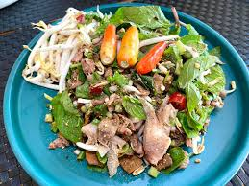

Chapter 2: Key Components of Agriculture for Nutrition and Nutrition
ກະສິກຳເພື່ອໂພຊະນາການ
Nutrition-Sensitive Agriculture
ອຈ. ທັນສະໄຫມ ເດດພະຄຸນ, (Thansamay Dethphkhoune)
ພາກວິຊາ ເສດຖະກິດຊົນນະບົດ ແລະ ເຕັກໂນໂລຊີ ອາຫານ, ຄະນະກະເສດສາດ, ມະຫາວິທະຍາໄລແຫ່ງຊາດ
Rural Economics and Food Technology, Faculty of Agriculture, NUoL
Dthansamay@gmail.com, Tel: +856 2096539515
© ISTOCK
Notes:
© ISTOCK

Slide 2
ກິດຈະກໍາກ່ອນການຮຽນ
Pre-learning activities

Slide 3
ຜົນໄດ້ຮັບຈາກບົດຮຽນ
Lesson learning outcomes
Learned and understood the food people consume each day
Learned about the meaning of nutrients and one's nutrient needs
Life-Stage Nutritional Needs That Support a Person's Growth

Slide 4
ຫົວຂໍ້ຫລັກ
Main Topics
1. Food Definitions
2. Nutrient content
3.Lifelong nutritional needs

Slide 5
ຄຳສັບທີ່ສຳຄັນ Keywords
ຄຳສັບທີ່ສຳຄັນ Keywords | ຄຳນິຍາມ Definition
ໂພຊະນາການ Nutrition | ການສຶກສາຂອງສານອາຫານໃນອາຫານ, ວິທີທີ່ຮ່າງກາຍໃຊ້ພວກມັນ, ແລະຄວາມສໍາພັນລະຫວ່າງອາຫານ, ສຸຂະພາບ, ແລະພະຍາດ the study of nutrients in food, how the body uses them, and the relationship between diet, health, and disease
ການຂາດໂພຊະນາການ Malnutrition | ໝາຍເຖິງ ພາວະທີ່ຮ່າງກາຍມີຄວາມບໍ່ສົມດຸນທາງໂພຊະນາການ, ຊຶ່ງສາມາດເກີດຂຶ້ນໄດ້ເມື່ອຮ່າງກາຍໄດ້ຮັບສານອາຫານທີ່ຈຳເປັນ ນ້ອຍເກີນໄປ ຫຼື ຫຼາຍເກີນໄປ.ມັນເປັນບັນຫາສຸຂະພາບລະດັບໂລກທີ່ສຳຄັນ, ໂດຍສະເພາະມີຜົນກະທົບຕໍ່ເດັກນ້ອຍ Malnutrition refers to a state of nutritional imbalance, which can occur when the body doesn't get enough or gets too much of essential nutrients.It's a significant global health issue, particularly affecting children
ອາຫານ food | ອີງ​ຕາມ​ອົງ​ການ​ສະ​ບຽງ​ອາ​ຫານ​ແລະ​ກະ​ສິ​ກໍາ (FAO) ແລະ Codex Alimentarius, ສະ​ບຽງ​ອາ​ຫານ​ແມ່ນ​ສານ​ໃດ​ຫນຶ່ງ, ບໍ່​ວ່າ​ຈະ​ເປັນ​ການ​ປຸງ​ແຕ່ງ, ເຄິ່ງ​ປຸງ​ແຕ່ງ, ຫຼື​ດິບ, ມີ​ຈຸດ​ປະ​ສົງ​ສໍາ​ລັບ​ການ​ບໍ​ລິ​ໂພກ​ຂອງ​ມະ​ນຸດ. According to the Food and Agriculture Organization (FAO) and the Codex Alimentarius, food is any substance, whether processed, semi-processed, or raw, intended for human consumption,
ສານອາຫານ Nutrients | ທາດອາຫານແມ່ນສານປະກອບເຄມີທີ່ສໍາຄັນທີ່ພົບເຫັນຢູ່ໃນອາຫານທີ່ສະຫນັບສະຫນູນການເຮັດວຽກຂອງຮ່າງກາຍ, ການເຕີບໂຕ, ແລະສຸຂະພາບໂດຍລວມ. Nutrients are essential chemical compounds found in food that support the body's functioning, growth, and overall health.

Slide 6
Pre-quiz worksheet
This worksheet is used to review past lessons or to ask students some questions related to the implementation of this lesson. You can add 3-5 questions. The types of questions may be: MCQ, Right or Wrong, Pairing, Adding Short Words.
Questions | Possible answer | Correct Answer | Feedback
Q1: What is the meaning of "nutrients"? | a) Substances that are not physically disposable b) substances that the body needs to grow and live c) Substances that impart food flavours d) Narcotic substances | b | . Why: Nutrients are substances that the body needs to live, to grow, to generate energy and to keep systems functioning normally.
Q2: What are macronutrients? | a) Proteins, carbohydrates, fats b) vitamins, minerals, water c) Protein, mineral salts, vitamins d) Sugar, oil, salt | a | Why: Macronutrients are substances that the body needs in large quantities to provide energy and build up the body's composition.
Q3: What is the main function of a "protein"? | a) Provides primary energy b) Assist in the creation of the content and help repair the sensitive parts. c) Give food flavor d) Helps to sweeten the blood | b | Why: Protein is a building block for muscles, skin, blood vessels and aids in the repair of damaged tissue.

Slide 7
ເນື້ອໃນບົດຮຽນ
Lesson body

Slide 8
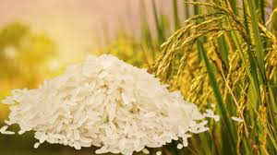
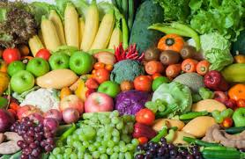
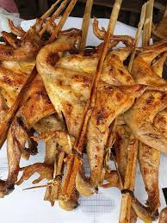

1.food
A food is defined as a substance that is ingested in a variety of forms, freshened, cooked, dipped, and processed. It does not include the category of "drugs".
Dietary supplements help to perform various bodily functions and promote good health
The foods we eat every day, such as rice, vegetables, fruits and vegetables, are made up of chemicals called nutrients.

Slide 9
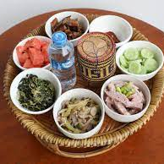
1.1 Balance of Diet
The balance of the diet is made up of a variety of foods and from many food groups, as well as minerals and vitamins that are essential for the body.
It also means drinking enough water to meet your body's needs.
A balanced diet can be planned by choosing healthy foods from different food categories
The challenge is to provide healthy food from a sustainable food system

Slide 10
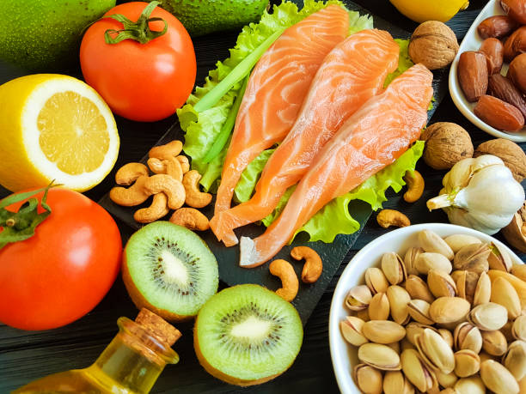
2 Nutrients
Nutrient: A component of natural chemicals or substances used by the human body to maintain metabolism and its proper functioning
Nutrients: is the process of nourishment; It's the process by which the body absorbs food and uses it for growth. The study of food (nutrients) and the knowledge of how our bodies use it, it is the knowledge of "nutrition" and food

Slide 11
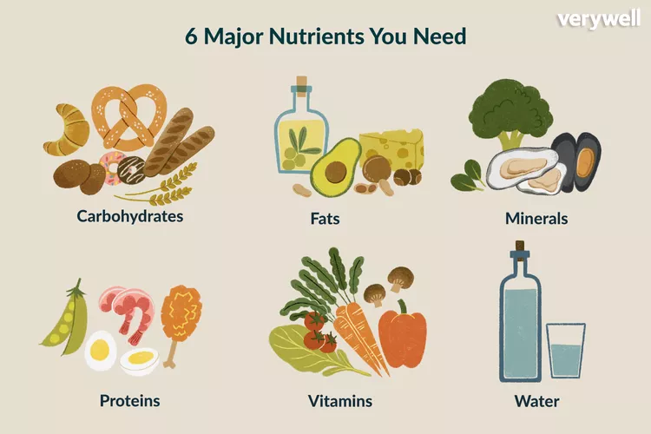
2.1 The Importance of Nutrients to the Body
We break it down as follows:
- Carbohydrates: (starch, sugar, and dietary fibers);
- Protein: (Plant-based and meat-based)
- Fats: (solid fats, oils)
- Vitamins: Vitamins A, D, E and K; B-Complex, including folate and Vitamin C
- Minerals: iron, zinc, calcium, iodine, sodium, potassium, phosphorus
Getting adequate nutrients means eating a variety of foods

Slide 12
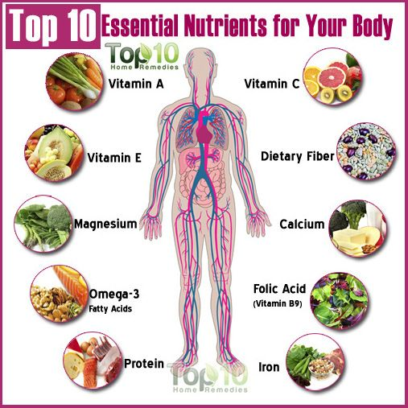
2.1 The Importance of Nutrients to the Body
Calcium: Root pain, muscle pain (in severe cases), broken bones, muscle
Magnesium: irregular heartbeat (arrhythmia), convulsions, dizziness, fatigue
Selenium: Abnormal Heart Function, Enlarged Heart
Folic acid: anemia, sweating.
Vitamin C: Slows wound healing.
Beta-carotene (Vitamin A): Eye damage (e.g., aids night vision), dry skin
Vitamin E: Antioxidant, helps protect the body's cells from damage and reduces the risk of chronic disease.
Omega-3s help with nutrition and heart
Proteins help regulate metabolic system functions
Iron strengthens the body's immune system

Slide 13
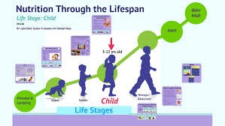
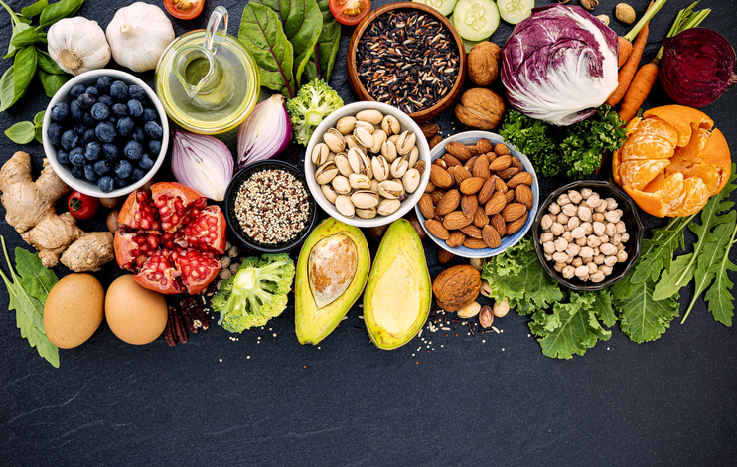
3 The Need for Food, Nutrition for a Lifetime
General Nutritional Needs: Many health problems are nutrition-related. It's important to know and follow the FOOD PYRAMID's tips and dietary tips
Good nutrition: 1). Fight disease; 2). Helps reduce recovery time; 3). Energy Supply!
Exercise is important throughout the life cycle
The right amount of FIBER directly helps in the prevention of various health problems

Slide 14
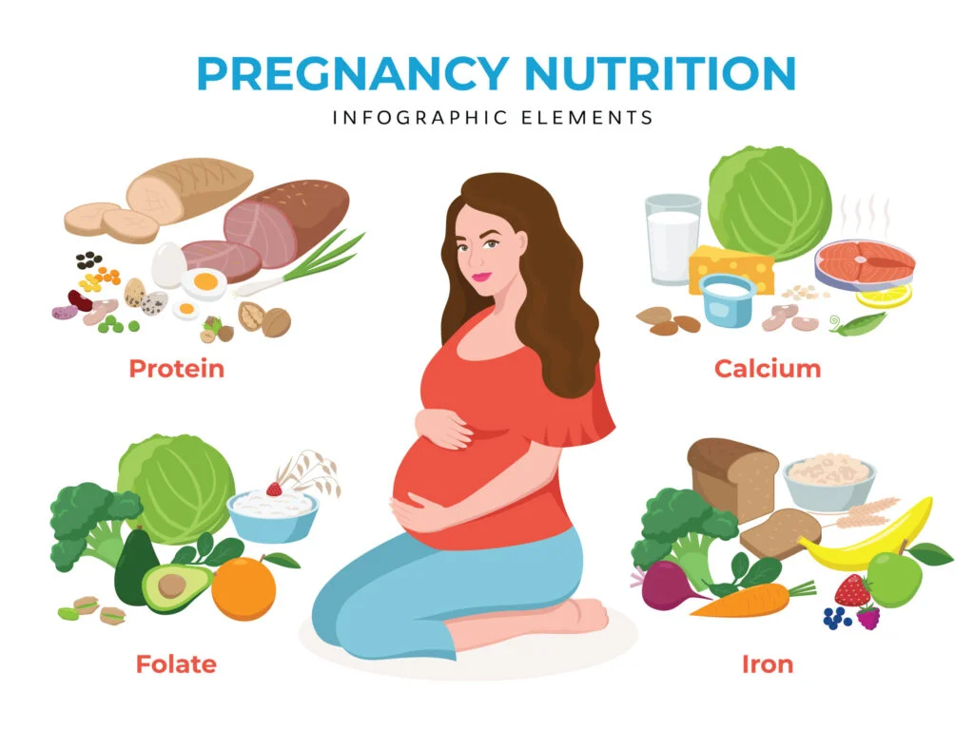
3.1 Nutritional needs during pregnancy
Proper pregnancy and developmental nutrition depends on the right nutrients. Diet can affect both the mother and the unborn child. If a mother does not eat enough nutrients, the nutrients will be sucked out of her body.
FOLATE helps protect against damage to the nervous system (brain and kidneys) and should be given to the mother before pregnancy.
Mothers will need more PROTEIN to aid in the growth of their fetuses, and most people are already eating enough food to meet their increased needs

Slide 15
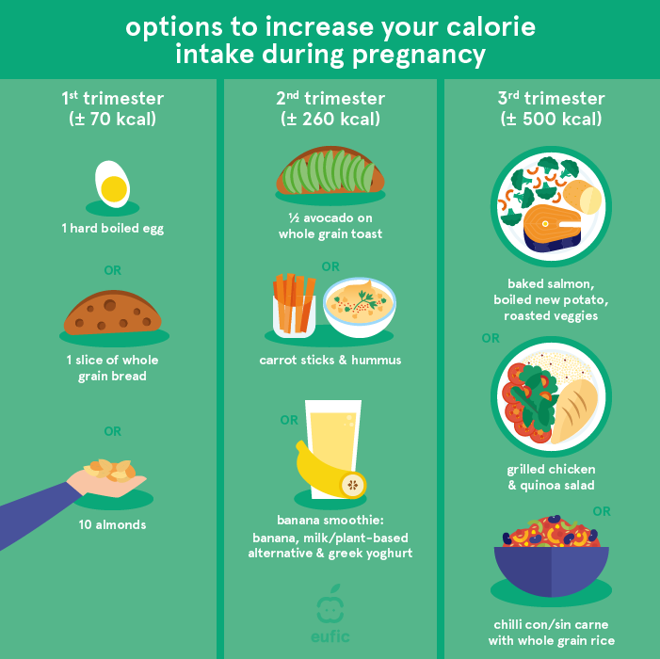
3.1.1 Awareness of Your Energy Needs (Pregnancy)
Generally, the first 3 months required an increase in calories by about 70 calories
The 3-6 month period requires an increase in the amount of 260 calories
The 6-7 month period requires an increase in the amount of calories by about 500 calories

Slide 16
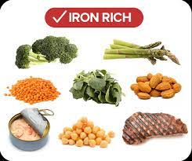
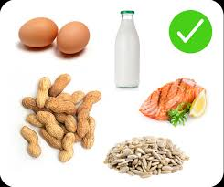
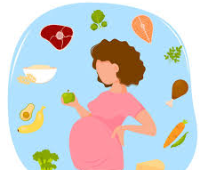
3.1.2 Supplements for pregnant mothers
CALCIUM is essential for bones
Iron accumulation is necessary for birth, since breast milk is rich in iron
Mothers should eat extra milk and green leafy vegetables each day.
Mothers should be given the vitamin each day before birth, but a physical therapist should also be consulted
Mothers should gain more than 25-35 lbs depending on their pre-pregnancy height and weight

Slide 17

3.2 Breastfeeding
Mothers should make sure that they are getting enough nutrients to replace the nutrients that are already in their milk, and that they are eating enough food to generate energy in their milk
Mothers will be more thirsty when they are breastfeeding. More junk food needs to be eaten to compensate for the loss of water. Try to eat 3 or more foods from dairy products.
She will need to drink 8 cups of water a day to produce milk and meet her needs.
Medication or ALCOHOL should not be used as it reaches the baby through breast milk

Slide 18

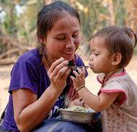

3.3 Baby food
Babies use stored iron, because breast milk contains less iron.
Babies will need water-soluble fats and vitamins, including riboflavin, niacinB-5 and vitamin C
At the end of the first year, the weight of the baby is 3. Therefore, it is important that children get the nutrients they need
Newborns will need to be fed 7-8 times a day. 2 months later, 5 times is enough,
Breast milk is recognized as the best food for brain development

Slide 19
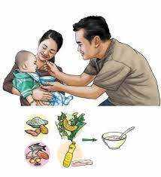
3.3 Baby food
Babies have a small stomach and need to be fed a small amount of soft food each day. In addition to cereals and legumes, provide a variety of foods - especially animal-derived foods (dairy products, eggs, meat, fish, and poultry), fruits and vegetables daily.
Babies should not drink cow's milk, until they are 10 years old and when the mother is milk-free after 6 months, all milk can be drunk
Children can eat solid food between 6 months of age
Later, the rice should be eaten with vegetables and followed by stalks
Sweet fruits, they may prefer vegetables less than fruit if we give them fruit first.

Slide 20
3.3 Baby food
Finally, they can eat meat, or poultry.
They should eat one food at a time to avoid allergic reactions
Between 6-8 months, they can drink a glass of water
Parents can add food to their child when they are 1 year old, if they have teeth that are erupting.
They have small stomachs, they can't hold much food at once. They need snacks to help them get enough energy and nutrients
Nutrient-dense snacks include: juices, milk, fruits, yellow and green vegetables, cooked meats, unsweetened foods,

Slide 21
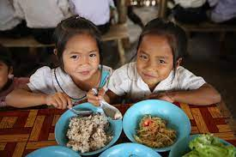
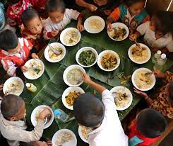

3.4 Food for school-age children
The size/proportion of juveniles is less than that of adults. Generally, 1 tablespoon of a child's diet should be given a variety of foods according to their age.
Children need foods that contain a variety of nutrients in very small quantities
Breakfast, lunch and dinner must be guaranteed
Empty meals can be added if they can't eat enough food
Take your child to a new meal each time, not every once in a while
Food should not be used as punishment or reward

Slide 22
3.4.1 Parents should encourage their children to eat a good breakfast
Parents should encourage their children to eat a good breakfast. Includes milk, low-fat yogurt, high-fibre (biscuits), peanut butter protein, cheese, ripe fruits; Fertilize 2-3 bushes of local soil daily.
Beware of soft drinks, CAFFEINE and sugar can cause food loss in children and lead to not eating highly nutritious foods
Children who drink a lot of fruit juice are at increased risk of weight gain and loss of appetite, which deprives them of protein, calcium and important nutrients
Children under 2 years old should drink whole milk, and children under 2 years old should drink 1% milk
The recommended intake of beer is 8g per day for 3 years to 23g per day for 18 years. To get that amount, you need to eat lots of fruits and vegetables and high-fiber/oatmeal-rich cheeses.
A healthy diet for children should focus on providing energy and nutrients to aid in growth and development.

Slide 23
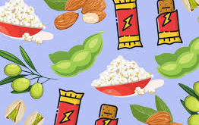
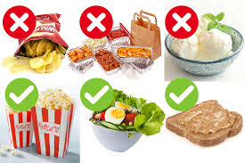
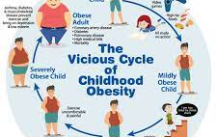

3.4.2 Obesity is becoming the norm for children
Parents should help keep their children active
Provide a low-energy, protein-rich and healthy diet
Average Animal Feed
Avoid insisting that children wash their plates and stop eating when they are full

Slide 24
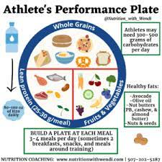
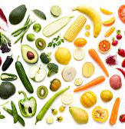
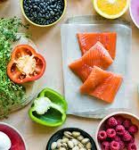

3.5 Food for Young Athletes
Carbohydrates, fats, proteins are all stored to aid in energy production
Muscle is built by exercise, not by protein supplementation
As a result of its high energy content, it requires eating foods that are nutrient-dense
Meals should be eaten 1 hour before your workout.
Juice Matters! Nutrients should be replaced immediately after exercise
2 cups of water for lost energy
Potassium substitutes are recommended: Dried fruits, low-fat milk, beans, green leafy vegetables, fruits, and vegetables are mostly of similar nutritional quality

Slide 25


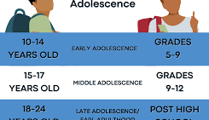

3.5.1 Youth is a good time and rapid growth
Teens need a variety of nutrient-dense foods each day, according to the Food PYRAMID.
Girls will need a maximum of 2,200 calories and boys will need 2,800 calories per day
Adolescents should eat foods that contain calcium (bones). Iron (helps increase muscle mass and muscle). Acupuncture, Vitamin A (fertility). Vitamins E and C (immune system and tumors)
A high-nutrient diet is important

Slide 26
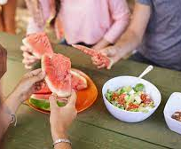

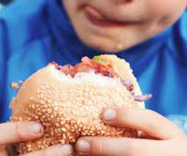

3.5.2 Adolescent eating habits tend to persist into adulthood
Adolescents with obesity are more likely to be obese
Keep in mind that fast food usually contains more fat and salt than home-cooked meals
Similar Difficulties of Eating Youth Diets
Lots of fat and fat, salt and caffeine.
Very sweet
Few fruits and vegetables
There's a lot of lighting.
Not enough iron
I don't like to eat breakfast or lunch.
Eating the Wrong Breakfast

Slide 27

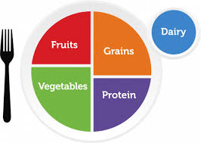
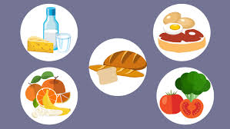
3.6 Adult diet
As we age, absorption slows down
Overall food consumption is down
Because the work schedule is full. Meals are replaced by raw plates and snacks
It needs to be eaten fruits, vegetables and whole grains/oatmeal, lean cheese and low in fat. Sizes that avoid sweet, high-fat foods
Suddenly, the life cycle creates a need for regular exercise.
Exercise is the heart of the balance between food intake and performance

Slide 28
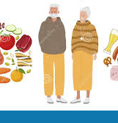
3.7 Diet for the Elderly
Older people have less taste sensitivity
including sensitivity to smell
Adults over the age of 50 need to increase their intake of vitamins D, calcium, folate,B6 and B12
Because they are less active, they must: 1). reduce fat, salt, calories, and 2). Increasing a high-nutrient diet, and regular exercise is still important
Older adults living alone find it difficult to consume nutrient-dense foods, anxiety about malnutrition
Health problems in the elderly are often the result of eating habits and low food choices

Slide 29
Summary and conclusion (ສັງລວມ ແລະ ສະຫຼຸບ)
Learning to understand food is essential to living a healthy diet
Food is the main source of nutrients the body needs to provide energy for life, growth and development, building and repairing tissues, maintaining organ function, boosting immunity and preventing disease, with nutrients such as carbohydrates, protein, fat, vitamins, minerals and water being the key ingredients in maintaining life and good health
© ISTOCK
© Cambodia News English

Slide 30
Post quiz (test)
This quiz is used to test the knowledge of students related to this lessons that they just finished learning. You can add 5-10 questions. Types of questions could be: MCQ, True or False, Matching, Fill in short words.
Questions | Possible answer | Correct Answer | Feedback
Q1: What types of foods are considered "junk food"? | A. Fresh Fruit B. Boiled vegetables C. Sweets and high-sugar beverages D. Undercover | C | This type of food is very unhealthy
Q2What diseases does a regular intake of vegetables and fruits help to prevent? | A. Bone Disease B. Cancer and Heart Disease C. Anemia D. Diabetes | B | Vegetables and fruits contain dietary fiber, vitamins and antioxidants that help reduce the risk of developing these diseases.
Q3: What foods should be avoided or small for good health? | A. Fish B. Saturated Fats and Trans Fat C. Green leafy vegetables d. Whole grains | B | Saturated fats and trans fats are found in fried foods, fatty meats, butter, cakes, burgers and desserts. Excessive intake can lead to heart disease, high blood pressure and obesity.
Q4: What foods are high in carbohydrates? | a) Lettuce, bread, French potatoes b) Fish, eggs, meat c) Oil, Butter d) Green leafy vegetables | A | Carbohydrates provide the body's main energy, found in beans, flour, nuts, and nuts.

Slide 31
Post quiz (test)
This quiz is used to test the knowledge of students related to this lessons that they just finished learning. You can add 5-10 questions. Types of questions could be: MCQ, True or False, Matching, Fill in short words.
Questions | Possible answer | Correct Answer | Feedback
Q5What minerals help strengthen bones? | a) Iron b) Preparation elements c) Society d) Sodium | D | Preparations are the main building blocks of bones and teeth, helping to prevent osteoporosis.
Q6What vitamins help your body fight off disease? | a) Vitamin A b) Vitamin B1 c) Vitamin C d) Vitamin D | C | Vitamin C boosts immunity, helps prevent infections and aids in tissue repair.

Slide 32
Assignment/Homework/Case study
Assignment
Write a brief comment (5–7 sentences) about: Their own eating habits What can be improved for better health?

Slide 33
Next lesson
This is the end of the lesson.
The conclusion and introduction to the next lesson, as well as the lesson title and heading, should be given.
Next Lesson Title | Next lesson Lesson 3: 1. Food Safety 2. The importance of washing your hands with soap and clean water 3. Boiling/clean water, keeping kitchens and appliances clean. 4. Disposal of sanitary waste.

