Slide 1
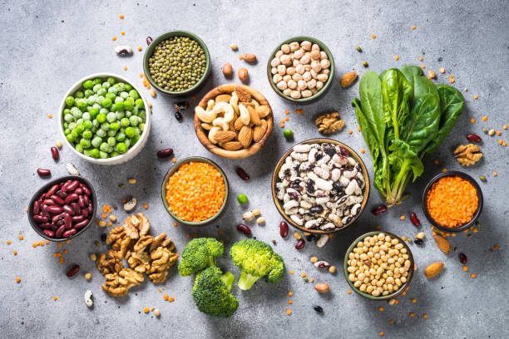
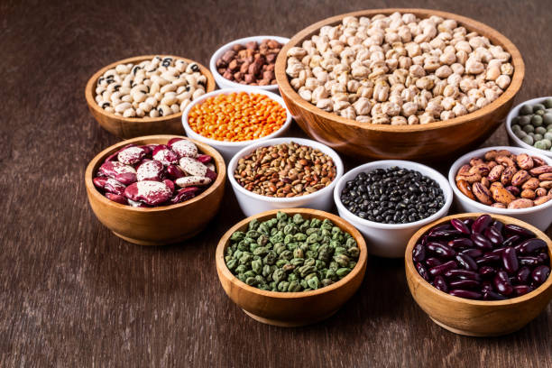
DIETARY DIVERSITY
Section on what is a healthy diet, food systems, diets and environment food-to-food enrichment
Sayvisene Boulom, Department Head of Agricultural Economics and Food Technology, Faculty of Agriculture, National University of Laos
sayvisene.b@nuol.edu.la, Tel: +856 202220118

Slide 2
Pre-learning activities

Slide 3
Lesson learning outcomes
After completing this lesson, the students will be able to:
Define and understand the concept of dietary diversity.
Explain the health benefits associated with consuming a diverse diet.
Identify key food groups and their nutritional contributions.
Recognize the impact of dietary diversity on environmental sustainability.

Slide 4
Lesson overviews (this is the outline of this lesson)
In this lesson, learners will learn about:
What is Dietary Diversity?
Strategies for Promoting Dietary Diversity
Case Studies and Practical Applications
Developing a Community Action Plan

Slide 5
Keywords
Keywords | Definition
Dietary Diversity | his refers to the number of different food groups consumed over a given period (e.g., 24 hours or 7 days). It is a key proxy indicator for micronutrient adequacy in a diet. A more diverse diet is generally associated with a higher likelihood of meeting nutrient requirements.
Food Groups | These are categories of foods with similar nutritional properties. Common groups include staples (cereals and tubers), pulses, vegetables, fruits, meat/fish, eggs, and dairy.
Dietary Diversity Score (DDS) | A simple count of the number of food groups consumed.
Minimum Dietary Diversity for Women (MDDS-W) | A measure of whether a woman has consumed at least 5 out of 10 food groups.
Minimum Dietary Diversity for Children Under 5 (MDD-CU5) | A measure of whether a child aged 6-59 months has consumed at least 4 or 5 out of 8 food groups.

Slide 6
Pre-quiz
This quiz is used to review previous lesson or ask students some questions related to the introduction of this lesson. You can add 3-5 questions. Types of questions could be: MCQ, True or False, Matching, Fill in short words.
Questions | Possible answer | Correct Answer | Feedback
Q1: What is the primary purpose of a Dietary Diversity Score (DDS)? | a) To measure the total caloric intake of an individual. b) To assess the amount of protein consumed. c) To serve as a proxy for the micronutrient adequacy of a diet. d) To determine an individual's Body Mass Index (BMI). | c | DDS is a widely used indicator because a greater variety of foods from different groups is strongly correlated with a higher intake of essential vitamins and minerals, which are often lacking in non-diverse diets.
Q2: The Minimum Dietary Diversity for Children Under 5 (MDD-CU5) measures the consumption of foods from how many food groups? | a) 5 b) 6 c) 7 d) 8 | c | he MDD-CU5 standard is based on a specific set of 7 food groups to ensure a child's diet includes a variety of nutrient sources critical for growth and development. The minimum threshold for meeting the indicator is consuming foods from at least 4 or 5 of these groups.
Q3: Which of the following is an example of a food group counted in most Dietary Diversity Scores? | a) Water and beverages b) Spices and condiments c) Pulses, nuts, and seeds d) Salt and sugar | c | Reason: Pulses, nuts, and seeds are considered a distinct and important food group because they provide protein and other essential nutrients. The other options are typically excluded as they contribute little to the overall nutrient profile of a meal.

Slide 7
Lesson body

Slide 8
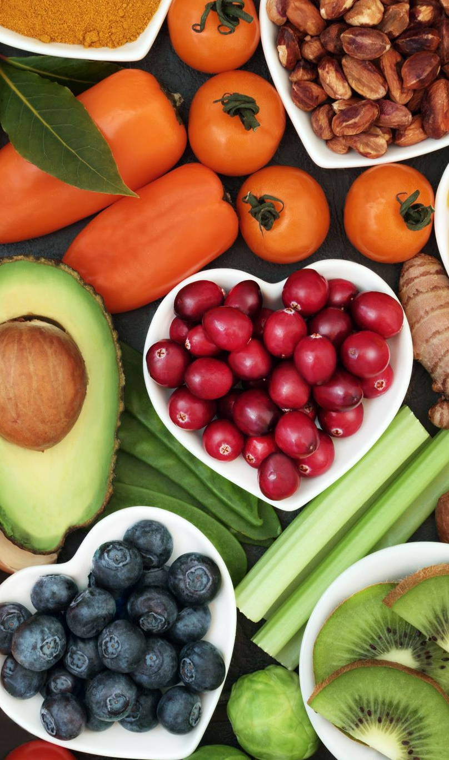
1. The main modules
Core nutrition messages/advisory statements on the principles and criteria of good dietary practices for nutritional well being
Healthy Diets (includes what is a healthy diets, safety, variety, quality, safety, what are micro-nutrients, calories etc)
Food-to-food enrichment, food combinations
Indicators (incl. a discussion on opportunities to link and report against NPAN indicators)
  Minimum dietary diversity for women (MDD-W)
  Minimum dietary diversity for children and minimum acceptable diet for Children (MDD-C, MAD-C)
Healthy food models (e.g. food flag)

Slide 9
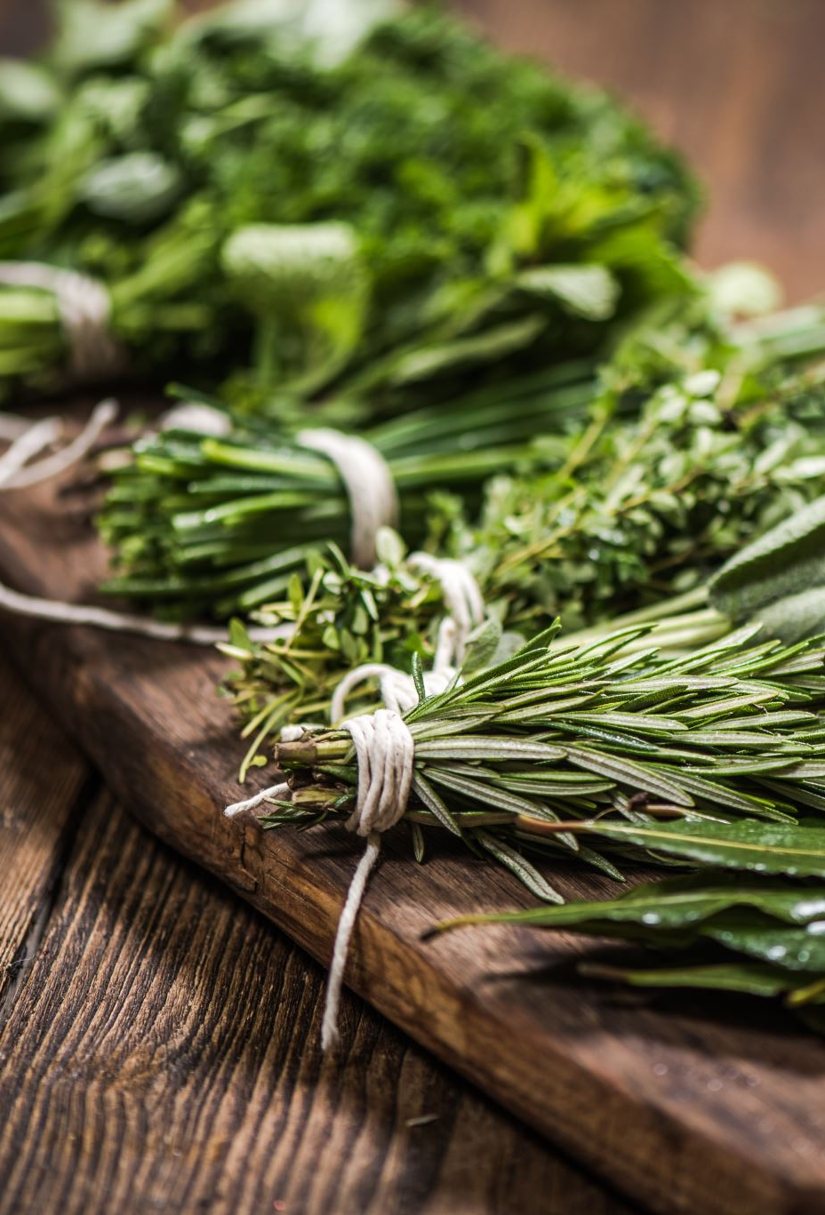
2. Food systems and diets
Food systems, environmental health, and the health of human populations are deeply interconnected
Policies within food systems, such as agricultural subsidies, influence the price and availability of different foods, which in turn influences food choice and consumption
An important step towards sustainable food systems is the provision of country-specific nutrition policies that take a holistic approach and integrate broader issues into nutritional guidance and national food-based dietary guideline (FBDG) to promote the purchase and consumption of healthy foods

Slide 10


3. Dietary guidelines
Food based dietary guideline (FBDGs) are used to inform national policies beyond health, such as the provision of food within education systems or public procurement.
In addition to ensuring that the nutritional needs of the population are met and that diets contribute to reducing disease risk, FBDGs should also be evaluated for the environmental costs of their implementation
Nutrient-rich value chain–USAID defines a commodity as nutrient-rich if it meets any of the following criteria:
  1) It is biofortified;
  2) It is a legume, nut, or seed, such as sesame, sunflower, pumpkin seeds, wheat germ, or sprouted legume seeds;
  3) It is an animal source food, including dairy products (milk, yogurt, cheese), fish, eggs, organ meats, meat, flesh foods, and other miscellaneous animal protein (e.g. grubs, insects);
  4) It is a dark yellow or orange-fleshed root/tuber;
  5) It is a fruit/vegetable that meets the threshold for being a “high source” of one or more micronutrients on a per 100 calorie and per 100 gram basis

Slide 11
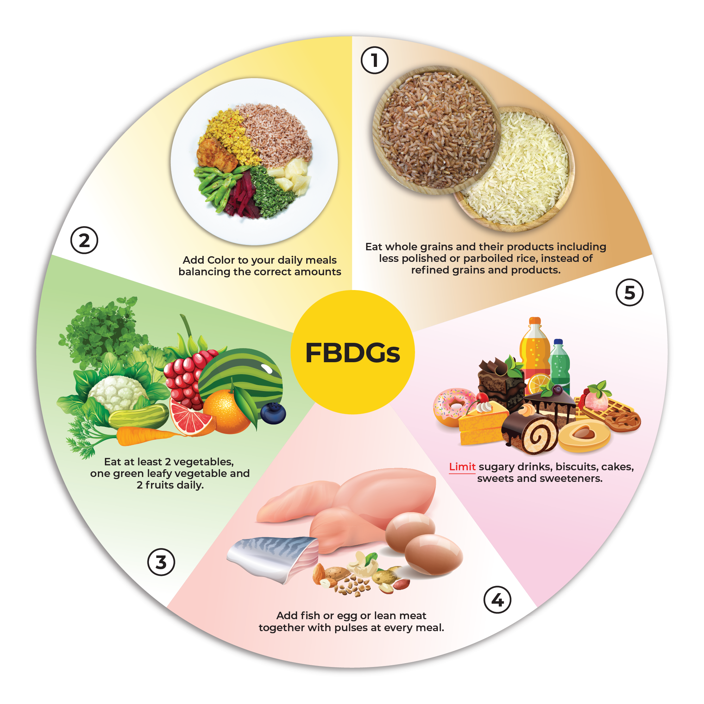
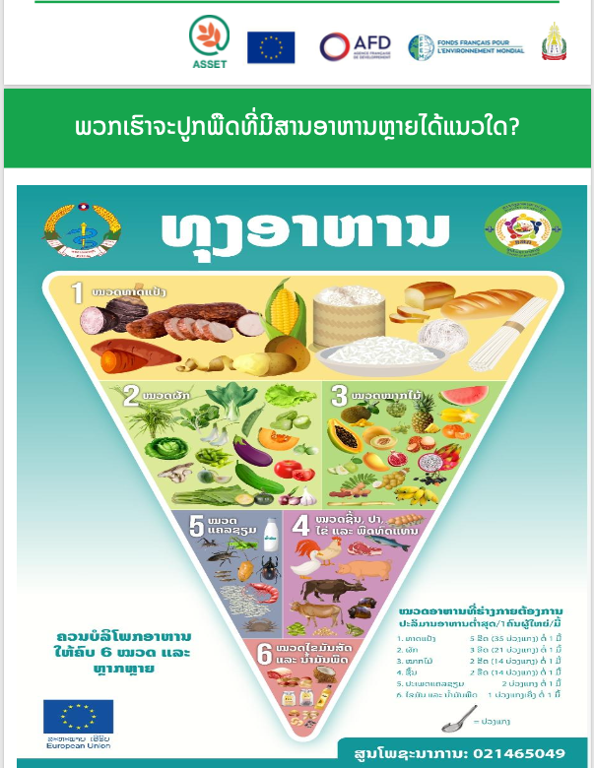
Food based dietary guidelines

Slide 12
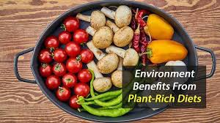
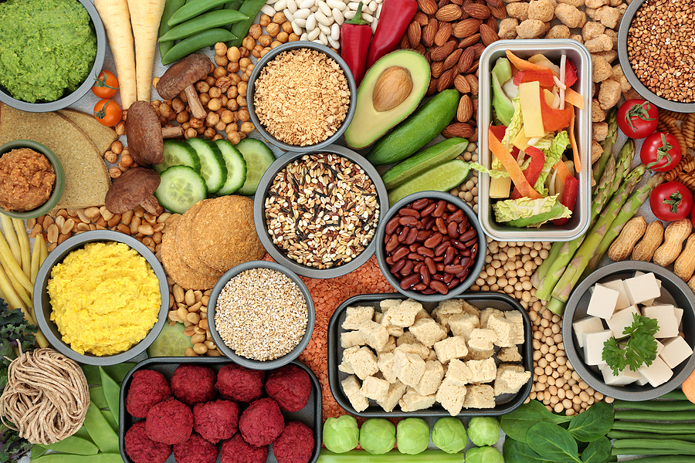
4. Diet and environment
Diets high in meat and dairy products are typically more resource-intensive and have a larger environmental footprint than plant-based diets.
This is because the production of meat and dairy requires more land, water, and energy than the production of plant-based foods
Food needs to be grown and processed, transported, distributed, prepared, consumed, and sometimes disposed of.
Each of these steps creates greenhouse gases that trap the sun's heat and contribute to climate change.
About a third of all human-caused greenhouse gas emissions is linked to food.

Slide 13
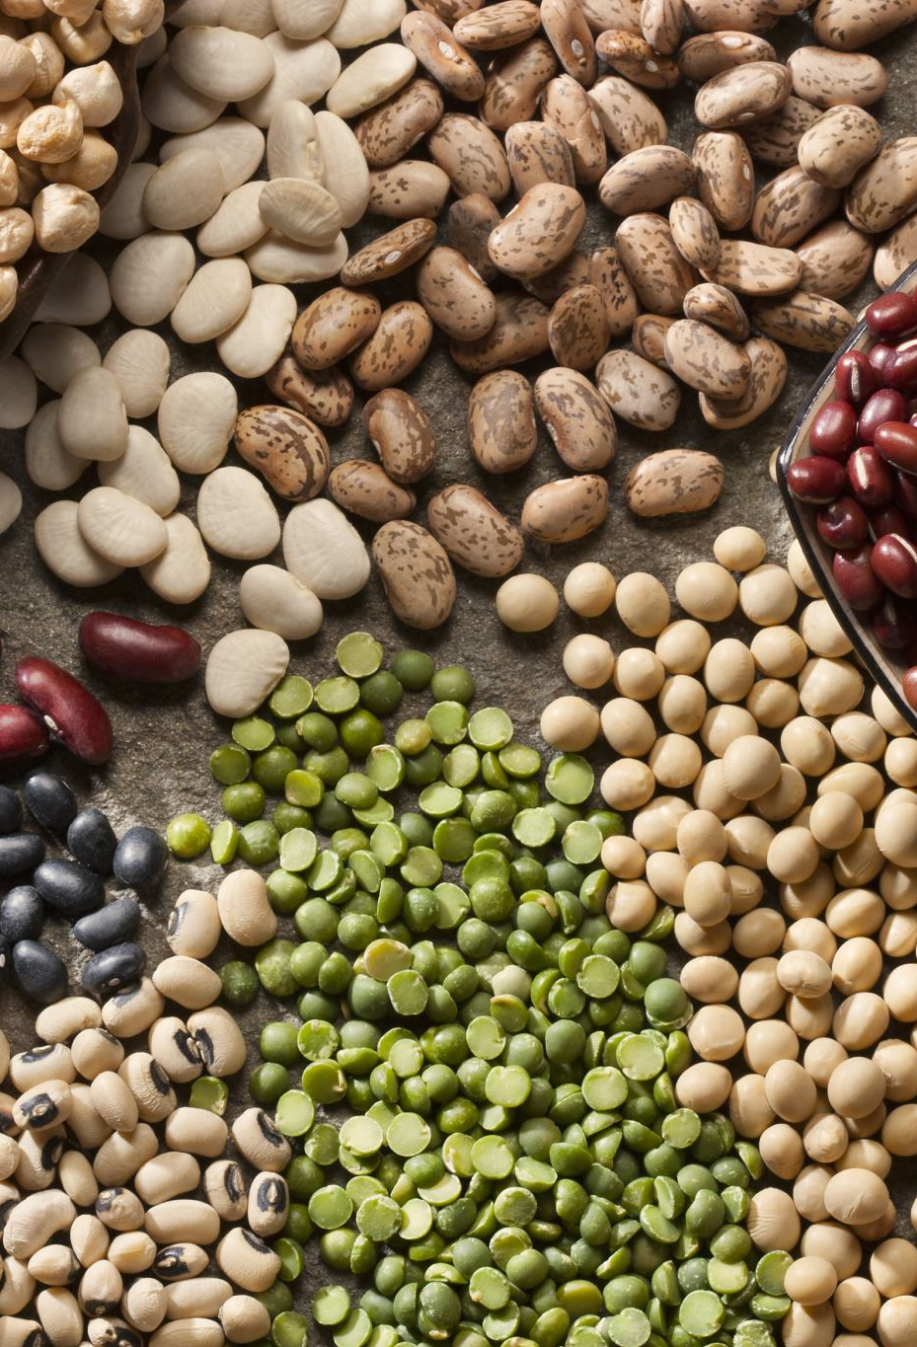
5. What is a Healthy Diet?
A healthy diet is one that contains a variety of foods (is adequate in micronutrients) and is hygienically safe
A healthy diet emphasizes fruits, vegetables, whole grains, and fat-free or low-fat milk and milk products
It includes a variety of protein foods such as seafood, lean meats and poultry, eggs, legumes (beans and peas), soy products, nuts, and seeds
Is low in added sugars, sodium, saturated fats, trans fats, and cholesterol

Slide 14
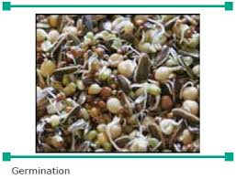
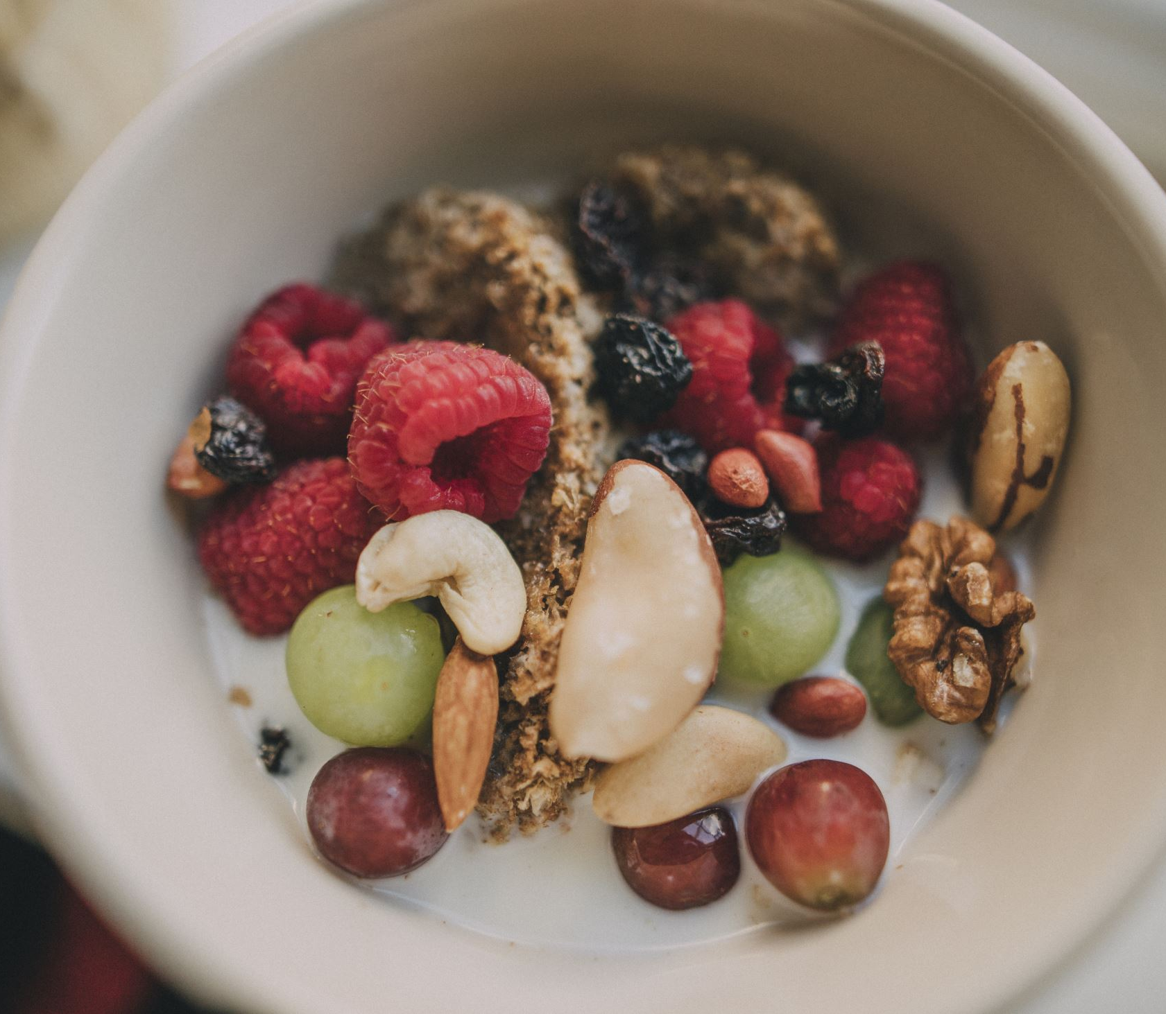
6. Food-to-food enrichment, food combinations
Food Enrishment
Adding protein and energy dense foods/products to normal meals
- Dairy products: milk, cream, yogurt, cheese, skimmed milk powder
- Fat: butter, oil (frying, margarine
- sugar: sugar, jam, honey
Ex: adding skimmed milk powder to fresh milk, adding honey to porridge, cream to soup etc.
Germination

Slide 15
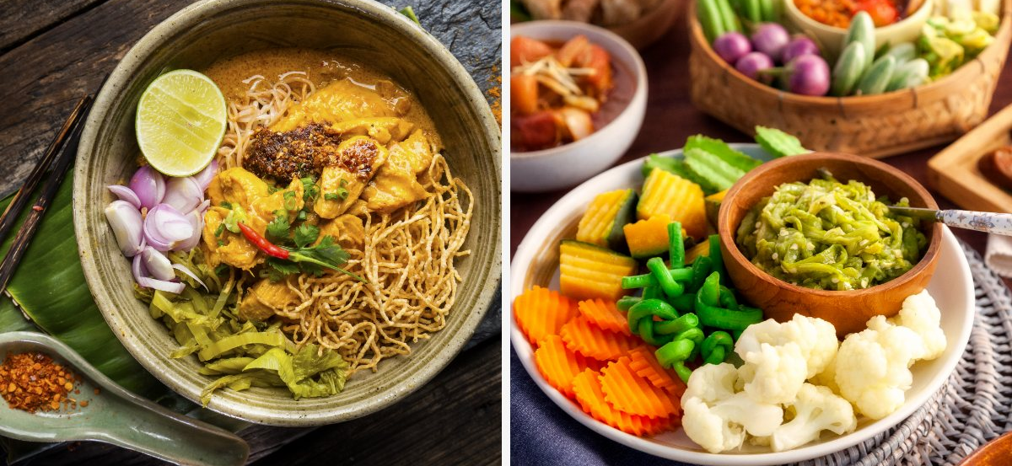
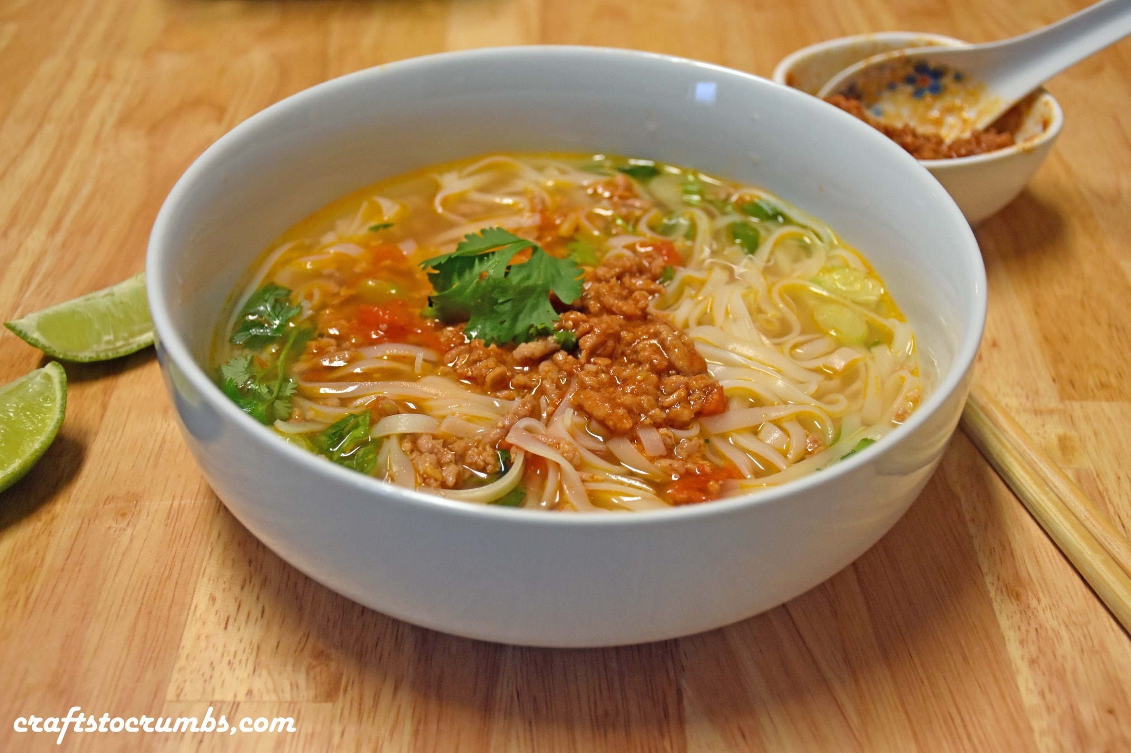
7. Food items can be enriched to improve their nutritional profile and add health benefits
The process of food-to-food enrichment restores the original nutritional content of the food, helps strengthen the nutrients in the foods, and mutually complements each of the foods in the food product/recipe
Examples of food-to-food enrichment
Khao Soi noodle in Lao PDR
Pork, Fermented soy bean (Toau Nao); boilerd soya sprout, leafy greens , Soup)

Slide 16
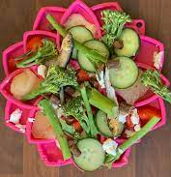
8. Benefits of food-to-food enrichment
Helps with children’s growth and development
Deficiencies of vital nutrients such as iron, vitamins A, B, C, and D, calcium, and zinc can cause serious physical and developmental growth issues.
Food naturally enriched and fortified help to fulfil children’s nutritional requirements, improve their growth, and promote overall health
Promotes the health of elderly
Our body and organs begin to deteriorate as we grow older and it becomes difficult for the digestive system to absorb nutrients properly
Therefore, elderly people commonly suffer from nutritional deficiencies. Enriched foods help maintain proper nutrient levels in elderly people for healthy organ function, better digestion, and stronger bones.
Safe and cost-effective, enhances culinary creativity
Naturally fortified and enriched foods are a safe and cost-effective way for improving diets and preventing and controlling micronutrient deficiencies
Enrichment can be done through innovative and healthy food combinations and recipes to improve culinary interest and health

Slide 17
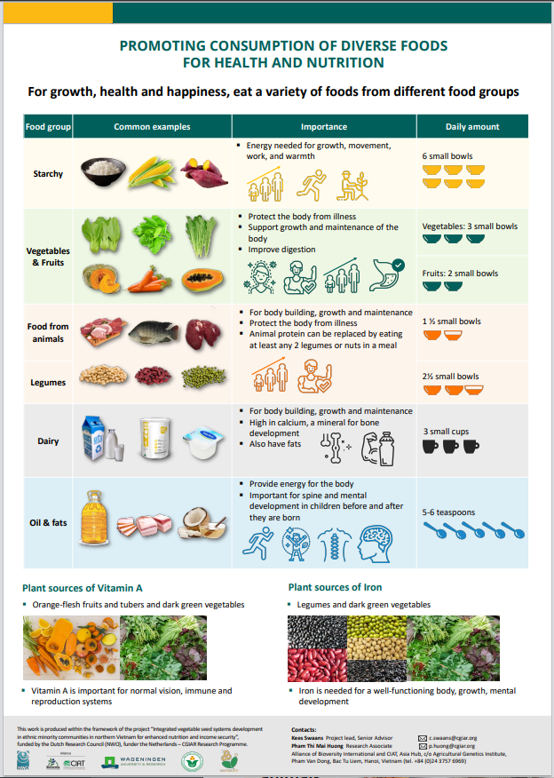
9. Strategies for Promoting Dietary Diversity
Promote Diverse Cropping Systems: Encourage farmers to grow a variety of crops, including fruits, vegetables, legumes, and root crops, rather than focusing on a single staple.
Establish Home Gardens: Teach families how to create and manage small-scale gardens to grow nutrient-rich foods for personal consumption.
Integrate Livestock: Incorporate small-scale livestock, such as chickens or goats, to provide a source of protein and micronutrients like iron and B-vitamins.
Improve Post-Harvest Practices: Educate communities on how to properly store, process, and prepare food to preserve its nutritional value and ensure food safety.

Slide 18
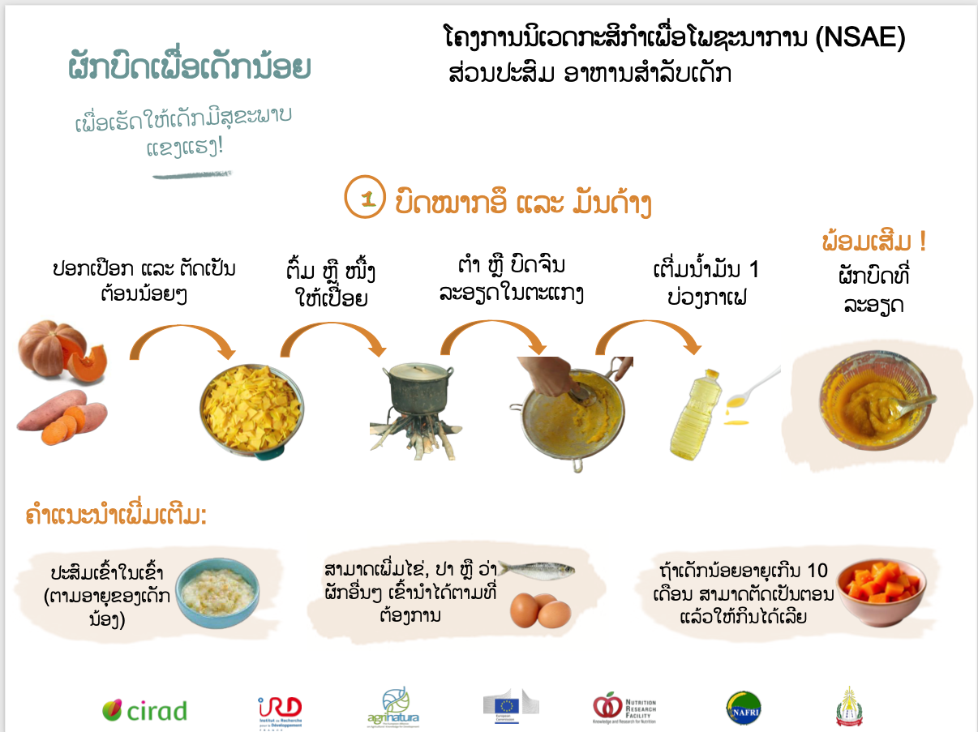
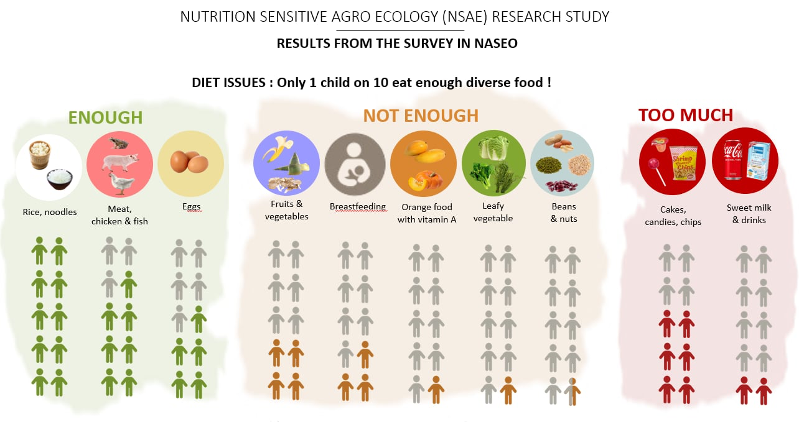
Developing a Community Action Plan

Slide 19
Post-learning activities

Slide 20
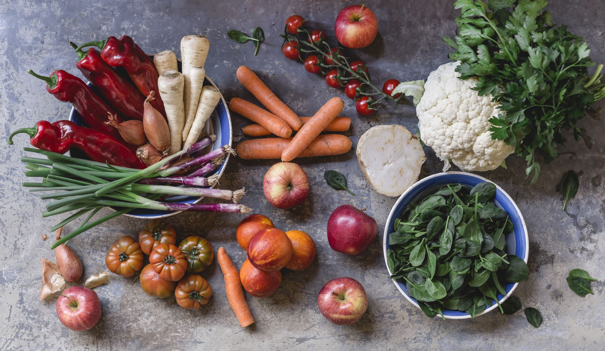
Summary and conclusion
Healthy Diets (includes what is a healthy diets, safety, variety, quality, safety, what are micro-nutrients, calories etc)
Food-to-food enrichment, food combinations
Indicators (incl. a discussion on opportunities to link and report against NPAN indicators)
  Minimum dietary diversity for women (MDD-W)
  Minimum dietary diversity for children and minimum acceptable diet for Children (MDD-C, MAD-C)

Slide 21
Post quiz (test)
This quiz is used to test the knowledge of students related to this lessons that they just finished learning. You can add 5-10 questions. Types of questions could be: MCQ, True or False, Matching, Fill in short words.
Questions | Possible answer | Correct Answer | Feedback
Q1: Which of the following best defines dietary diversity? | A. The total number of calories a person consumes from different food groups. B. The number of different food groups a person consumes over a specific period. C. The number of different nutrients a person consumes daily. D. The variety of foods within a single food group. | C | Dietary diversity is a measure of diet quality and is typically quantified by counting the number of food groups consumed over a reference period, such as 24 hours. A-rich sweet potatoes.
Q2: A high dietary diversity score is often associated with which of the following? | A low intake of essential fatty acids. Improved micronutrient adequacy. An increased risk of chronic diseases A greater intake of ultra-processed foods. | B | Eating from a wider range of food groups increases the likelihood of consuming a balanced mix of essential vitamins and minerals.
Q3: What is the primary objective of Food-Based Dietary Guidelines (FBDGs)? | To provide a uniform dietary plan for all populations worldwide. To provide simple, practical, and culturally relevant advice for healthy eating. To establish specific nutrient intake levels for different age groups. To serve as clinical guidelines for treating diet-related diseases. | B | FBDGs are created to translate complex nutritional science into understandable and actionable messages about what foods to eat for a healthy diet.
Q4: Which of the following describes a potential limitation of using a simple dietary diversity score (DDS) as a sole indicator of nutritional adequacy? | It does not account for the nutrient density of the foods consumed. It can be difficult to collect data on food groups from different cultures. It is not a valid measure for any population. It takes into account the specific quantities of each food group consumed. | A | A high DDS is associated with better nutrient intake, but it doesn't guarantee the diet is rich in nutrients if the foods chosen are of low quality (e.g., highly processed snacks).

Slide 22
Assignment/Homework/Case study
Assignment
Project team: create 4 teams (5-6 students/team) per group A, B, C, D Students needs to provide the ideas generation and selection of an school garden to produce foods in the context of their home town.

Slide 23
Reference
Adeyeye, S. A. O. (2017). The role of food processing and appropriate storage technologies in ensuring food security and food availability in Africa. Nutrition & Food Science, 47(1), 122–139.
Ruel, M. T. (2002). Is dietary diversity an indicator of food security or dietary quality? International Food Policy Research Institute (IFPRI).
Kennedy, G., Ballard, T., & Dop, M. (2013). Guidelines for measuring household and individual dietary diversity. Nutrition and Consumer Protection Division, FAO.

Slide 24
Next lesson
This is the end of the lesson.
Ending message and introduction to next lesson including lesson title and topics should be given.
Next Lesson Title | Next lesson Lesson 5: Diversified agricultural foods productions for healthy diets and income (Improve access to foods) Understanding Diversification of agricultural food productions Diversification for Health and Nutrition Diversification for Income and Resilience Practical Diversification Strategies

