Slide 1
Online Course on Nutrition Sensitive Agriculture for health diets
Module 7 Assessment methods for food and nutrition security
Sayvisene Boulom, Department Head of Agricultural Economics and Food Technology, Faculty of Agriculture, National University of Laos
sayvisene.b@nuol.edu.la, Tel: +856 202220118

Slide 2
Pre-learning activities

Slide 3
Lesson learning outcomes
After completing this lesson, the students will be able to:
- Understand different methods to assess food and nutrition security of household, women and children,
- Understand the importance of each method and apply to results to design, monitor and evaluate food security in venerable target groups.

Slide 4
Lesson overviews (this is the outline of this lesson)
In this lesson, learners will learn about:
different assessment methods to identify food and nutrition security and its Importance
Understand limitation and advantage the assessment method to design interventions

Slide 5
Keywords
Keywords | Definition
Dietary Diversity | The number of different foods or food groups consumed over a given period of time. Household-level dietary diversity can be used as an indicator of household food security, and individual-level dietary diversity is an indicator of diet quality for an individual (typically measured for women or young children) (World Bank, 2013). The term is used as synonym of diet variety.
Food insecurity | A situation that exists when people lack secure access to sufficient amounts of safe and nutritious food for normal growth and development and an active and healthy life. It may be caused by the unavailability of food, insufficient purchasing power, inappropriate distribution or inadequate use of food at the household level. Food insecurity, poor conditions of health and sanitation and inappropriate care and feeding practices are the major causes of poor nutritional status. Food insecurity may be chronic, seasonal or transitory (FAO et al., 2015).
Care practices | An individual caretaker’s typical practices for feeding and caring for infants, young children, mothers/selves and others in the family (FAO, 2016).
Food and Nutrition Security (FNS) | Food and nutrition security is achieved, if adequate food (quantity, quality, safety, socio-cultural acceptability) is available and accessible for and satisfactorily used and utilized by all individuals at all times to live a healthy and active life (Weingärtner, 2004)

Slide 6
Pre-quiz
This quiz is used to review previous lesson or ask students some questions related to the introduction of this lesson. You can add 3-5 questions. Types of questions could be: MCQ, True or False, Matching, Fill in short words.
Questions | Possible answer | Correct Answer | Feedback
Q1: What is the primary purpose of the Household Dietary Diversity Score (HDDS)? | a) To measure the amount of calories consumed by a household. b) To assess the micronutrient adequacy of a household's diet. c) To count the number of different food groups consumed by a household in a 24-hour period. d) To determine the level of food security based on income. | C | The HDDS is a qualitative tool designed to measure the variety of foods consumed as a proxy for diet quality and access to different food types, not calorie intake. It is based on a simple count of 12 food groups
Q2: The Minimum Dietary Diversity for Women (MDDS-W) measures the consumption of how many food groups out of a total of 10? | a) At least 3 b) At least 4 c) At least 5 d) At least 6 | C | The MDDS-W is a binary indicator (yes/no) that classifies a woman's diet as 'minimally diverse' if she has consumed at least 5 of the 10 defined food groups in the last 24 hours.
Q3: What is the main difference in purpose between the Food Consumption Score (FCS) and the Household Dietary Diversity Score (HDDS)? | FCS measures the amount of food, while HDDS measures the quality. b) FCS measures consumption over 7 days, while HDDS measures consumption over 24 hours. c) FCS is used for children, while HDDS is used for adults. d) FCS is a simple count, while HDDS is a weighted score. | b | The FCS uses a 7-day recall period to capture less frequently consumed foods, and it assigns different weights to food groups based on their nutritional density. The HDDS uses a 24-hour recall and is a simple count

Slide 7
Lesson body

Slide 8
Introduction: Assessment of diet and nutrition status
Nutritional status indicators and food indicators
Minimum acceptable diet (MAD), Minimum dietary diversity for women (MDD-W)
SDG # 2 :
Target 2.1 By 2030, end hunger and ensure access by all people, in particular the poor and people in vulnerable situations, to safe, nutritious and sufficient food all year round;
Target 2.2 By 2030, end all forms of malnutrition, including achieving,
by 2025, agreed targets to end on stunting and wasting in children under 5 years of age, and address the nutritional needs of adolescent girls, pregnant and lactating women and older persons.
Prevalence of undernourishment (PoU): the percentage of the population whose habitual food consumption is insufficient to provide the dietary energy levels that are required to maintain a normal active and healthy life
Food insecurity experience scale : FIES is a food insecurity severity experience matrix that relies on immediate responses of respondents to questions about their access to adequate food → to see the ability to access / obtain food.

Slide 9
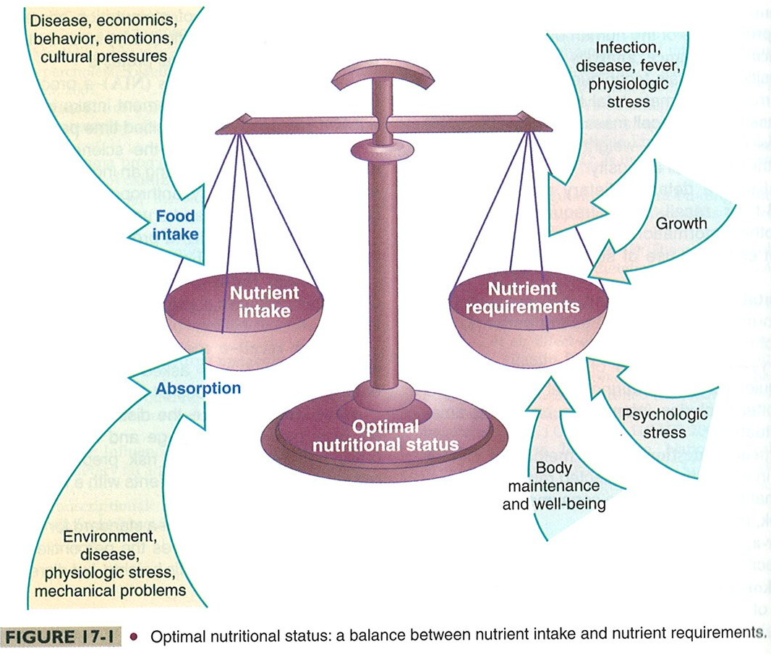
OPTIMAL NUTRITIONAL STATUS

Slide 10
What are the nutritional indicators used for nutrition assessment?
Assessing Nutritional Status Nutritional status can be assessed through:
Body ( anthropometric ) measurements, used to measure growth in children and body weight changes in adults.
Clinical examination and biochemical testing , used to diagnose deficiencies of micronutrients (e.g., iodine, vitamin A and iron).
What do these indicators tell us?
The indicators stunting, wasting, overweight and underweight are used to measure (growth/physical dimensions) nutritional imbalance
Such imbalance results in either undernutrition (assessed from stunting, wasting and underweight) or overweight

Slide 11
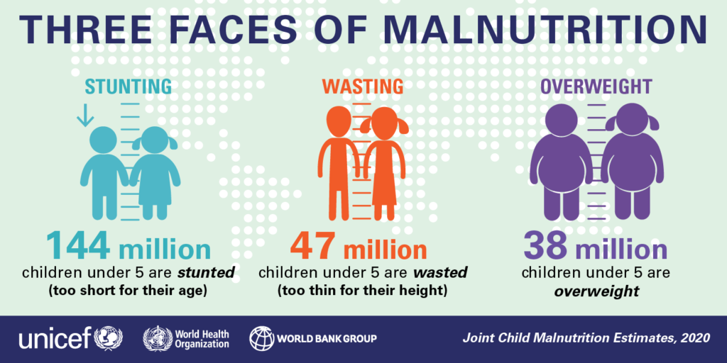
USE OF NUTRITION INDICES
Measure or Index | Nutritional Condition | Usefulness of Index
WFA (weight for age) | UNDERWEIGHT ( composite measure of stunting and wasting) | To assess changes in the magnitude of malnutrition over time
HFA (height for age) | STUNTING (Past growth failure; associated with a number of long-term factors including chronic insufficient protein and energy intake, frequent infection, sustained inappropriate feeding practices and poverty etc.) | Problem analysis in designing interventions Evaluation of program preferably for children under 2 years of age not for monitoring as it does not change in the short term such as 6-12 months
WFH (Weight for Height) | WASTING ( current or acute malnutrition resulting from failure to gain weight or weight loss. Causes includes inadequate food intake, incorrect feeding practices, disease, and infection or, more frequently, a combination of these factors.) | Screening or targeting purposes as wasting in individual children and population groups can change rapidly and shows marked seasonal patterns associated with changes in food availability or disease prevalence to which it is very sensitive. Annual reporting

Slide 12
NUTRITION INDICES :WASTING
Measure or Index | Nutritional Condition | Usefulness of Index
MUAC | WASTING | Rapid screening of acute malnutrition from the 6–59-month age range Assessing acute adult undernutrition and Estimating prevalence of undernutrition at the population level
Oedema (presence of excessive amounts of fluid in the intracellular tissue) | Clinical sign of severe malnutrition | Screening and Surveillance

Slide 13
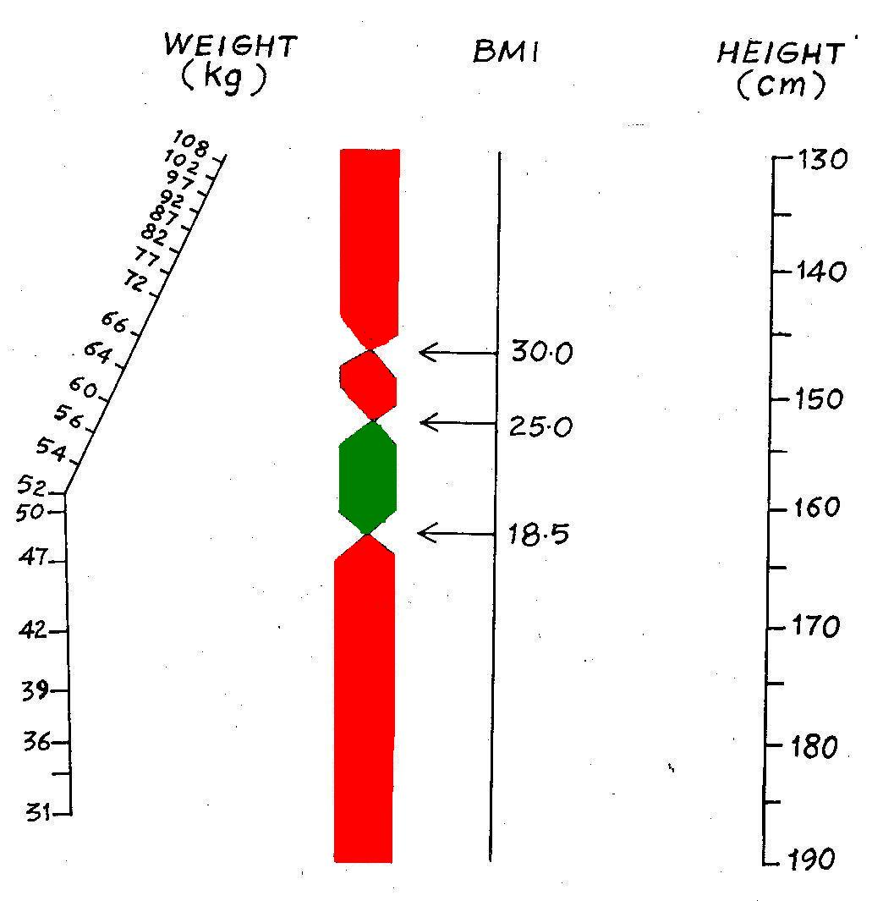
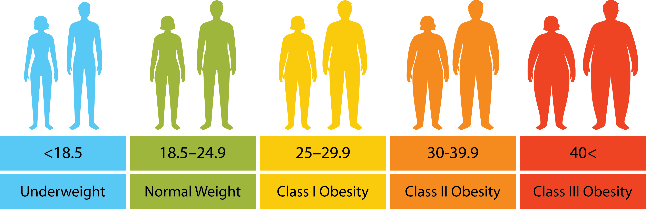
Body mass index for adult
Source: https://www.healthyweightcolorado.com/bmi/

Slide 14
1. Household Dietary Diversity Score
The "HDDS" you mentioned in your question stands for Household Dietary Diversity Score.
This is an indicator used in the field of food security and nutrition, particularly by the Food and Agriculture Organization of the United Nations (FAO), to assess the quality and access to food at the household level.
What is HDDS?
The HDDS (Household Dietary Diversity Score) is an indicator that reflects the diversity of foods consumed by households over the past 24 hours. It is used as a proxy for:
Household food access: The economic ability of households to produce, purchase, or procure a variety of foods.
Socioeconomic status: Households with higher incomes or better economic status tend to have higher HDDS scores.
Household food security: Higher HDDS scores are generally associated with better food security.
Important:
The HDDS does not provide information on the quantity of food consumed or the nutritional value of foods at the individual level. It is a measure of the overall quality of household food access.

Slide 15
1.1. How to measure the HDDS
The HDDS is measured by asking the person responsible for preparing meals in the household about all the food and beverages consumed by household members in the past 24 hours. The foods are categorized into 12 main food groups:
Cereals: Rice, bread, pasta, and other grain products.
Raw tubers and bananas: Cassava, sweet potatoes, sweet potatoes, and raw bananas.
Beans, peanuts, and lentils: All beans, peanuts, and lentils.
Dark green leafy vegetables: Kale, spinach, chard, spinach.
Other fruits and vegetables rich in vitamin A: Ripe papaya, ripe mango, carrots, and sweet potatoes.
Other fruits and vegetables: Common fruits (e.g. watermelon, orange), common vegetables (e.g. cucumber, eggplant) not classified in groups 4 or 5.
Meat: Beef, pork, goat, game.
Poultry: Chicken, duck, bird.
Eggs: Chicken eggs, duck eggs, bird eggs.
Fish and seafood: All types of fish, shrimp, shellfish, crab.
Dairy products : Milk, yogurt, cheese.
Oils, fats, and sweets: Vegetable oil, lard, candy, sugar.

Slide 16
1.2. Interpretation of Results
In general, higher HDDS scores indicate better dietary diversity and better access to food for the household. There is no internationally defined “cutoff point” for the HDDS that directly indicates food security, as it varies by context and eating culture. However, some studies or projects may define their own cutoff points to group households (e.g., secure, moderate risk, high risk).
Importance of HDDS Measurement
Assessing the food security status: Helps to understand the food security status of households in a given area.
Project design and monitoring: Provides information for designing interventions related to agriculture, nutrition, and livelihood development.
Indicators of change: Can be used to track changes in household food security over time, especially after an intervention.
Cost-effectiveness: A relatively simple and cost-effective tool for collecting data.

Slide 17
Continue….
The HDDS is often used in conjunction with other indicators (e.g. HFIAS - Household Food Insecurity Access Scale, FCS - Food Consumption Score) to provide a more complete picture of household food security.

Slide 18
2. Minimum Dietary Diversity for Women - MDD-W)
"MDDW assessment" generally refers to the Minimum Dietary Diversity for Women (MDD-W) assessment. This is a key indicator used in the fields of nutrition and public health to measure the quality of the diet consumed by women.
What is MDD-W?
MDD-W is a simple indicator that measures dietary quality based on the number of different food groups consumed by women aged 15-49 years (Lao Case, 12-49 years) in the past 24 hours. The aim is to assess whether women are getting enough micronutrients (vitamins and minerals) from a variety of food sources.

Slide 19
2.1. How to Assess MDD-W
The MDD-W is assessed by asking women about all the foods they consumed in the previous day (24 hours). The foods are categorized into 10 main food groups:
1. Grains, legumes, and raw bananas: rice, bread, potatoes, sweet potatoes, raw bananas.
2. Beans, peanuts, and nuts: all beans, nuts.
3. Dairy products: milk, yogurt, cheese.
4. Meat, poultry, and fish: beef, pork, chicken, all fish.
5. Eggs: chicken eggs, duck eggs.
6. Dark green leafy vegetables: kale, spinach, chard, spinach.
7. Other fruits and vegetables rich in vitamin A: ripe papaya, ripe mango, pineapple, carrots, sweet potatoes.
8. Other vegetables: General vegetables that are not dark green or rich in vitamin A (e.g. cucumber, eggplant, white cabbage).
9. Other fruits: All fruits that are not rich in vitamin A (e.g. watermelon, orange).
10. Fats, oils, and sweets: Vegetable oil, lard, sugar, candy.

Slide 20
2.2. Scoring method
Women receive 1 point for each food group consumed at least once. The maximum score is 10 points.
Interpretation of results
• MDD-W ≥ 5: Women who consume foods from 5 or more food groups are considered to have adequate dietary diversity and are more likely to obtain adequate amounts of essential micronutrients.
• MDD-W < 5: Women who consume foods from fewer than 5 food groups are considered to have low dietary diversity and are at higher risk of micronutrient deficiencies.

Slide 21
2.3. Importance of MDD-W Assessment
Health Indicators: A good indicator of overall diet quality and adequate nutritional intake.
Program Planning: Helps organizations and governments understand which groups of women are at risk of malnutrition and where interventions should be focused.
Monitoring and Evaluation: Used to track the effectiveness of nutrition improvement programs over time.
Nutrition Promotion: Encourages women to consume a variety of foods for their own and their children’s good health.

Slide 22
III. Minimum Dietary Diversity Assessment for Children Under 5 Years of Age (MDD-CU5)
"MDD-CU5" is not a commonly used indicator.
Usually, when talking about dietary diversity in children, the indicator used is the MDD (Minimum Dietary Diversity) for children aged 6-23 months.
You may be referring to this indicator or indicators related to children under 5 years of age in general.
The MDD (Minimum Dietary Diversity) for children aged 6-23 months, which is a standard indicator recommended by the World Health Organization (WHO) and UNICEF.

Slide 23
3.1. What is MDD for children aged 6-23 months?
MDD (Minimum Dietary Diversity) for children aged 6-23 months is an indicator that measures the quality of the food consumed by children in this age group.
The aim is to assess whether children are getting enough micronutrients (vitamins and minerals) from a variety of food sources during this important period of complementary feeding.

Slide 24
3.2. How to Assess MDD (for Children 6-23 Months)
The MDD assessment is done by asking the caregiver (usually the mother) about all the foods and drinks that the child consumed in the past 24 hours. The foods are categorized into 8 main food groups:
1. Breast milk: (including breast milk given directly or expressed breast milk)
2. Grains, tubers, and raw bananas: rice, bread, potatoes, sweet potatoes, raw bananas.
3. Beans, nuts, and seeds: soybeans, peanuts, beans, nuts, sunflower seeds.
4. Dairy products (other than breast milk): infant formula, cow's milk, yogurt, cheese.
5. Meat, fish, poultry, and offal: beef, pork, chicken, all types of fish, liver, heart.
6. Eggs: Chicken eggs, duck eggs.
7. Fruits and vegetables rich in vitamin A: Ripe papaya, ripe mango, carrots, sweet potatoes, pumpkin.
8. Other fruits and vegetables: Common vegetables (e.g. cucumber, eggplant), common fruits (e.g. watermelon, orange) not classified in group 7.

Slide 25
3.3. Scoring method
Children receive 1 point for each food group consumed at least once. The maximum score is 8 points.
Interpretation of results
  MDD ≥ 4: Children who consume foods from 4 or more food groups are considered to have adequate dietary diversity and are more likely to obtain adequate amounts of essential micronutrients.
  MDD < 4: Children who consume foods from fewer than 4 food groups are considered to have low dietary diversity and are at high risk of micronutrient deficiencies.
Importance of MDD assessment (for children 6-23 months)
  Dietary quality assessment: A good indicator of the quality of complementary foods in children.
  Risk screening: Helps identify children at risk of micronutrient deficiencies.
  Program planning: Provides information for planning and designing programs to improve infant and young child feeding (IYCF).
  Monitoring and evaluation: Used to monitor the effectiveness of nutrition interventions at the community or national level.

Slide 26
IV. Measuring the Household Food Insecurity Access Scale (HFIAS)
The Household Food Insecurity Access Scale (HFIAS) is a tool used to assess the level of food insecurity at the household level.
It is an experience-based indicator that focuses on household "access" to food, by asking about behaviors and feelings related to food insecurity.

Slide 27
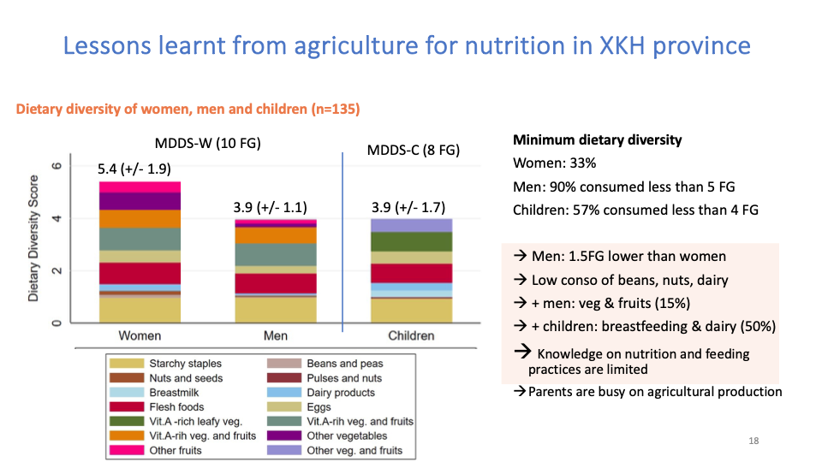
Example: study result on dietary diversity

Slide 28
4.1. What is HFIAS?
The HFIAS was developed by the USAID-funded FANTA (Food and Nutrition Technical Assistance) project.
It is a questionnaire that measures psychological and behavioral aspects of food insecurity, such as worrying about running out of food or reducing the number of meals.

Slide 29
4.2. How to Measure HFIAS
The HFIAS is conducted by interviewing the primary food preparer in the household. The questionnaire asks about the household’s experiences over the past 4 weeks (30 days).
The HFIAS consists of 9 occurrence questions that indicate the severity of food insecurity, along with 9 frequency-of-occurrence questions that ask about the frequency of occurrence.

Slide 30
4.3. 9 Occurrence Questions:
These questions ask whether the following events have occurred in the past 4 weeks (answer: yes/no). If the answer is "yes", follow-up questions (frequency) are asked.
Category 1: Concerns and uncertainties about household food supply
1. In the past four weeks, have you ever worried that your household will not have enough food?
Category 2: Inadequate food quality (including variety and preferences)
2. In the past four weeks, have you or any household member been unable to eat your favorite foods because of a lack of resources?
3. In the past four weeks, have you or any household member had to eat a reduced variety of foods because of a lack of resources?
4. In the past four weeks, have you or any household member had to eat foods that you did not want to eat because of a lack of resources to buy other types of food?

Slide 31
9 Occurrence Questions
Category 3: Insufficient Food Quantity and Physical Effects
5. In the past four weeks, have you or any household member had to eat less than you felt you needed because of not enough food?
6. In the past four weeks, have you or any household member had to eat less food in one day because of not enough food?
7. In the past four weeks, have you ever run out of food in your household because of a lack of resources to obtain food?
8. In the past four weeks, have you or any household member ever gone to bed hungry at night because of not enough food?
9. In the past four weeks, have you or any household member ever gone hungry all day and night because of not enough food?

Slide 32
4.4. Calculating the HFIAS Score
There are two main ways to calculate and interpret the HFIAS:
1. Continuous HFIAS Score:
  Each frequency-of-occurrence question is scored as follows:
  “No” (to the main question) = 0 points
  “Rarely” = 1 point
  “Sometimes” = 2 points
  “Often” = 3 points
o The total HFIAS score for a household is obtained by summing the scores for all 9 follow-up questions.
      o The total score can range from 0 to 27.
      o Lower scores indicate better food security.
      o Higher scores indicate more severe food insecurity. This method is sensitive to small changes over time.

Slide 33
4.4. 2. Categorical HFIAS Status:
In addition to continuous scores, the HFIAS can also be used to categorize households into 4 levels of food insecurity:
  Food Secure: No experience or minimal food anxiety (rarely).
  Mildly Food Insecure: Worries about food frequently, and/or experiences inadequate food quality (e.g., not being able to eat favorite foods, eating less variety, eating unwanted foods) sometimes or rarely.
  Moderately Food Insecure: Worries about food frequently, and/or experiences inadequate food quality frequently, and/or begins to experience inadequate food quantity (e.g., eating less food than desired, eating fewer meals) sometimes or rarely.
  Severely Food Insecure: Experiences of food insecurity frequently, or extreme experiences (e.g., running out of food, going to bed hungry, going hungry all day) even if it occurs infrequently.

Slide 34
4.5. Importance of HFIAS
• Measurement of experience: The HFIAS is a unique tool that measures households’ direct experiences of food insecurity.
• Severity detection: It can detect food insecurity at various levels, from mild to severe.
• Planning and monitoring: It provides important information for program planning, setting targets, and monitoring changes in food security status over time.
• Flexibility: It can be used in both rapidly changing contexts (transient insecurity) and stable situations (chronic insecurity).
Caution: HFIAS data can change seasonally. Therefore, if it is to be used to assess the impact of interventions, it is recommended to collect data at the same time of year.

Slide 35
V. Calculating Food Consumption Score (FCS)
The Food Consumption Score (FCS) is a widely used food security indicator, particularly by the World Food Programme (WFP). It is a composite score based on dietary diversity, frequency of food consumption, and the relative nutritional value of different food groups. The FCS is used as a proxy indicator for calorie availability at the household level.

Slide 36
5.1. What is FCS?
The FCS reflects the typical food consumption patterns of a household over a 7-day period. It helps to classify households into groups: poor, borderline, or acceptable food consumption.
How to measure and calculate FCS
The FCS calculation involves the following steps:
Step 1: Collect food frequency data
Interview the main person responsible for preparing meals in the household.
Ask the household how many days each food item was consumed by the household in the past 7 days.
There are usually 8 main food groups (plus side dishes). The sub-food items within each group should be adjusted to reflect local dietary patterns.

Slide 37
5.2. Main food groups and examples (may be adjusted according to circumstances):
1. Grains, tubers, tubers, and raw bananas: rice, crackers, potatoes, sweet potatoes, raw bananas, wet rice, noodles, rice cakes, bread.
2. Beans, nuts, and seeds: peanuts, soybeans, green beans, soybeans, peanuts, sesame seeds.
3. Vegetables: leafy greens, other vegetables, spinach, cucumber, cabbage.
4. Fruits: bananas, mangoes, papayas, watermelons, pineapples.
5. Meat, fish, poultry, and eggs: beef, pork, chicken, duck, all types of fish, eggs.
6. Milk and dairy products: fresh milk, condensed milk, powdered milk, yogurt, cheese.
7. Oils and Fats: Vegetable Oil, Lard, Butter.
8. Sugars and Sweets: Sugar, Sweets, Soft Drinks.
9. Condiments: Salt, Fish Sauce, Lemon Juice, Herbs, Spices (sometimes not included in the score).

Slide 38
5.3. Step 2: Group foods and set maximum frequency
Sum the frequency of consumption of food items belonging to the same food group. • Set the maximum value (recoding):
If the total frequency of a food group exceeds 7 days (e.g., eat rice every day + Chinese noodles every day = 14 days), change the value to 7.
This prevents any one food group from being overly influential.

Slide 39
5.4. Step 3: Multiply the weight of each food group
Each food group has a different weight based on its nutrient density. These weights are standardized by WFP:
Grains, legumes: 2
Beans, nuts, seeds: 3
Vegetables: 1
Fruits: 1
Meat, fish, poultry, eggs: 4
Milk and dairy products: 4
Oils and fats: 0.5
Sugars and sweeteners: 0.5
Condiments: 0 (no weight, does not count in the overall score)

Slide 40
5.5. Calculation example:
Food groups | Frequency of food consumption (F) (in 7 days) | Weight (W) | Scores (F x W)
Grains, legumes | 7 | 2 | 7×2=14
Beans, nuts, seeds | 3 | 3 | 3×3=9
Vegetables | 5 | 1 | 5×1=5
Fruit | 2 | 1 | 2×1=2
Meat/fish/egg | 4 | 4 | 4×4=16
Milk | 1 | 4 | 1×4=4
oils | 7 | 0.5 | 7×0.5=3.5
Sugar | 2 | 0.5 | 2×0.5=1
Sum FCS |  |  | 54.5

Slide 41
5.6. Step 4: Add the weighted scores to obtain the final FCS
Add the weighted scores for all food groups together. This sum is the household FCS score.
Interpretation of the FCS
WFP recommends standard cut-off points to classify households:
  0 – 21.0: Poor Food Consumption: Households do not eat enough staple foods and vegetables every day, and rarely eat high-protein foods (e.g. meat, fish, dairy).
  21.5 – 35.0: Borderline Food Consumption: Households eat staple foods and vegetables every day, and occasionally eat oils and legumes.
  > 35.0: Acceptable Food Consumption: Households eat staple foods and vegetables every day, and occasionally eat oils and legumes, and occasionally eat meat, fish, and dairy.

Slide 42
5.7. Importance:
These cut-off points may need to be adjusted according to local circumstances and dietary patterns of the target population. It is advisable to consult with experts or country/area-specific guidance documents.
Importance of FCS
Food consumption indicators: A good indicator of energy consumption and overall food quality at the household level.
Monitoring and evaluation: Used to track changes in household food security over time.
Targeting: Helps to target households most at risk of food insecurity for interventions.
Comparison: As a standardized method, it can be used to compare situations across areas or over time.
Caution: FCS, like HDDS, is sensitive to seasonal changes. Therefore, data should be collected at the same time of year as the monitoring is conducted.

Slide 43
Post-learning activities

Slide 44
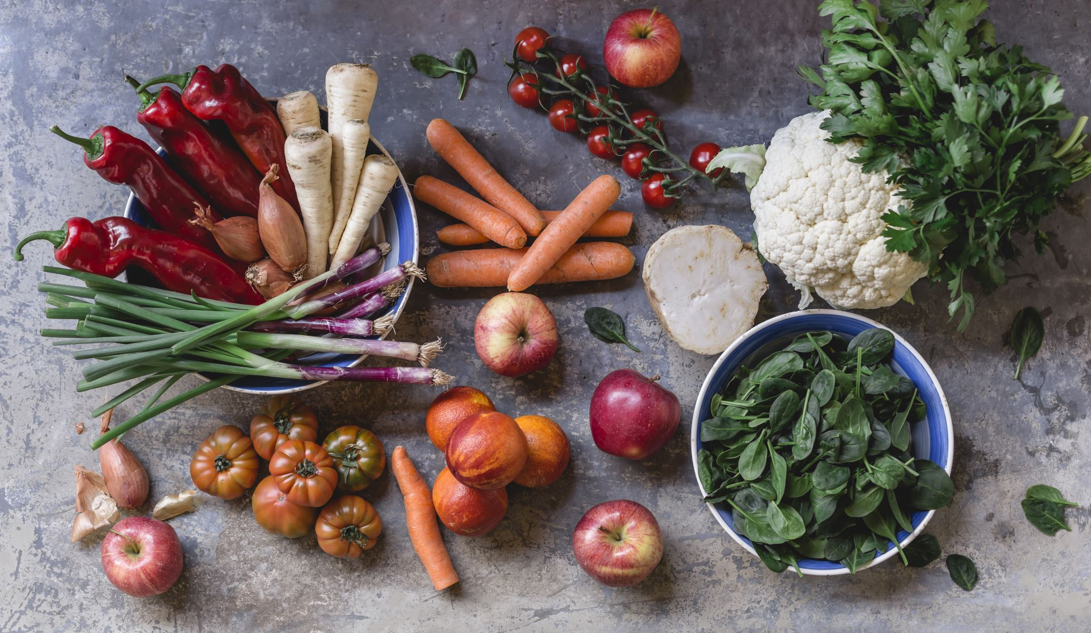
Summary and conclusion
we learned assessment methods to assess dietary diversity for household, women and children in the family
Household Food Insecurity Access Scale can identify food security challenges, flexibility, monitory and design intervention
food consumption score can help us to identify energy and quality of food consumed in households and we can help us implement intervention at targeted population especially vunerable food insecurity household
Seasonality is important during assessment

Slide 45
Post quiz (test)
This quiz is used to test the knowledge of students related to this lessons that they just finished learning. You can add 5-10 questions. Types of questions could be: MCQ, True or False, Matching, Fill in short words.
Questions | Possible answer | Correct Answer | Feedback
Q1: Which of the following food groups is NOT typically included in the Household Dietary Diversity Score (HDDS)? | a) Cereals and Tubers b) Spices, Condiments, and Beverages c) Pulses, Nuts, and Seeds d) Fish and Seafood | b | The HDDS focuses on food groups that contribute significantly to a person's nutrient intake. Spices, condiments, and beverages are not considered major sources of macro or micronutrients, so they are excluded from the score.
Q2What is the primary objective of the Minimum Dietary Diversity for Children Under 5 (MDD-CU5)? | a) To measure the caloric intake of a child. b) To assess the prevalence of stunting and wasting in children. c) To determine if a child has consumed foods from at least 4 out of 7 food groups in the past 24 hours. d) To evaluate the quality of a child's diet based on a 7-day recall. | c | The MDD-CU5 is a proxy indicator for the micronutrient adequacy of a young child's diet. It is designed to check if a child has received the minimum variety of foods necessary for healthy growth and development.
Q3: Which food group is considered a key source of Vitamin A for children and is included in the MDD-CU5 score? | a) Grains, Roots, and Tubers b) Dairy products c) Vitamin A-rich fruits and vegetables d) Fats and oils | c | Fruits and vegetables, particularly those with a yellow/orange color (e.g., carrots, mangoes, pumpkins), are rich in beta-carotene, which the body converts to Vitamin A. This group is specifically included to track intake of this critical nutrient.
Q4: What does the acronym HFIES stand for? | a) Household Food Insecurity Experience Scale b) Household Food Intake and Expenditure Survey c) Health, Food, and Income Evaluation Scale d) Humanitarian Food Insecurity Estimation Score | a | TThe HFIES is a direct measure of food insecurity based on a set of questions that ask about a household's experiences and behaviors related to a lack of food over a specific period.

Slide 46
Assignment/Homework/Case study
Assignment
Project team: create 4 teams (5-6 students/team) per group A, B, C, D Students needs to provide the ideas generation and selection of an school garden to produce foods in the context of their home town.

Slide 47
Reference
Boulom, S., Essink, D. R., Kang, M.-H., Kounnavong, S., & Broerse, J. E. W. (2020b).
Factors associated with child malnutrition in mountainous ethnic minority communities in Lao PDR. Global Health Action, 13(sup2), 1785736. https://doi.org/10.1080/16549716.2020.1785736
FAO. (2000). Food Security: concepts and measurement. Food and Agriculture Organization of the United Nations. https://www.fao.org/4/Y4671E/y4671e06.htm#fn21
FAO. (2008). An Introduction to the Basic Concepts of Food Security. In Food Security Information for Action: Practical Guides (pp. 1–3). FAO.

Slide 48
End lesson
This is the end of the lesson.
Ending message and introduction to next lesson including lesson title and topics should be given.
Lesson Title | End of Module

