Slide 1
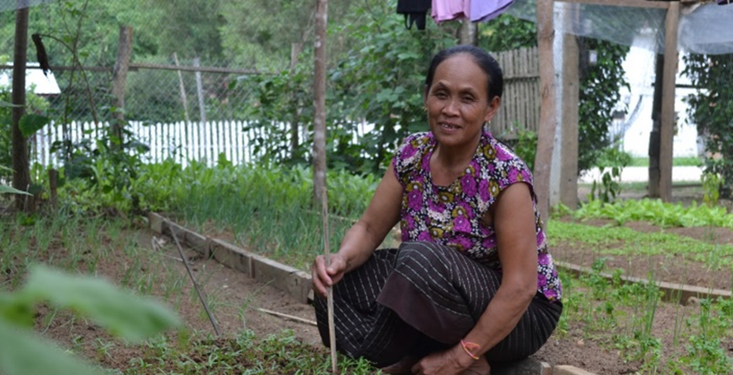
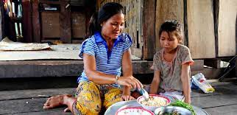
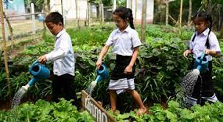
MODULE 4
Diversified food production for healthy diets and income (improve access)
Sayvisene Boulom, Department Head of Agricultural Economics and Food Technology, Faculty of Agriculture, National University of Laos
sayvisene.b@nuol.edu.la, Tel: +856 202220118

Slide 2
Pre-learning activities

Slide 3
Lesson learning outcomes
After completing this lesson, the students will be able to:
Provides a comprehensive guide to implementing diversified agricultural practices.
Design for farmers, agricultural extension workers, community leaders, and development professionals who want to improve both nutrition and economic outcomes for rural households

Slide 4
Lesson overviews (this is the outline of this lesson)
In this lesson, learners will learn about:
Understanding Diversification
Diversification for Health and Nutrition
Diversification for Income and Resilience
Practical Diversification Strategies

Slide 5
Keywords
Keywords | Definition
Crop diversification | the practice of growing a variety of crops on a farm over time or simultaneously, instead of relying on a single crop. It involves increasing the number of different crop species or varieties, which can be achieved through methods like intercropping (growing multiple crops at once) or crop rotation (planting different crops in sequence)
nutrient-rich foods | foods that provide a high amount of essential vitamins, minerals, fiber, and protein with relatively few calories and minimal added sugars, saturated fats, and sodium. The goal is to get the most beneficial nutrients for the calories consumed, making them an important part of a healthy diet
Homegarden | A homegarden is a land area close to a family's dwelling used to cultivate a diverse range of plants and sometimes livestock for personal use, food security, or income, often featuring multiple layers of vegetation and serving social and economic functions for the household and community
Food waste | any food that was intended for human consumption but is discarded at any point along the food supply chain, from farm to fork. It encompasses edible food that spoils or is discarded, as well as less desirable parts like peels and rinds
Food loss | Occurs earlier in the supply chain, from primary production, processing, and distribution, and involves issues like spoilage or damage before reaching consumers.

Slide 6
Pre-quiz
This quiz is used to review previous lesson or ask students some questions related to the introduction of this lesson. You can add 3-5 questions. Types of questions could be: MCQ, True or False, Matching, Fill in short words.
Questions | Possible answer | Correct Answer | Feedback
Q1 What is a primary benefit of polyculture farming over monoculture? | It leads to a higher yield of a single, uniform product. It requires more chemical fertilizers and pesticides. It increases resistance to pests and diseases by creating a more complex ecosystem. It simplifies harvesting and mechanization. | C | In a polyculture system, the presence of multiple plant species can confuse pests and attract natural predators, reducing the spread of diseases and the need for pesticides.
Q2: How does reduced agricultural diversity impact global food security? | It makes food systems more vulnerable to large-scale crop failure from a single threat. It increases the availability of a wide range of nutritious foods. It makes food production more resilient to climate shocks and diseases. It simplifies the global food supply chain, making it more efficient. | A | When food production is concentrated on a few genetic varieties, a single pest, disease, or climate event can cause a catastrophic failure of that crop, threatening food security.
Q3: Which of the following crops is most likely to be high in nutrient density? | A staple crop like corn grown in a monoculture. A variety of heirloom vegetables grown in a diverse garden. A highly processed grain product like white flour. A genetically modified crop engineered for pest resistance. | B | Heirloom varieties are often selected for their flavor and nutrient content, and a diverse garden provides a wide array of micronutrients from different plants.

Slide 7
Lesson body

Slide 8
Outline
The module covers elements of:
Household food production for healthy diets and income (note: income refers to income through agriculture, and importance of income for women).
Food waste and loss, post-harvest processing and nutrient preservation
Integrated home gardening
Growing range of foods within limited household land
Household food security (note: focus on those not covered by the above)
Utilization of seldom used parts of vegetables -stalks, stems, seeds, nuts (questions: peels?) (note: underutilized and traditional foods common in Laos).

Slide 9
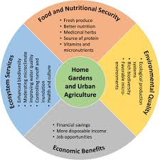
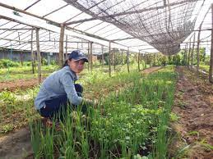

1. Household food production for nutrition and income
Household production is one way to ensure that there is food within the home at all times
Producing enough of a variety of foods in the home garden and in the field requires access to adequate resources, including land, water, seeds, tools, knowledge, skills and labor
Household food production helps in proper distribution of food and makes the food available to the household and community
Household food production also plays a significant role in the economy.

Slide 10
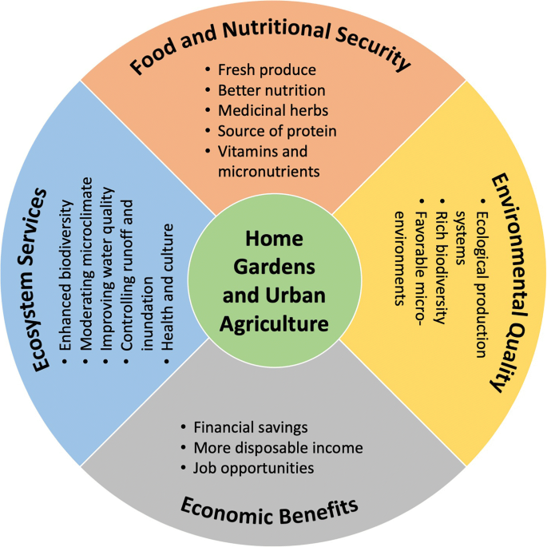
2. Household food production for nutrition and income
Importance of home garden and urban agriculture
- Food and nutritional security
- Environmental quality
Ecosystem services
- Economic benefits

Slide 11
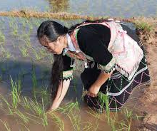
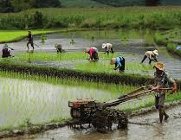
3. Income through agriculture, and importance of income for women
Agriculture remains an important source of employment for ASEAN women
On average, the agriculture sector employs 26.7% of all working women in ASEAN
Women living in rural areas are more likely to be self-employed than women living in urban areas
There is a significant gap between rural and urban areas in the proportion of self-employment among female workers
A large share of rural women are self-employed, given that there are fewer opportunities for formal employment in rural areas than in urban areas
The policies of Lao government have been promoting the roles of women in agriculture for income through the Lao Women's Union

Slide 12
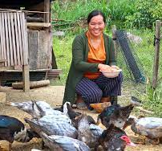
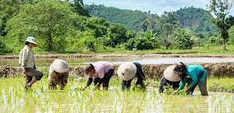
4. Women’s participation in agriculture and income
Evidence in Lao PDR showed that women’s participation in agriculture project meetings was 30%-60% during the initial implementation period, which increased to 49%-65% by the project end
Women benefited from diversified farming demonstrations and training on farming techniques on household plots.
Women comprised 41% of participants of the on-farm crop productivity improvement trials and were similarly represented in activities related to rice intensification
Women benefited directly through water supply investments, poultry farming and community managed irrigation schemes
Women were major beneficiaries of training and extension support for poultry raising as an income-earning activity.

Slide 13
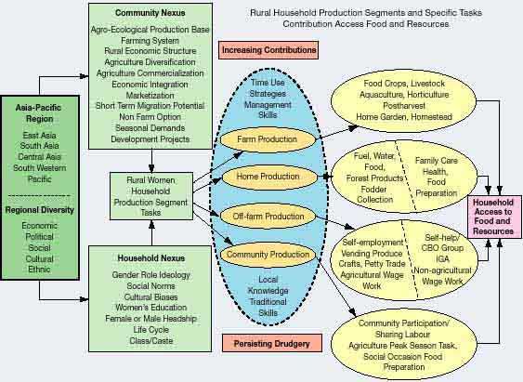
Pathways of rural household food production and contribution to food access and resources (Source : FAO)
R. Balakrishnan. Widening Gaps in Technology Development and Technology Transfer in Support of Rural Women.
In Human resources, agricultural and rural development. FAO, 2000.

Slide 14
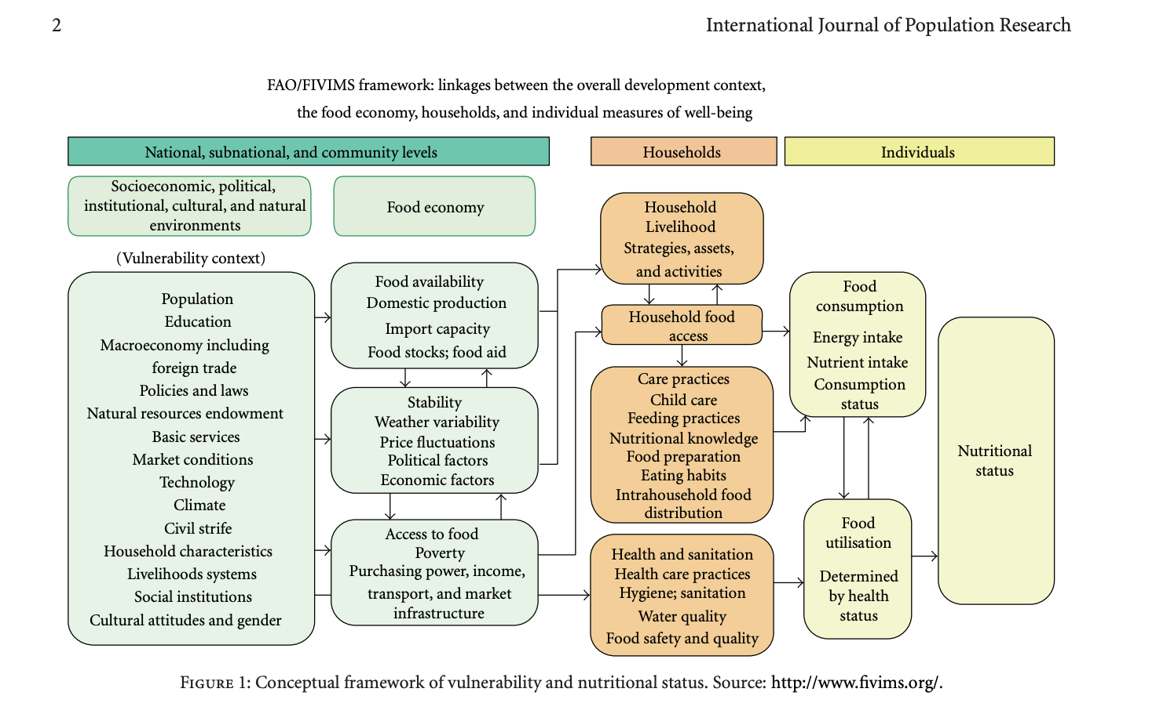
Pathways of rural household food production and contribution to food access and resources

Slide 15
Lao PDR: Integrated Home Gardens for
Improved Nutrition (FAO Project, 2005)
Decline in rates of malnutrition under five years demonstrated evidence of project impacts on nutrition

Slide 16
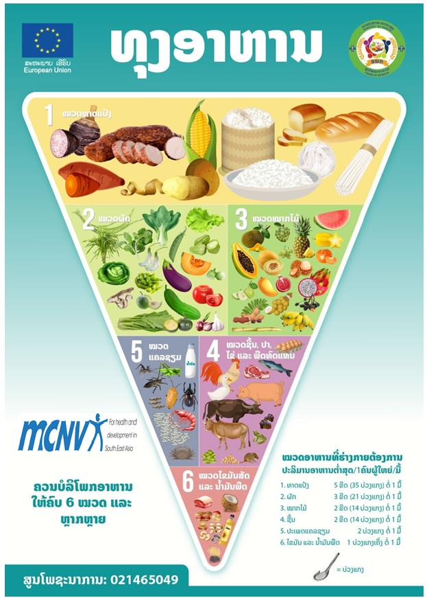
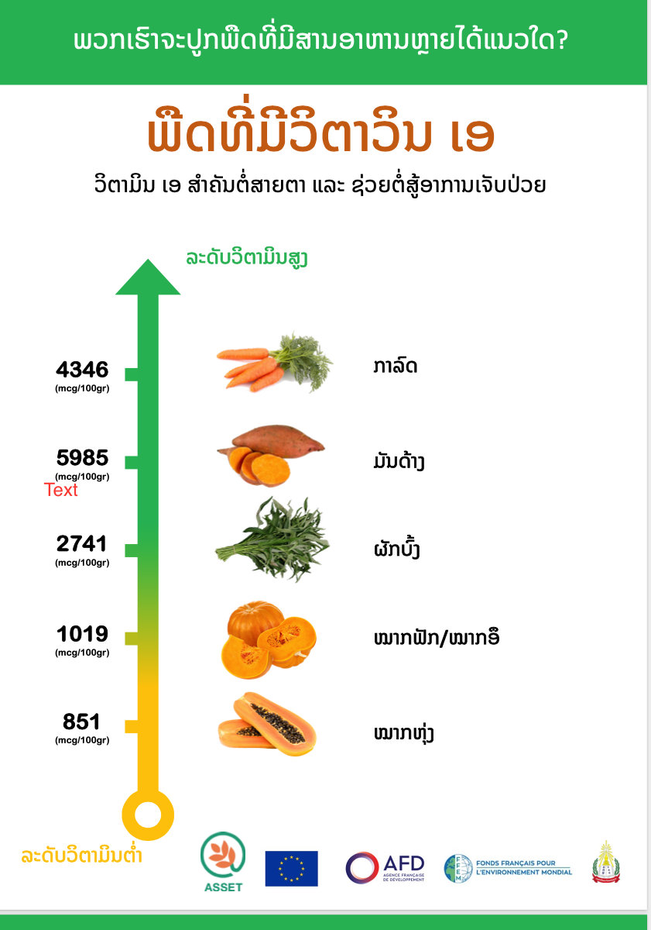
Example of Nutrition Sensitive Agroecology project 2024-2025, in Xienglhouan province, Lao PDR.

Slide 17
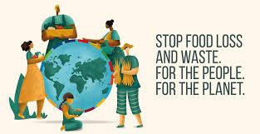
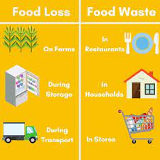
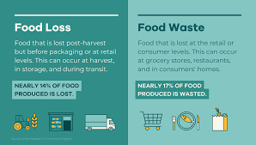
Food loss and waste
Food loss and waste is food that is not eaten
FAO defines food loss and waste as the decrease in quantity or quality of food along the food supply chain
Overall, about one-third of the world's food is thrown away
The causes of food waste or loss are numerous and occur during production, processing, distribution, retail and food services sales and consumption

Slide 18
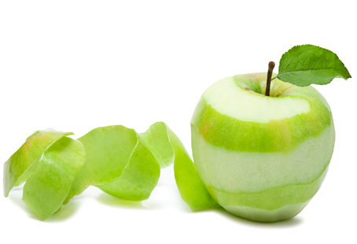

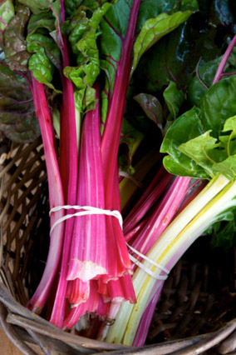
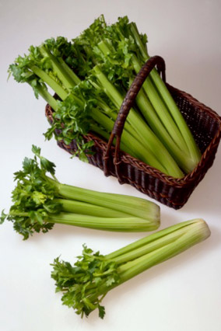
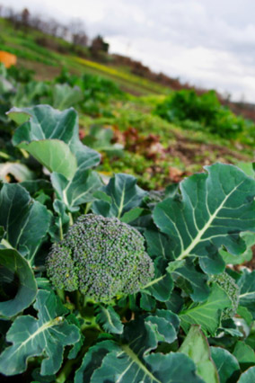
Avoid waste: encourage use of fruit and vegetable peels and stalks in the diet
Fruit peels of apple, citrus
fruits can be candied, added to flavor confectionary
A one-ounce serving of broccoli
florets with leaves provides 90 %
daily vitamin A requirement
Notes:
Fruit peel, especially of citrus fruits can be candied; added to flavour confectionary; peels of blue berries, guava, grapes, kumquat contain higher concentration of anti oxidants such as anthocyanin pigments, tannins and catechins than in their flesh (pulp); in India unripe mango peels are sun dried and ground to a powder (Aamchoor) and used as a condiment

Slide 19
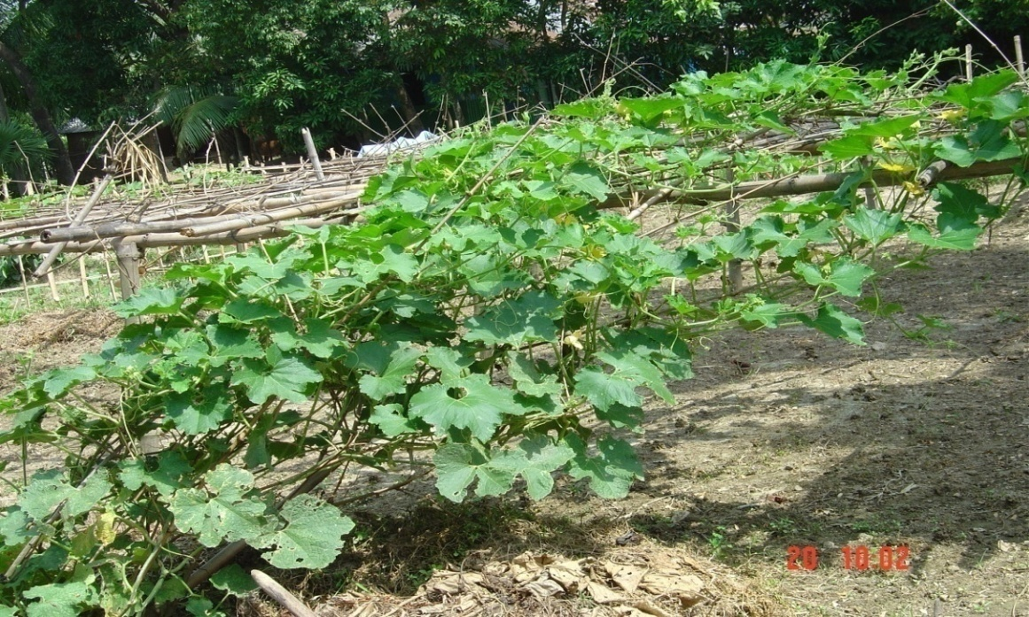
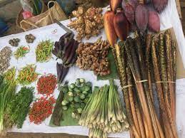
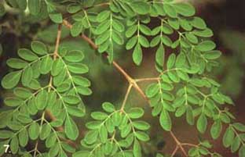
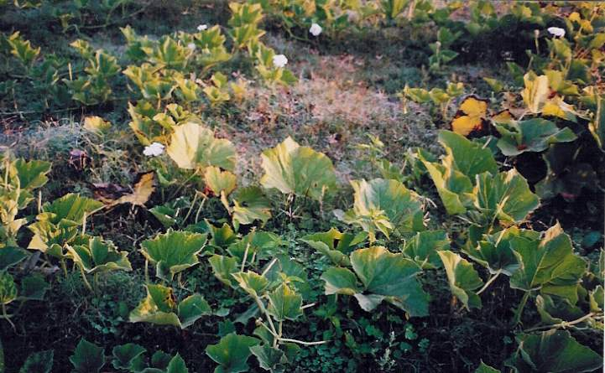
Avoid waste -promote underutilized parts
Use yard long beans and seeds nutritious and remunerative
Encourage use of bottle gourd and leaves -
low cost and nutritious
A range of underutilized foods being promoted in Lao PDR
Drumstick and leaves are rich in micronutrients and fibre - serves as a natural fencing for home gardens

Slide 20
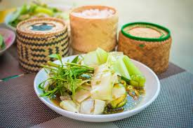
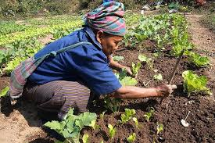
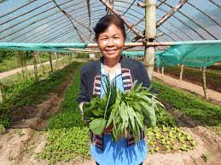
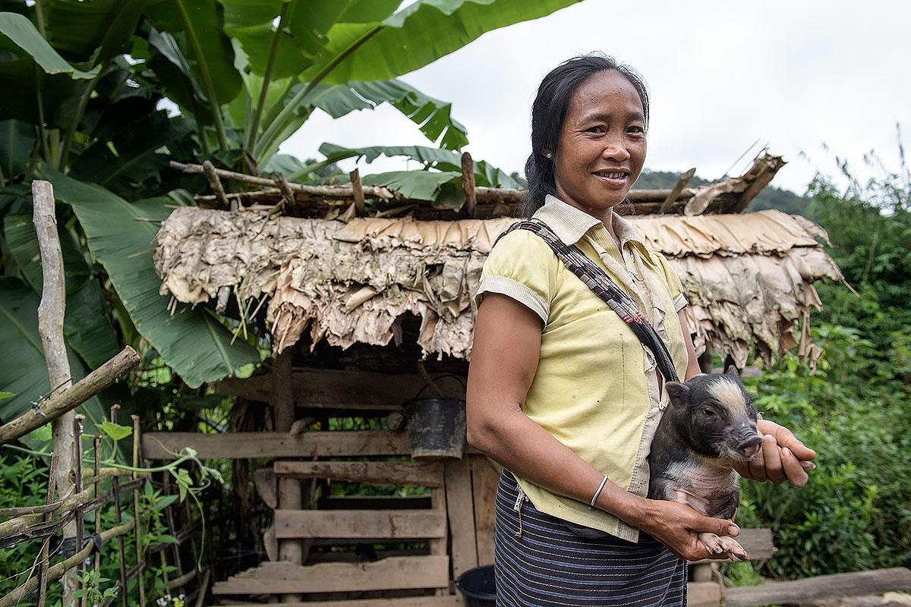
Growing range of foods within limited household land
Average rice farms in Lao are small, averaging only around 1–2 hectares
Environmental instability such as frequent flooding and droughts cause significant fluctuations in yearly agricultural yields
Majority of Laos's producers are rice farmers
The major crop is rice, which account for 50% of the national agricultural output
Additional crops include sweet potatoes, sugarcane, maize and coffee
Crops grown in home gardens include fruits (papaya, banana, citruses, pineapples, mango and jackfruit) and vegetables (aubergine, chili, cabbage, beans), plus ginger, taro, bamboo, peanuts and medicinal plants.
80 percent of the rural population (>6 million people) are subsistence farmers, depending heavily on rice-based agriculture, raising livestock, and relying on collecting food from the wild to supply their dietary needs.

Slide 21
Post-learning activities

Slide 22
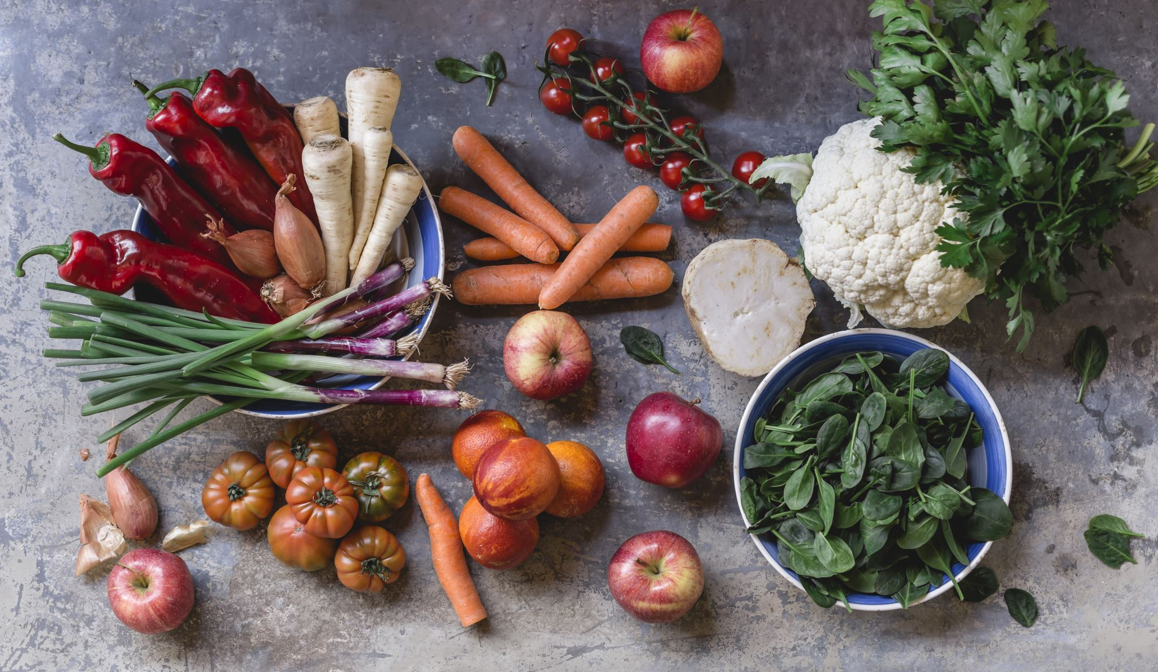
Summary and conclusion
Mainstream nutrition in food security policies and programs (agricultural, health, social protection policies and education programs)
Accelerate diversification in food production combined with nutrition education
Disseminate nutrition messages through agriculture extension and farmers field schools, women farmer groups
Ensure food safety, hygiene and quality through comprehensive strategies
Address issues of climate change, environment, biodiversity and sustainable diets
Establish methods to quantify food losses and food waste
Increase financing and investment for nutrition-sensitive agriculture and food security programmes
Enhance capacity of agriculture staff in development, implementation, monitoring and evaluation of nutrition-sensitive food security programmes
Support to food and nutrition security policy implementation and country investment plan monitoring

Slide 23
Post quiz (test)
This quiz is used to test the knowledge of students related to this lessons that they just finished learning. You can add 5-10 questions. Types of questions could be: MCQ, True or False, Matching, Fill in short words.
Questions | Possible answer | Correct Answer | Feedback
Q1: How does a lack of diversity in the human diet affect nutrition and health? | It leads to a broader intake of essential vitamins and minerals. It can result in micronutrient deficiencies and an over-reliance on a few sources of calories. It simplifies digestion and improves nutrient absorption. It reduces the risk of non-communicable diseases. | B | A lack of dietary diversity, often linked to a lack of agricultural diversity, can cause people to miss out on key vitamins and minerals, leading to health problems.
Q2: What is the relationship between climate change and agricultural diversity? | Agricultural diversity makes food systems more resilient to climate change. Agricultural diversity contributes to climate change by increasing carbon emissions. Climate change only affects large-scale, monoculture farms. Climate change has no impact on agricultural diversity. | A | A diverse range of crops, including drought-resistant or heat-tolerant varieties, makes a food system better equipped to adapt to the unpredictable effects of climate change.
Q3: The loss of traditional crop varieties due to the focus on a few high-yield crops is known as: | Biodiversity enhancement Genetic engineering Crop rotation Genetic erosion | D | Genetic erosion refers to the irreversible loss of genetic diversity, particularly in domesticated plants and animals, which often occurs when traditional varieties are replaced by a small number of modern, high-yielding ones.
Q4: A farm that integrates crop farming with animal husbandry is an example of: | Intensive farming An integrated farming system Monoculture Extensive farming | B | Integrated farming systems combine different agricultural components, such as crops and livestock, to create a more efficient, diverse, and sustainable farm.

Slide 24
Assignment/Homework/Case study
Assignment
Project team: create 4 teams (5-6 students/team) per group A, B, C, D Students needs to provide the ideas generation and selection of an school garden to produce foods in the context of their home town.

Slide 25
References
Lal, R. Home gardening and urban agriculture for advancing food and nutritional security in response to the COVID-19 pandemic. Food Sec. 12, 871–876 (2020). https://doi.org/10.1007/s12571-020-01058-3
Mazumdar, S. (2012). Assessing Vulnerability to Chronic Undernutrition among Under‐Five Children in Egypt: Contextual Determinants of an Individual Consequence. International Journal of Population Research, 2012(1), 939541.
R. Balakrishnan. Widening Gaps in Technology Development and Technology Transfer in Support of Rural Women. In Human resources, agricultural and rural development. FAO, 2000.

Slide 26
Next lesson
This is the end of the lesson.
Ending message and introduction to next lesson including lesson title and topics should be given.
Next Lesson Title | Next lesson Lesson 6: ອົງປະກອບຫຼັກຂອງກະສິກຳເພື່ອໂພຊະນາການ ແລະ ອາຫານຕໍ່ສຸຂະພາບ Nutritious foods and Importance of healthy diets: Definition of foods Importance of micro and macro-nutrients Needs of food and nutrition in daily life

