Slide 1
Chapter 3: Food Safety and Food Nutrition Hygiene
Agriculture for Nutrition
ອຈ. ທັນສະໄຫມ ເດດພະຄຸນ, (Thansamay Dethphkhoune)
ພາກວິຊາ ເສດຖະກິດຊົນນະບົດ ແລະ ເຕັກໂນໂລຊີ ອາຫານ, ຄະນະກະເສດສາດ, ມະຫາວິທະຍາໄລແຫ່ງຊາດ
Rural Economics and Food Technology, Faculty of Agriculture, NUoL
Dthansamay@gmail.com, Tel: +856 2096539515
© ISTOCK
Notes:
© ISTOCK
ເຮົາມາເຂົ້າບົດຮຽນທີ່ 3 ທີ່ເວົ້າກ່ຽວກັບ ຄວາມປອດໄພຂອງອາຫານ ແລະ ສຸຂະອະນາໄມ ທາງດ້ານໂພຊະນາການອາຫານ

Slide 2
Pre-learning activities

Slide 3
Lesson learning outcomes
Understand the importance of healthy food safety.
Practice properly in the use of clean water and wastewater.
Practice washing your hands with soap consistently.
Implement garbage management principles properly.
Notes:
ຫລັງຈາກເຮົາຮຽນບົດນີ້ແລ້ວພວກເຮົາຈະເຂົ້າໃຈເຖີງ

Slide 4
Main Title
1. Food Safety
2. Use of clean water and sewage
3. Washing your hands with soap
4. Waste Management

Slide 5
Keywords
Keywords | Definition
Food Safety | ຄວາມປອດໄພຂອງອາຫານ ແມ່ນ ການຮັບປະກັນວ່າອາຫານທີ່ຖືກຜະລິດ ຈັດການ ແລະ ບໍລິໂພກ ບໍ່ມີສານປົກເປື້ອນ ຫຼື ຈຸລິນຊີທີ່ກ່ອນໃຫ້ເກີດໂທດຕໍ່ສຸຂະພາບ ແລະ ປອດໄພຕໍ່ຜູ້ບໍລິໂພກ. Definition: Food Safety Food safety is the assurance that food produced, handled, and consumed is free from contaminants or harmful microorganisms that could cause illness, making it safe for consumers’ health.
Food Risks | ວາມສຽງໃນອາຫານ ແມ່ນ ຄວາມເປັນອັນຕະລາຍທີ່ອາຫານອາດຈະເຮັດໃຫ້ຄົນກິນປ່ວຍ ຫຼືສົ່ງຜົນກະທົບຕໍ່ສຸຂະພາບ. ພາສາອັງກິດ: Food risk is the potential danger in food that can harm human health, possibly causing illness, poisoning, or other health problems.
Clean Water | ນໍ້າສະອາດ ແມ່ນ ນໍ້າທີ່ປອດໄພ ບໍ່ມີເຊື້ອທີເຣຍ, ບັກເຣຍ, ສານທີ່ເປັນອັນຕະລາຍ ແລະສາມາດນໍາໄປກິນ ຫຼື ໃຊ້ໄດ້ຢ່າງປອດໄພ. ພາສາອັງກິດ: Clean water is water that is safe, free from harmful microorganisms, bacteria, or dangerous substances, and suitable for drinking or use without causing health problems.
Washing hands with soap | ຄຳນິຍາມ (ພາສາລາວ) ການລ້າງມື ແມ່ນ ຂັ້ນຕອນທີ່ກະທຳເພື່ອປ່ອງກັນເຊື້ອທີເຣຍ ແລະ ສານທີ່ເປັນອັນຕະລາຍ ດ້ວຍການໃຊ້ນໍ້າ ແລະ ຜະລິດຕະພັນທີ່ປອດໄພ. Definition (English) Handwashing is the process of cleaning hands with safe water and soap to remove harmful microorganisms and dangerous substances, preventing illness and maintaining hygiene.

Slide 6
Keywords
Keywords | Definition
Infections | Health effects such as fever, hypothermia, or other physical symptoms. 2. Impact on Communism and Society Comics and disease may spread to others About Public Safety 3. Effects on patients Patients may experience very high risk factors such as death, physical weakness 4. Impact on the economy Sickness can drive up costs and affect social mobility

Slide 7
Pre-quiz
This quiz is used to review previous lesson or ask students some questions related to the introduction of this lesson. You can add 3-5 questions. Types of questions could be: MCQ, True or False, Matching, Fill in short words.
Questions | Possible answer | Correct Answer | Feedback
How to Prevent Dietary Noise Answer: D | A. Design Cleanliness B. Store at the right temperature C. Inspection of Raw Materials and Soundproofing Materials D. Both A, B and C | : D | Sound insulation must be manufactured through procedures including cleaning, storage, and acoustic inspection
How can clean water and toilets help increase food safety? | A. Prevention of Viruses and Autism B. Helps reduce food allergies C. Increase quality and aroma D. Both A and B | D
What are the tips for using clean water with food? | A. Must be safe and unfiltered B. Should be baked only C. Helps with Digestion D. Helps to Aromatize Food | A

Slide 8




1. Food Safety
What is food safety?
Food safety is the science, process, or practice that protects food from substances that can harm a person's health.
Food Cleanliness
Dangers
All necessary conditions and measures at every stage of the food chain
Conditions of foods that may cause adverse health effects
Food quality
Food Safety
It is the quality of the food that is acceptable to the consumer.
Guaranteeing that food will not cause harm to consumers
Notes:
ເຮົາເວົ້າກ່ຽວກັບຄວາມປອດໄພໃນອາຫານ ຄວາມປອດໄພໃນອາຫານແມ່ນຫຍັງ ມັນແມ່ນ

Slide 9
1.1 Safety and Quality of Food Used in the Agricultural Industry and Supply Chain
Farmers
Collector/Intermediary
Factory/Processor
Retailers
OA, GI, PGS, GAP
Eurepgap
SQF1000^{CM}
SQF2000^{CM}
AgroControl
Own QA Scheme
Food hygiene
GMP
HACCP
SQF2000^{CM}
Halal
Contract agreement
Food hygiene
GMP
HACCP
SQF2000^{CM}
BRC
Halal
ISO 9001/ISO22000
ISO 14001
Food hygiene
Vendor Assessment.
Supplier evaluation
Product monitoring
Product recall
Non-conformity mnt.
INFORMATION
(Forced)
INFORMATION
(Forced)
INFORMATION
(Forced)
< 22 /25 >

Slide 10
1.2 Food Risks
Microbiology-Biology
Chemicals
Physical
Causes of foodborne illness can be caused by:

Slide 11
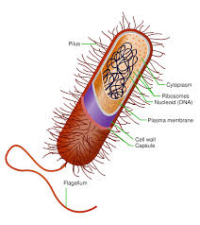
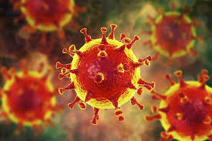
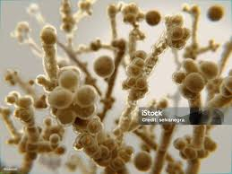
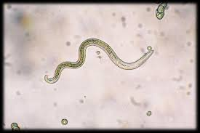
Microbiological-Biological Risks
Pathogenic bacteria
Foodborne viruses
Fungi/fungi
Parasites

Slide 12
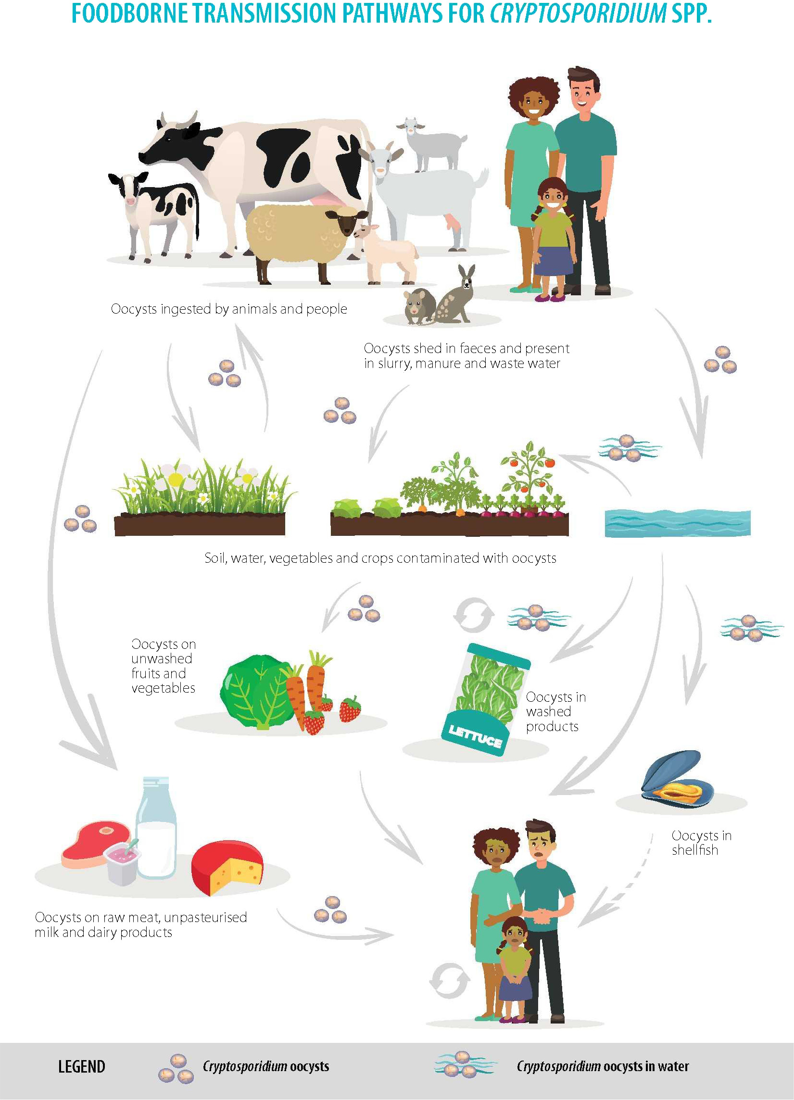
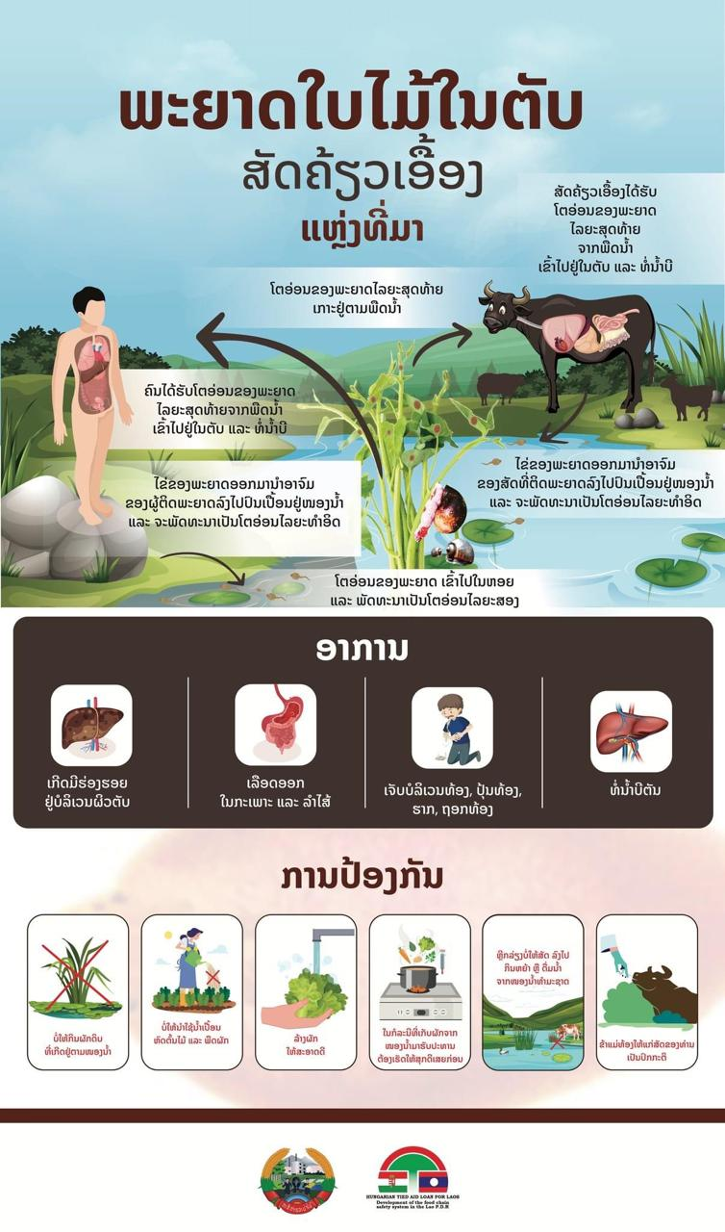

Slide 13
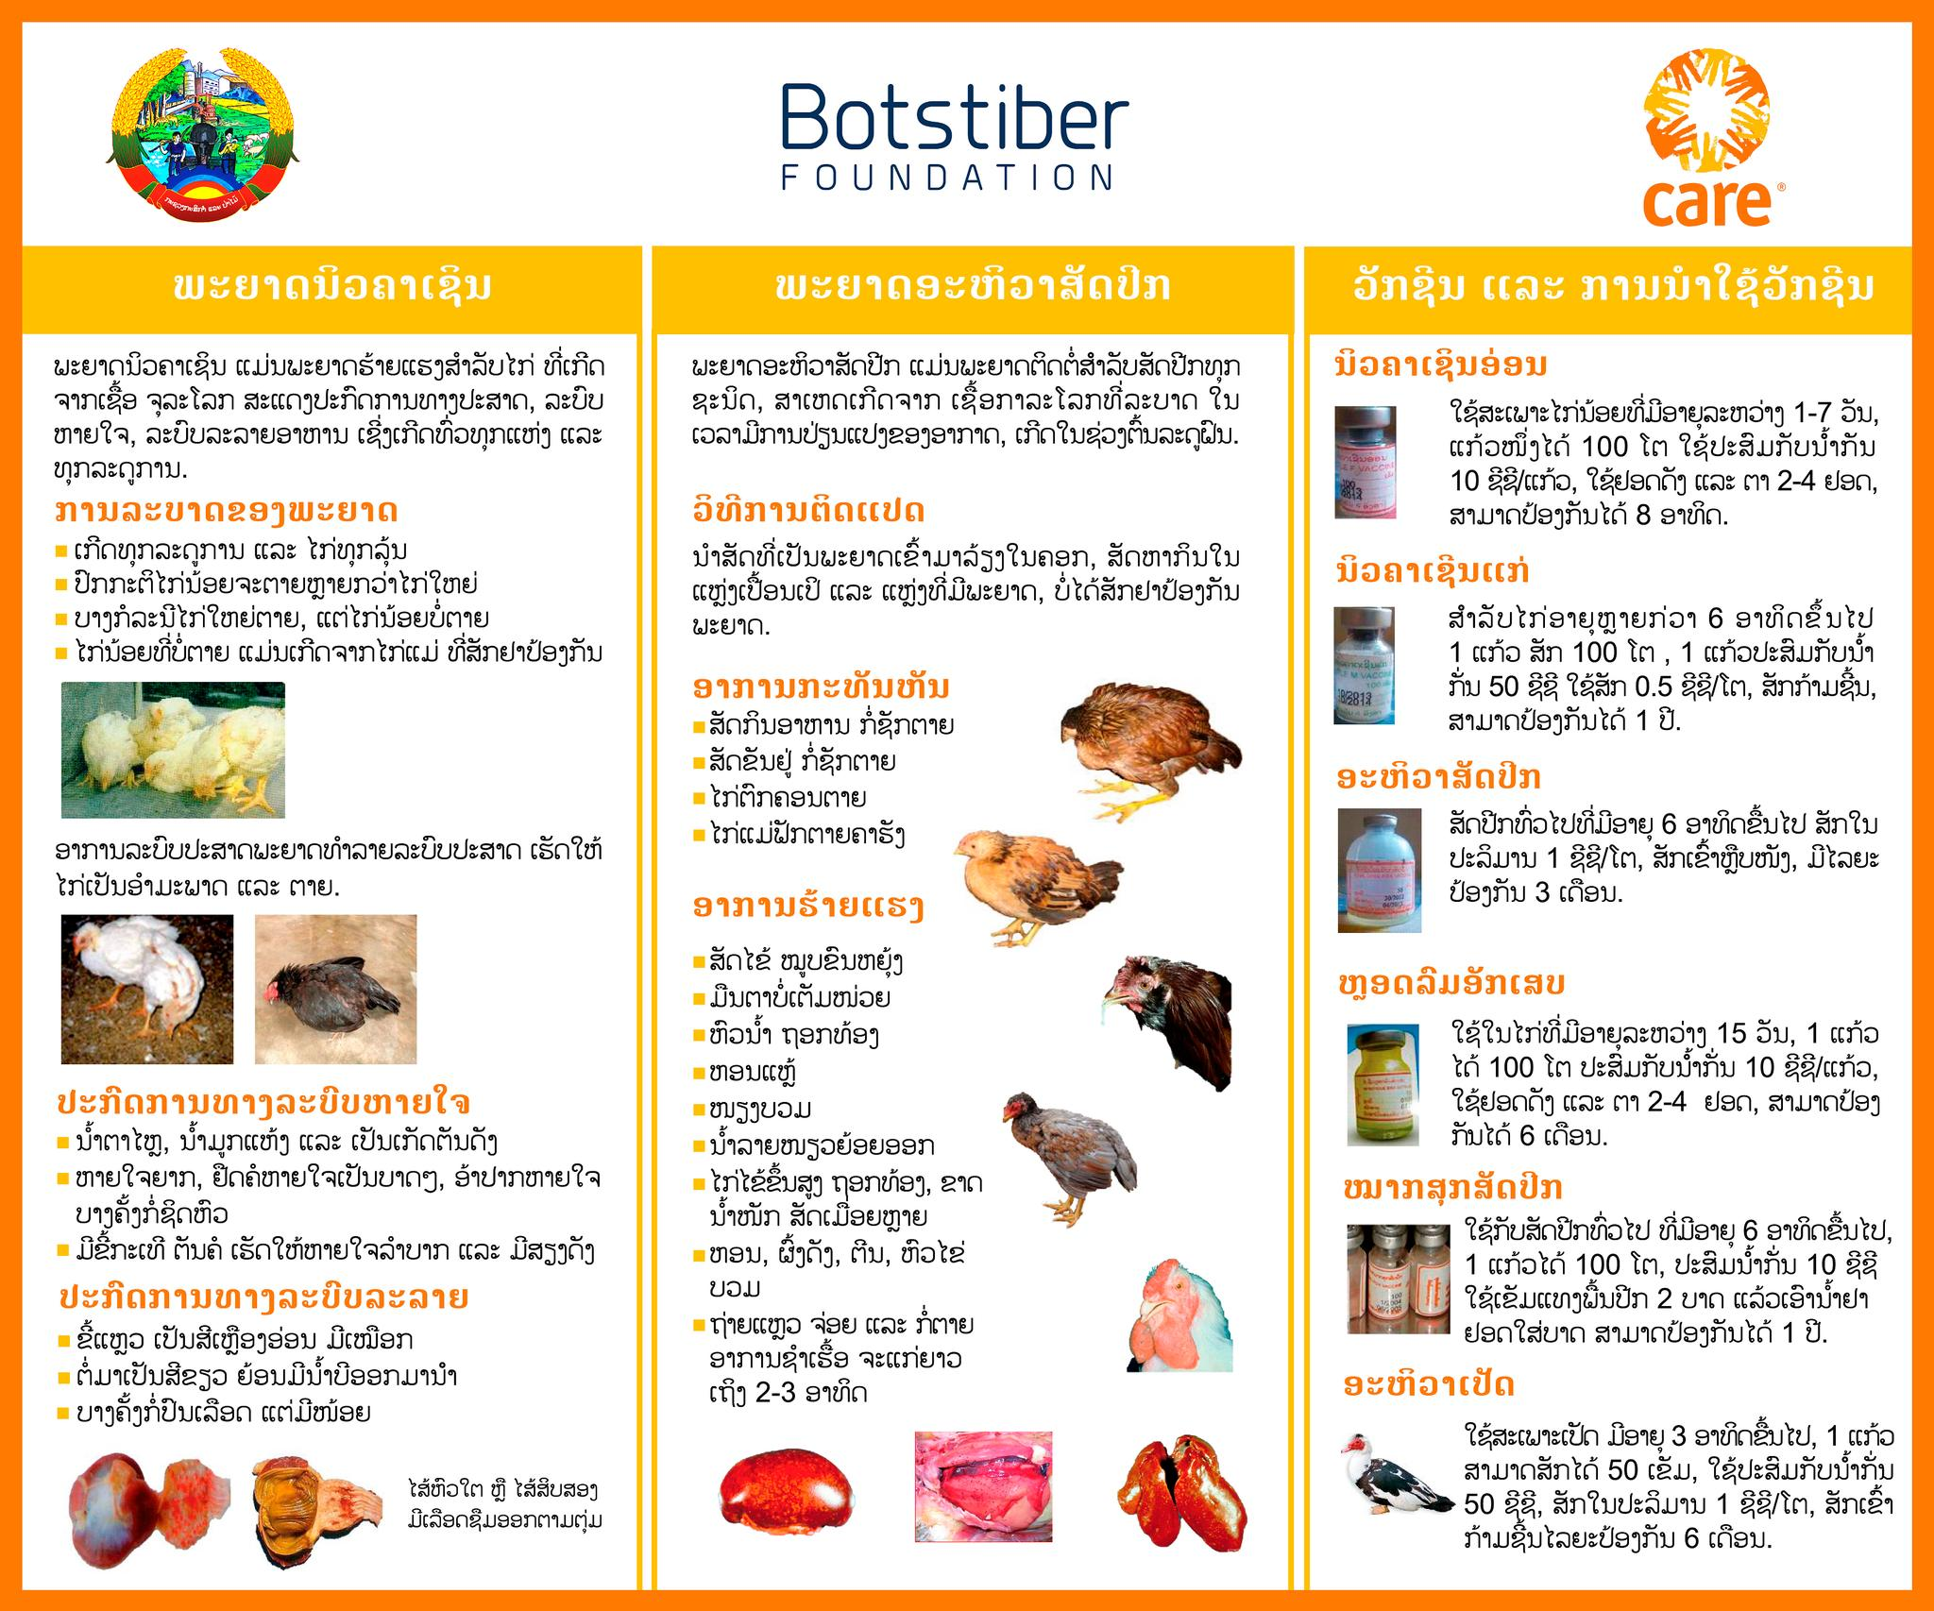

Slide 14
Chemical Risks
Pesticide residue from plant spraying
Chemical residues from post-harvest treatment
Contamination of chemicals during transport / storage
Natural toxins in production.

Slide 15
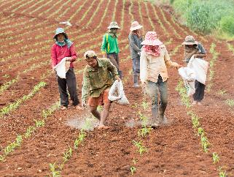
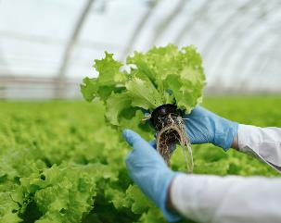
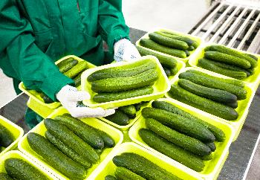
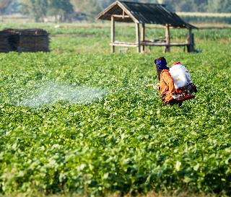
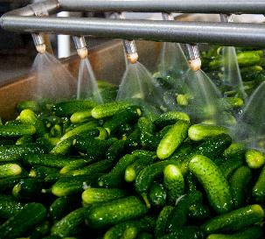
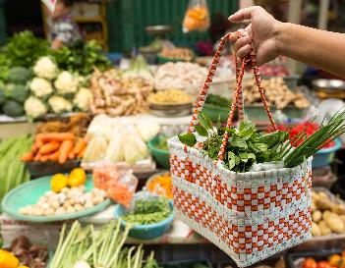
Risks through the green product supply chain

Slide 16
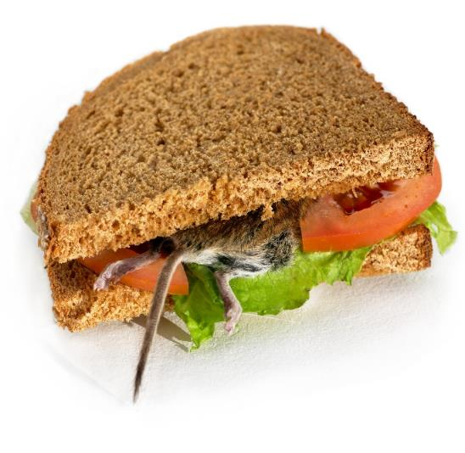
Physical Risks
Foreign Materials - From the Environment
Foreign Materials - From Equipment
Foreign Objects - From Humans
Glass

Slide 17






Consequences of Food Safety Violations
Injured
The Sick
Products may be rejected
Possible loss of market
Bad reputation
Testing and Investigation

Slide 18
2. There are 4 main principles of cleaning.
- Use of clean water and sewage
- Hand washing with soap
- Proper food arrangements
- Garbage management

Slide 19
2 Use of clean water and sanitation
- Clean Water Sources and Clean Running Water in Laos
- Clean Water Sources: Maintain Clean Water Properly: Wells are generally safe, as long as they are drilled away from sewers, sealed, clean, well maintained.
-Tap Water Filters: Found in cities and metropolises, tap water is safe to use.
- Rainwater: Rainwater is generally safe as long as it is stored in a clean pond or basin.

Slide 20
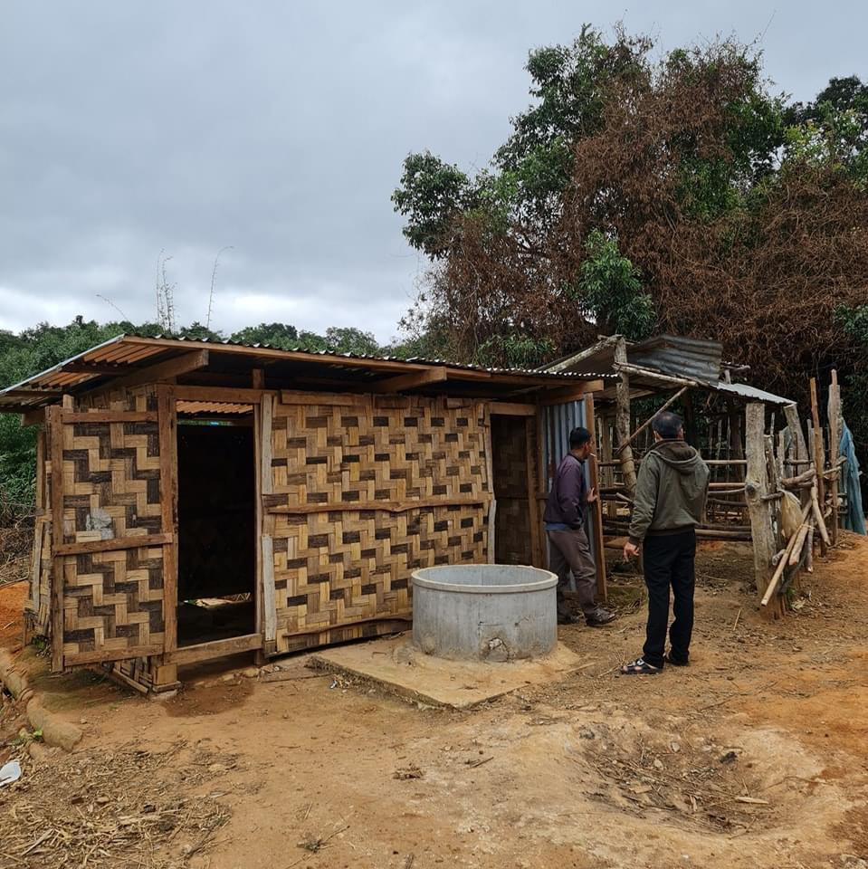
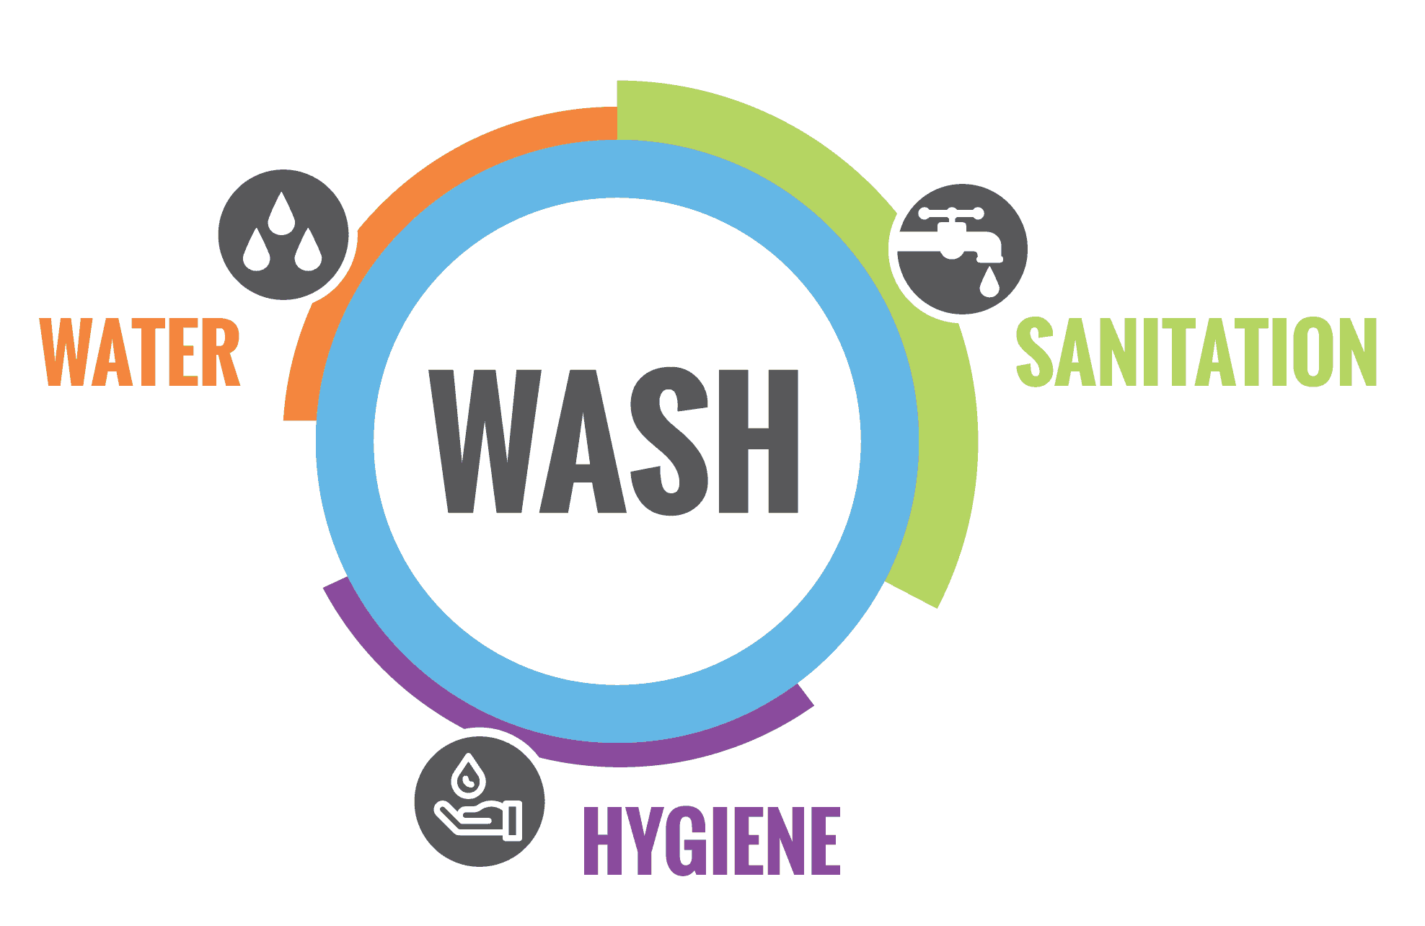
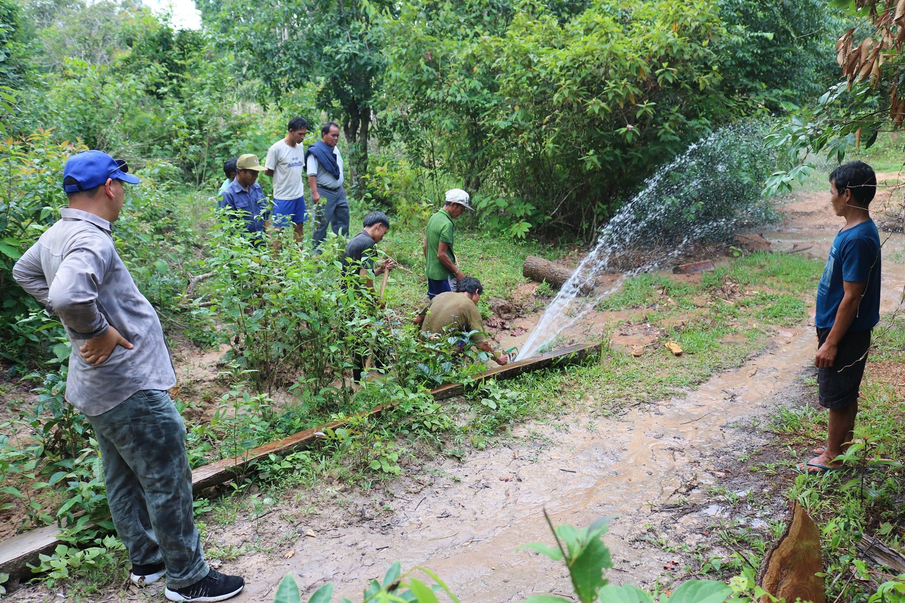
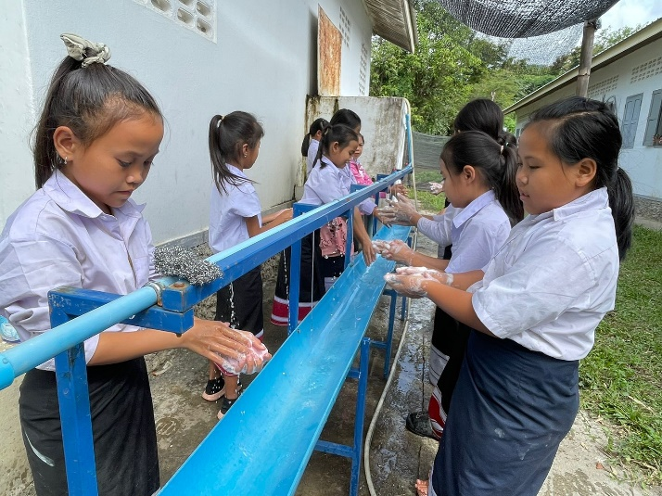
2.1 Water and sanitation

Slide 21
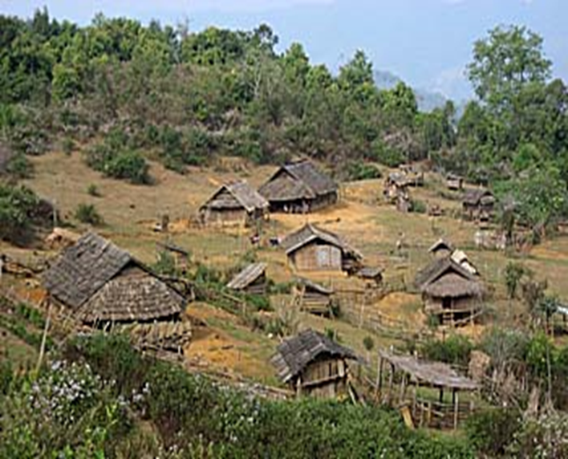

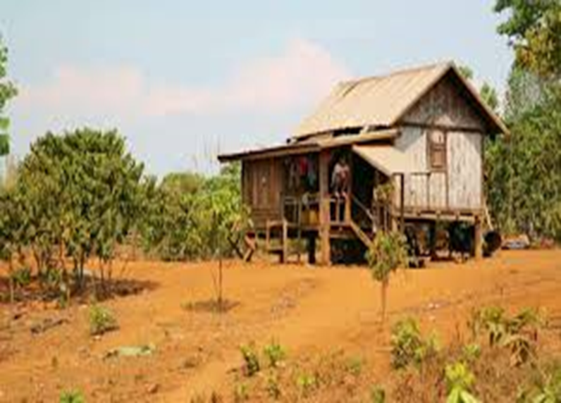
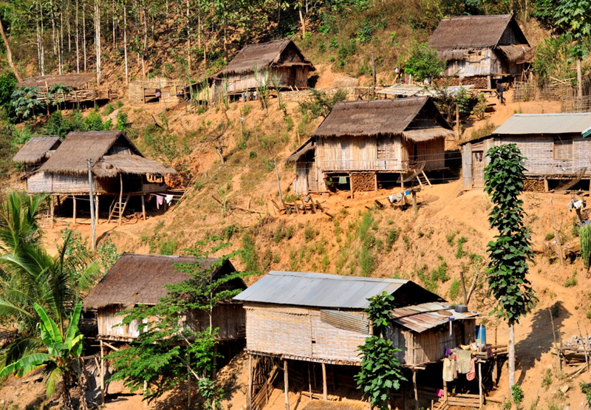
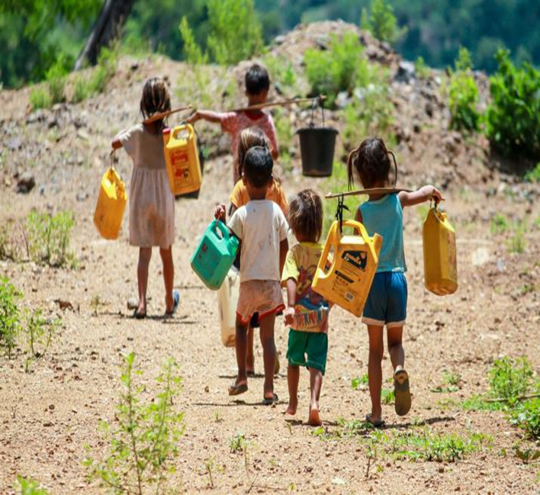
The infrastructure of the village and the basic needs of inadequate water resources have not been developed.

Slide 22
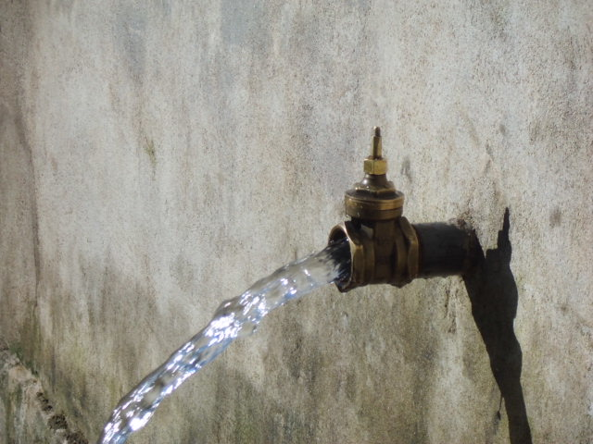
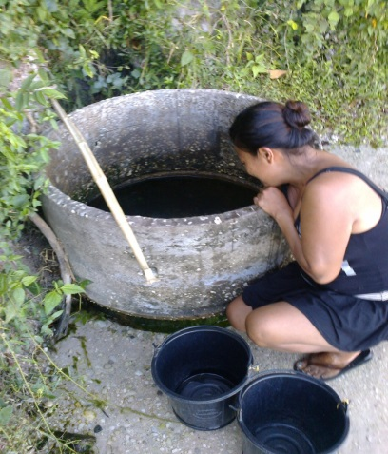
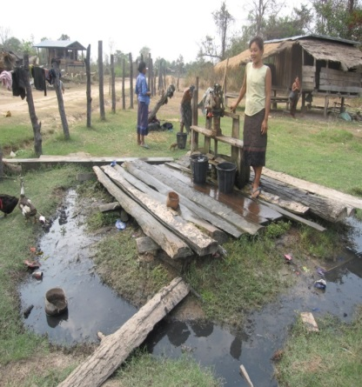
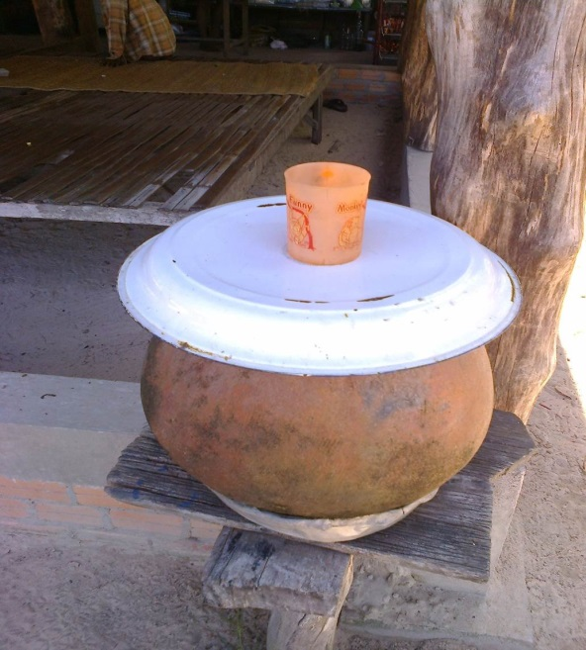
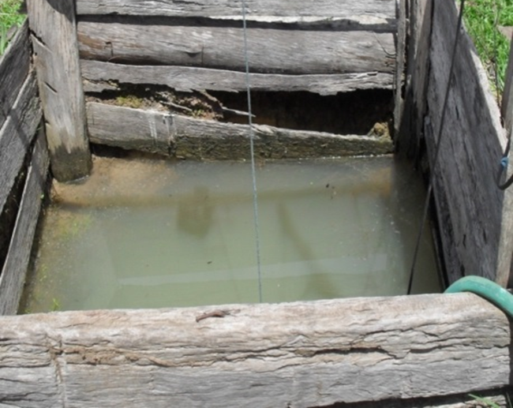
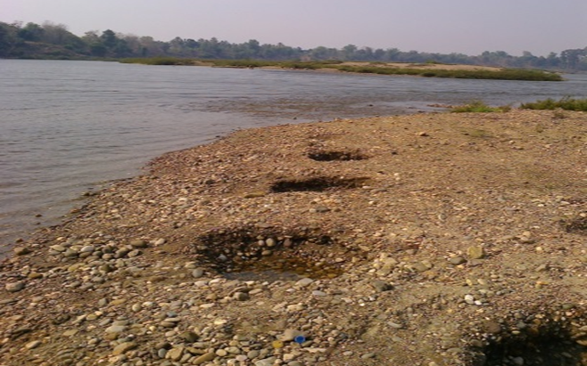
Nature of Water Use
- Unclean water sources contaminated with germs
- Remote water sources, inconvenient use
- Existing water lacks good management
- Uncleaned drinking water, drinking raw water
- Lack of water source protection

Slide 23
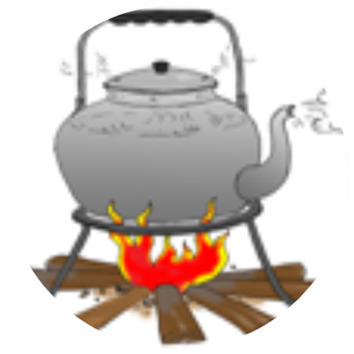
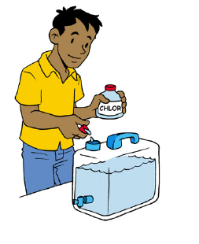
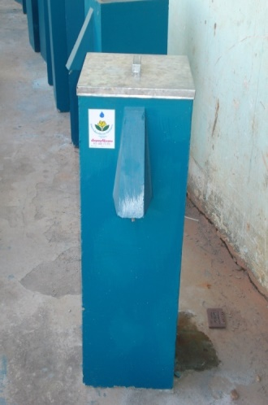
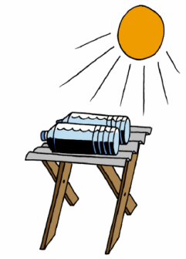
What measures should be taken if the water is contaminated with germs?
If drinking water or water is not clean, it should be purified by rehabilitation, there are many methods of water rehabilitation, but the most common ones are:
Boiling
  Chlorine infusion
  Filtering.
  Use of sunlight

Slide 24
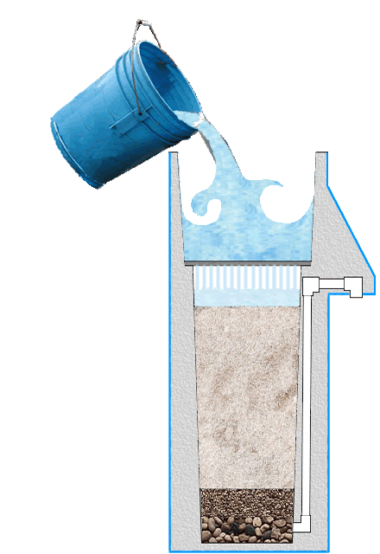
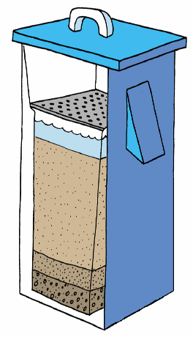
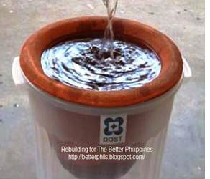
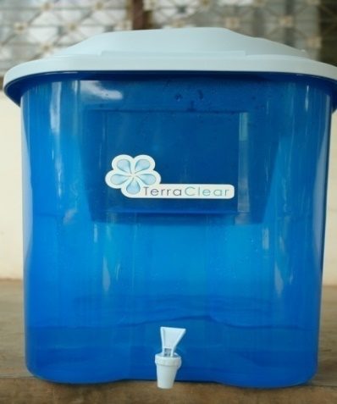
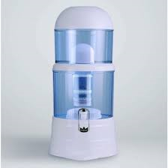
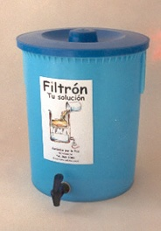
- There are several ways to filter water, such as:
Apply biogas water filters,
Clay Boiler Filter,
bio-sand water filters,
Tank Filter
Symmetrical Water Filter.
Water filtration
Water Filter Tank
Biogas Water Filter
Clay Boiler Filter
Bio-Desertifier Filter
  Symmetrical Water Filter.

Slide 25
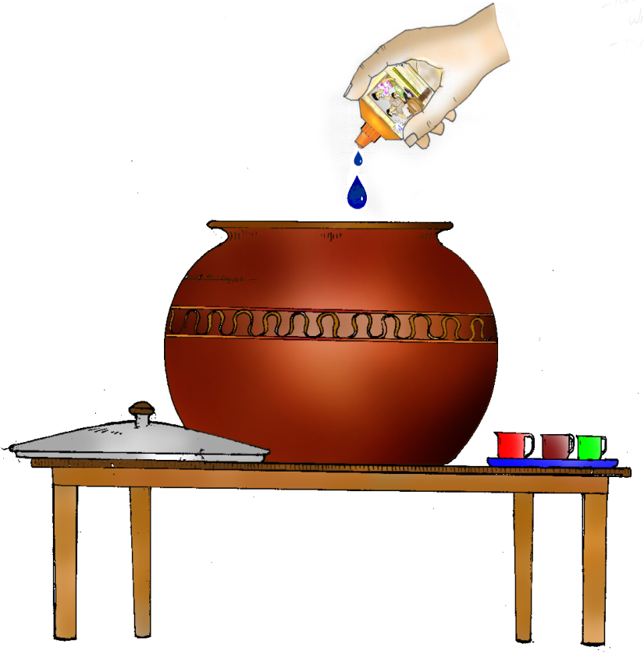
The amount of chlorine to be mixed with water
Type of water | Amount of chlorine (teaspoon per 1 liter of water)
Underground Waters, Tap water | 5
wells | 7
Streams, Lakes | 9
Rainfall | 5
Dripping water | 10
Data from the Center for Environmental Sanitation and Clean Water Supply

Slide 26
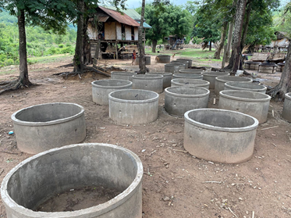
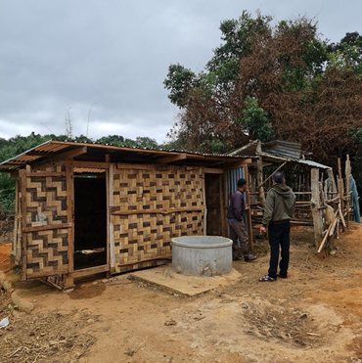
Uses of Toilets
The use of toilet leads to greater privacy, safety and health.
- Using the toilet will be more convenient for yourself and your children
- Everyone uses a toilet to prevent the spread of the virus
Before using and leaving the toilet, wash your hands with clean water with hand soap

Slide 27
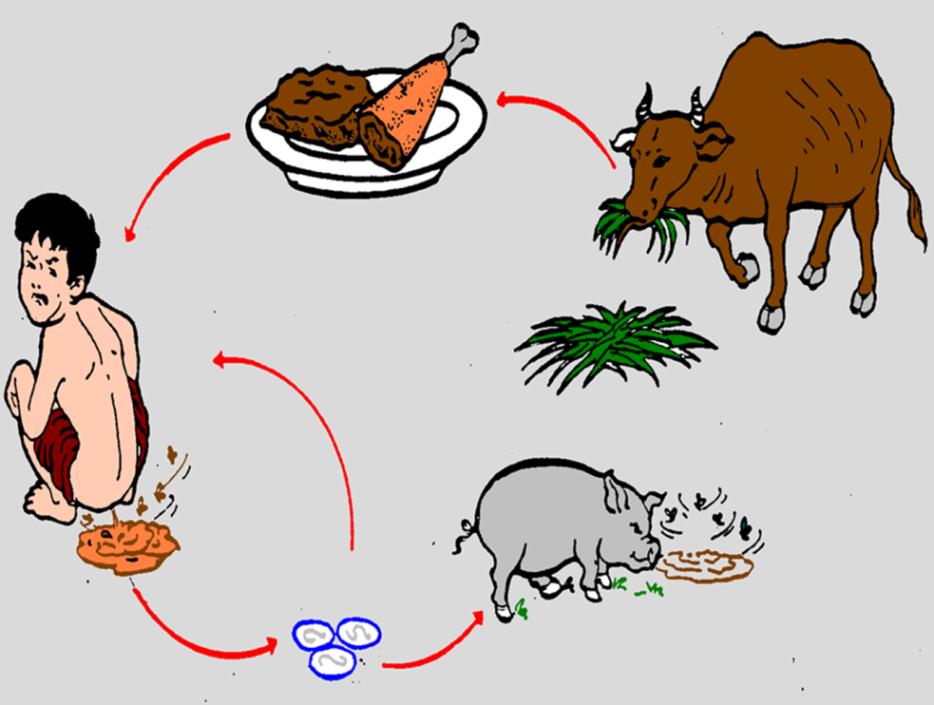
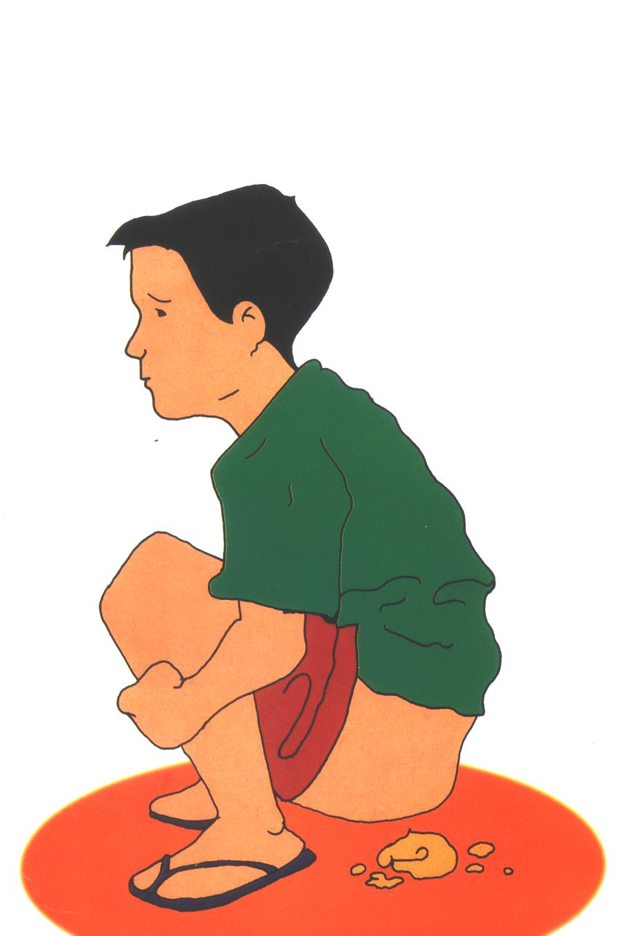
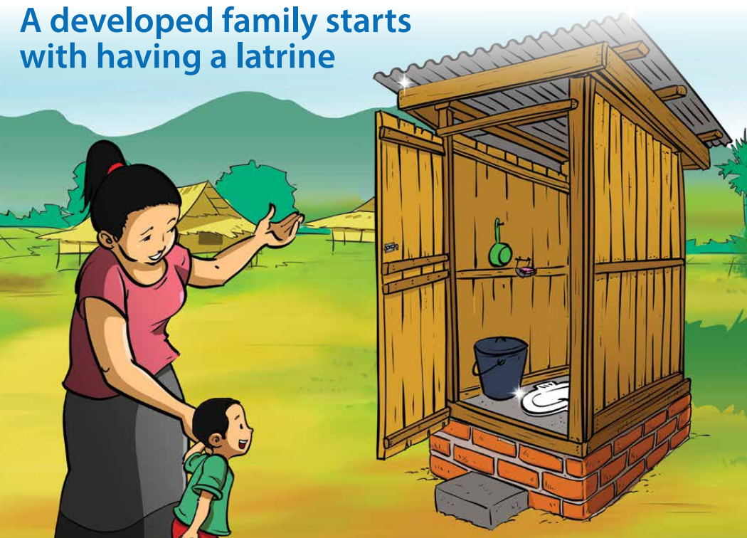
Germ cycle
1g (gram) of feces can contain germs
10,000,000 viruses
1,000,000 Germs
1,000 Parasite’ eggs
100 Parasites

Slide 28
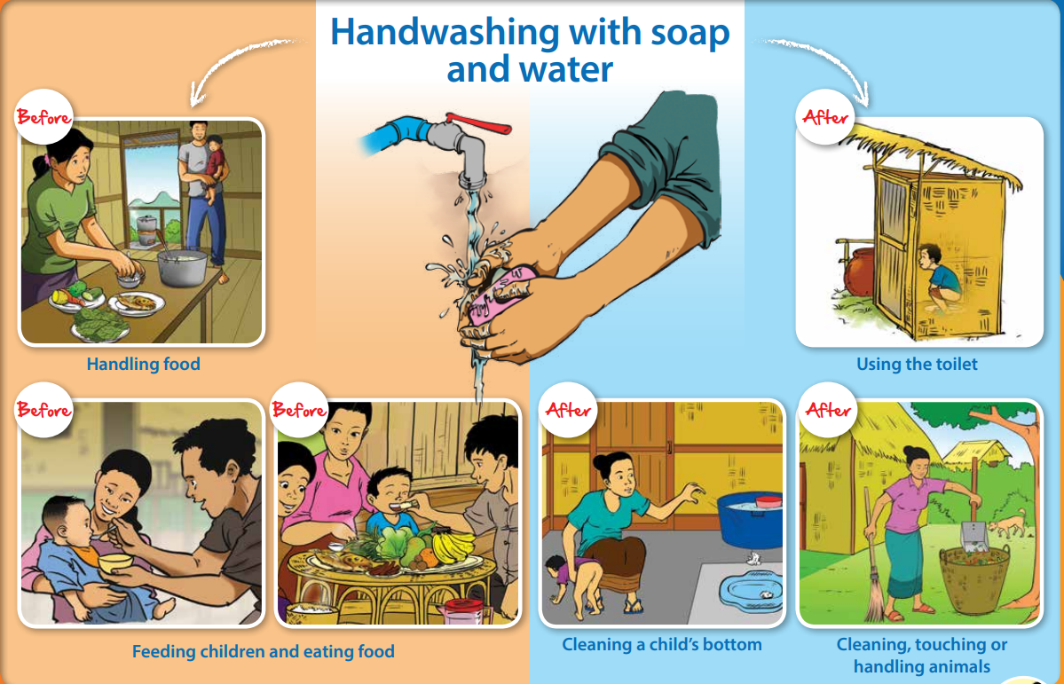

2.2. Washing hands with soap
Washing your hands and keeping them clean with the right soap will help clean and prevent the spread of germs and keep children safe from getting sick.
Previous
Atfer
ຈັບອາຫານ
ໃຊ້ຫ້ອງນໍ້າ
Before
Before
After
After
Feed, eat
Wash baby ass
Grooming, touching or handling pets

Slide 29
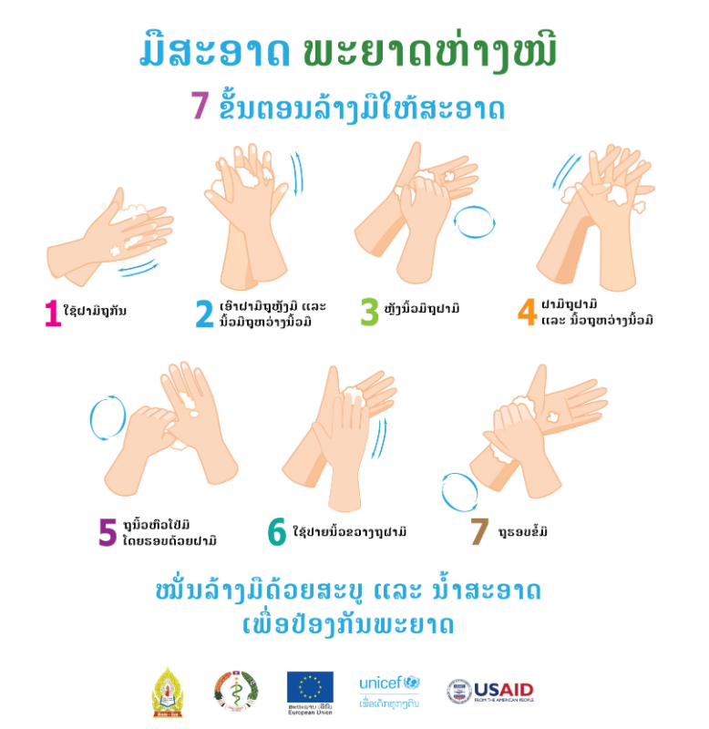
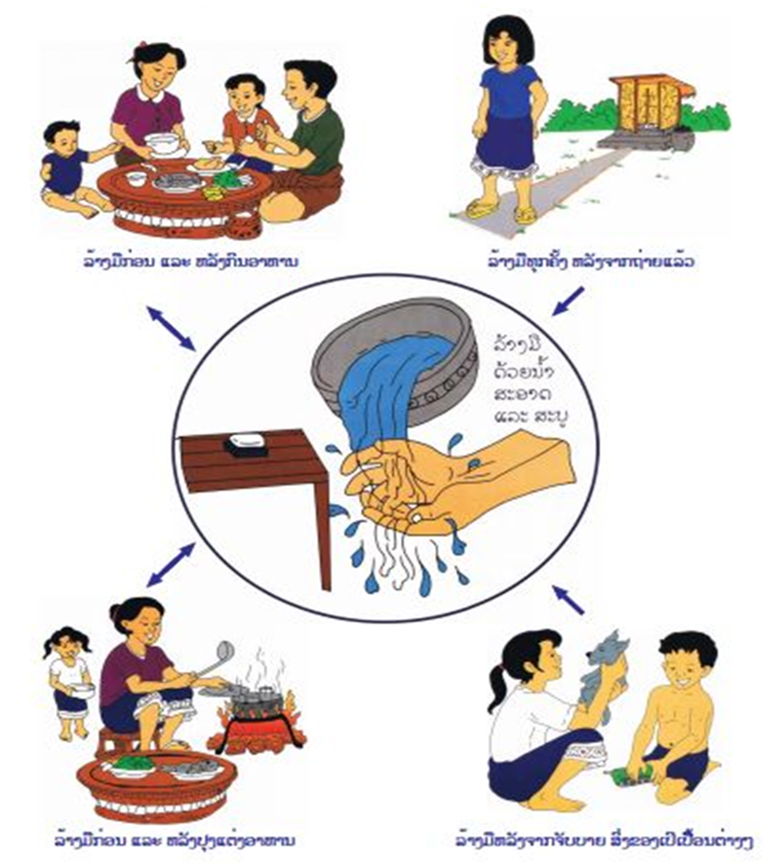

Slide 30
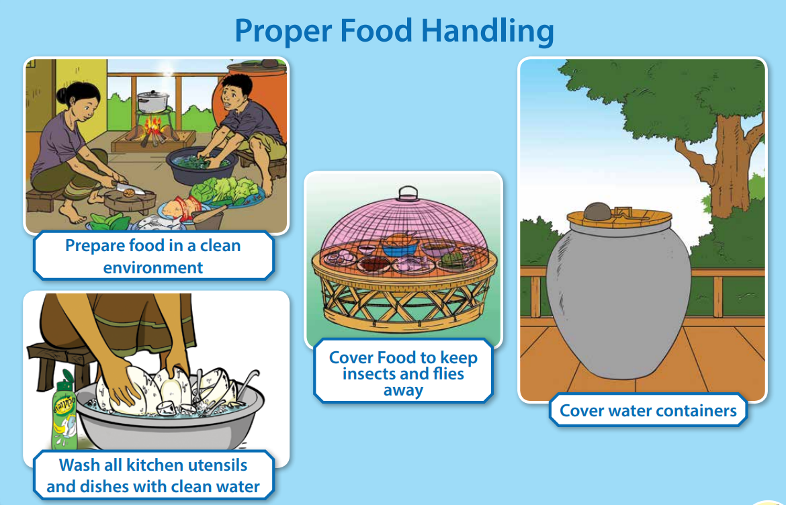
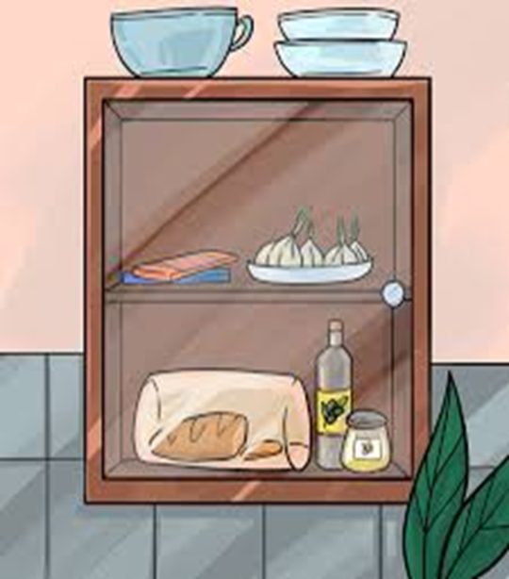
2.3. Proper Food Preparation
Preparing unclean food can lead to danger because germs can make children sick. Children can't resist disease, so they must:
- Stay Clean
- Separate raw and cooked foods.
- Cook well-cooked.
- Store food at the right temperature.
- Use clean water and fresh food from safe sources.
Cook in a clean place
Food with lids against insect poisoning
Close the water tank
Cleaning your child’s toys

Slide 31
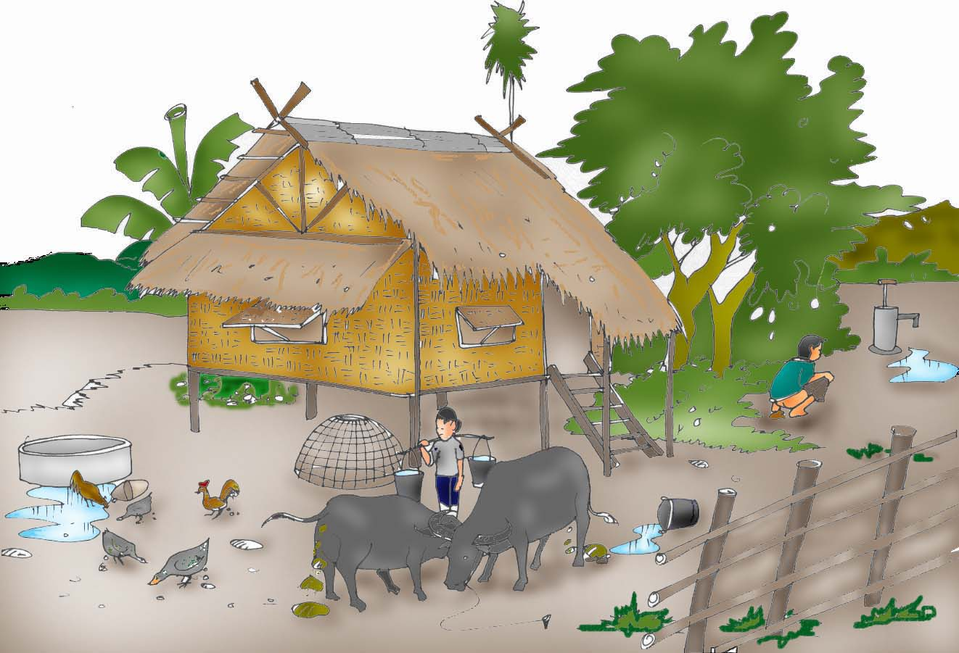

2.4 Removal of garbage, contaminated water and pet feces

Slide 32
Summary and conclusion (ສັງລວມ ແລະ ສະຫຼຸບ)
Students gain knowledge and understanding that food safety is an important foundation that helps protect the body from infectious diseases and helps maintain good health.
Knowing that using clean water and using proper discharge not only protects oneself from disease, but also helps keep the environment and communities safe.
It can be explained that washing your hands with soap is a simple but very effective way to reduce the introduction of germs into the body.
Understand that proper waste management helps to reduce environmental impacts and prevent potential diseases in the community.
➡️ Conclusion: This lesson gives students not only a theoretical understanding, but also a practical way to live a healthy and safe life.
© ISTOCK

Slide 33
Post quiz (test)
This quiz is used to test the knowledge of students related to this lessons that they just finished learning. You can add 5-10 questions. Types of questions could be: MCQ, True or False, Matching, Fill in short words.
Questions | Possible answer | Correct Answer | Feedback
1. Food safety is the science that keeps food safe from germs and other hazards | A. Right B. Wrong | : A | It's the science that keeps food safe from germs and other hazards
2.What are the potential effects of water contaminated with food germs? | A. Stomach B. Developing cold symptoms C. Deadly Potential in Certain Machines D. Both A, B and C | D | Mixed water can contain germs, which can cause diarrhea, colds, or death in some cases3
3.How should contaminated water, which may contain germs, be avoided in drinks? | A. Drink in general B. Boil water before drinking C. Produce only clean water | B | Boiling water uses heat to kill germs

Slide 34
Post quiz (test)
This quiz is used to test the knowledge of students related to this lessons that they just finished learning. You can add 5-10 questions. Types of questions could be: MCQ, True or False, Matching, Fill in short words.
Questions | Possible answer | Correct Answer | Feedback
4 How many steps are there in the process of washing your hands? | A. 2 B. 4 C. 5 D. 7 | : D | Hand washing is in 7 steps
5. When should you wash your hands with soap? | Before and after every meal Before and after every bathroom visit. After cleaning the house All of them. | D | This is because after contact with the peppermint, germs can get on your hands

Slide 35
Assignment/Homework/Case study
Assignment
1. What are the harmful effects of drinking unclean water? 2. Explain how to dispose of garbage in a hygienic manner. 3. Notice if clean or boiled water is available in your household? And write a report. 4. Take a photo or draw a picture of the trash can in your home or school, explaining if it is sanitized.

Slide 36
ບົດຮຽນຕໍ່ໄປ
Next lesson
This is the end of the lesson.
The conclusion and introduction to the next lesson, as well as the lesson title and heading, should be given.
Next Lesson Title | Next lesson Lesson 4: 1. What is food diversity? 2.Food Diversity Promotion Strategy 3. Case Studies and Practical Practices Create a Community Action Plan

